Slide 1



Slide 2
Staff & Volunteer Partnerships
Notes:
We will be spending the next 90 minutes focused on three topics that are essential to our success as an organization. Staff and volunteer partnerships, finances and coaching and mentoring volunteers. For the next bit of time we would like to discuss the vital relationship between staff members and you all our volunteer core.

Slide 3
Introductions
Notes:
We will be spending the next 90 minutes focused on three topics that are essential to our success as an organization. Staff and volunteer partnerships, finances and coaching and mentoring volunteers. For the next bit of time we would like to discuss the vital relationship between staff members and you all our volunteer core.

Slide 4
Organizational Partnership
What are the key characteristics necessary for a staff and volunteer partnership?

Slide 5
“Paid staff and external volunteer talent, our knowledge philanthropists, work side-by-side as equal yet different contributors to the organization.”
Annastasia Palubiski, Director, People Engagement, Vantage Point, Vancouver, BC, Canada
Notes:
READ QUOTE. Knowledge philanthropists...

Slide 6
Defining Roles and Responsibilities
Volunteers- Ideas, Strategies, Knowledge
Staff- Implementers, Consistency of Operations
Notes:
HALLIE

Slide 7
Organizational Partnership
What are some examples of how you and staff have worked together?
Notes:
Molly would you mind asking our panelists the following question

Slide 8
Organizational Partnerships
Create good will
Do no harm
Get the work done
Notes:
HALLIE

Slide 9
Getting the Work Done
Create efficiency
Extend grace, trust and respect
Prepare for pitfalls
Set healthy boundaries
Define responsibilities
Establish communication norms
Notes:
When we think about how to get the work done successfully...we have found the following 6 items to be the key
Create Efficiency- finding ways to work smarter not harder within your subject areas is needed. When meeting collectively, ask yourself is this the most efficient way to achieve our desired outcome?
Extend grace, trust and respect-
Prepare for pitfalls-
Set healthy boundaries
Define responsibilities
Establish Communication norms
Joanna could you ask our panelists the following question....

Slide 10
Create Good Will
What is your vision for what this partnership should look like in the future?
Notes:
JOANNA

Slide 11

Notes:
Plug in DG headlines
Identify your teams priorities
Set realistic timelines

Slide 12
Define Responsibilities
Up-to-date position descriptions that all on the team are made aware of
Task descriptions for committees
Clear description of expected results and time frames
Single person responsible
Action items at the end of every meeting
Responsibility flow chart
Inform and follow up
Notes:
READ SLIDE

Slide 13
“It’s crucial that volunteers and staff have a mutual respect for one another and see themselves as part of a team- working together for the benefit of the organization.”
Notes:
Hallie to read and ping pong following quotes

Slide 14
“This past year, with so many special projects related to our sesquicentennial, it was such a relief to have so many dedicated and caring volunteers devoting so much of their time to the important plans. Working with volunteers connects us to our membership on a deeper level, and that is always a good thing!”

Slide 15
“Collaboration with passionate volunteers continues to make me feel invigorated in my role. Our volunteers are not only our colleagues but also our friends and we are so appreciative of their willingness to work alongside us.”

Slide 16
“Simply stated, we could not do what we do without our volunteers. They are so many things all at once: time dedicated, knowledge imparted, and generosity personified. Our volunteers make doing good easier and more accessible for our collegians, alumnae, communities, and organizations that share our mission. Thank you will never be enough!”

Slide 17
Volunteer Focus Groups
By June 2026, Leadership and staff roles have been assessed and adjusted for maximum participation, productivity, efficiency, and fulfillment. Thursday, July 13 at 5 p.m. PT | 8 p.m. ET Tuesday, July 25 at 8 a.m. PT | 11 a.m. ET Wednesday, July 26 at 11 a.m. PT | 2 p.m. ET Wednesday, August 9 at 6 p.m. PT| 9 p.m. ET

Slide 18
THANK YOU!

Slide 20
Top Five
Finance Facts
Lexie Kiernan
assistant director for leadership & learning

Slide 21
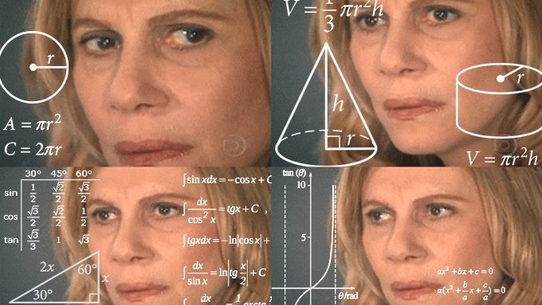

Slide 22
Top Five Finance Facts
Budgeting process
Funding sources
Concerns & collegiate chapters of note
Use of Venmo
Application to your role

Slide 23
Budgeting Process

Slide 24
Budgeting Process
Fraternity
  2-year business cycle, Biennium
  Fraternity Constitution
Foundation
  Annual basis
  Provides funds to fraternity programming via Gift Grant
Collegiate Chapters
  Annual basis
  Driven by chapter size and programming needs
Alumnae Groups
  Annual basis
  Driven by year of biennium
Notes:
Dues and fees
Training fee

Slide 25
Funding Sources

Slide 26
Tax Status
Fraternity: 501(c)(7) (nonprofit social and recreational clubs, donations not tax deductible)
  Collegiate chapters
  Alumnae groups
Foundation: 501(c)(3) (nonprofit status, donations are tax deductible)

Slide 27
Fraternity Funded
Through income generated by collegiate members, alumnae dues, specific gifts, and unrelated business income.
Business Operating Expense Examples:
2-year biennium budgeting:
  Marketing and branding
  Volunteers, Leadership, and EO Staff
  Executive Offices Building
  Business events like Convention, OTS, etc.
Other
  Functional training initiatives (training fee)

Slide 28
Fraternity Set-Aside Funds
Leftover funds that Council votes to identify as retained assets for future spending. Non-taxable based on IRS guidelines.
Non-fraternity business expenses. Educational and professional development purposes. Examples:
Anchor Academy
Keynote speakers
Leadership development initiatives

Slide 29
Foundation Funded Programs
Funds raised for training and programming initiatives through the Foundation Gift Grant and gifts.
Foundation Funded Program Examples:
Act with Intention series
Lewis Institute
CDC program
Anchor Academy

Slide 30
Concerns & Collegiate Chapters of Note

Slide 31
Financial Concerns & Threats
Declining enrollment on college campuses
Declining recruitment numbers
Declining interest in living in chapter facilities on some campuses
Difference in expectations of what collegiate membership should cost

Slide 32
Use of Venmo

Slide 33
Proper Venmo Use for Foundation Fundraising
Venmo is only allowed through a member planet donation site or payment form.
No business, chapter or personal Venmo accounts are allowed for
FoundationFinance@deltagamma.org
Notes:
As leadership, we feel that it’s important for you to understand the proper Venmo usage related to collegiate and alumnae group fundraising, along with knowledge that you can use in your daily lives.
For Foundation fundraising, Venmo is only allowed through a memberplanet donation site or a payment form. The donation site or payment form must be connected to the Foundation. Chapters and groups can reach out to FoundationFinance@deltagamma.org for assistance in setting up a donation site or payment form.
No business, chapter or personal Venmo accounts are allowed for Foundation fundraising purposes. All Venmo payments must go through a memberplanet site or form.
There are potential consequences with the IRS. Venmo is now sending documents to the IRS regarding user’s transaction history. Any money collected via a Venmo account can be considered income in the eyes of the IRS, causing members or chapters to be audited and/or taxed on the money they collected.
There’s also the potential for fraud since the Foundation cannot regulate the money being collected via a chapter or personal Venmo account. We only know what is submitted to us.
If you come across a chapter or group that has used Venmo improperly, remind them of these potential issues and encourage them to keep detailed records of money collected, along with transferring the money out of their Venmo balance to the chapter/group’s bank account. Money in a Venmo balance is not insured by the FDIC.

Slide 34
Application to Your Role

Slide 35
What does this mean for you?
If you work with house corporations…
How can the AA be reduced?
If you work with programming…
Can events be held at less expensive venues?
If you work with alumnae…
How can Founders Day costs be reduced?
If you work with membership…
Are new decorations for each round of recruitment critical?
If you work with fundraising events…
Do chapters need t-shirts for each event?
If you work with chapter goal setting…
How does the budget embody chapter values and goals?

Slide 36

Notes:
Why are we prioritizing this conversation?
Our collective efforts ensure our success
As a membership driven organization, the financial impact to our individual members is of importance to us as a whole
As we are gathered here to celebrate 150 years, this is another example of how we can ensure our relevance and impact for the next 150 years

Slide 38

Mentoring & Coaching
Lauren Utley
associate director for training & volunteer management

Slide 39
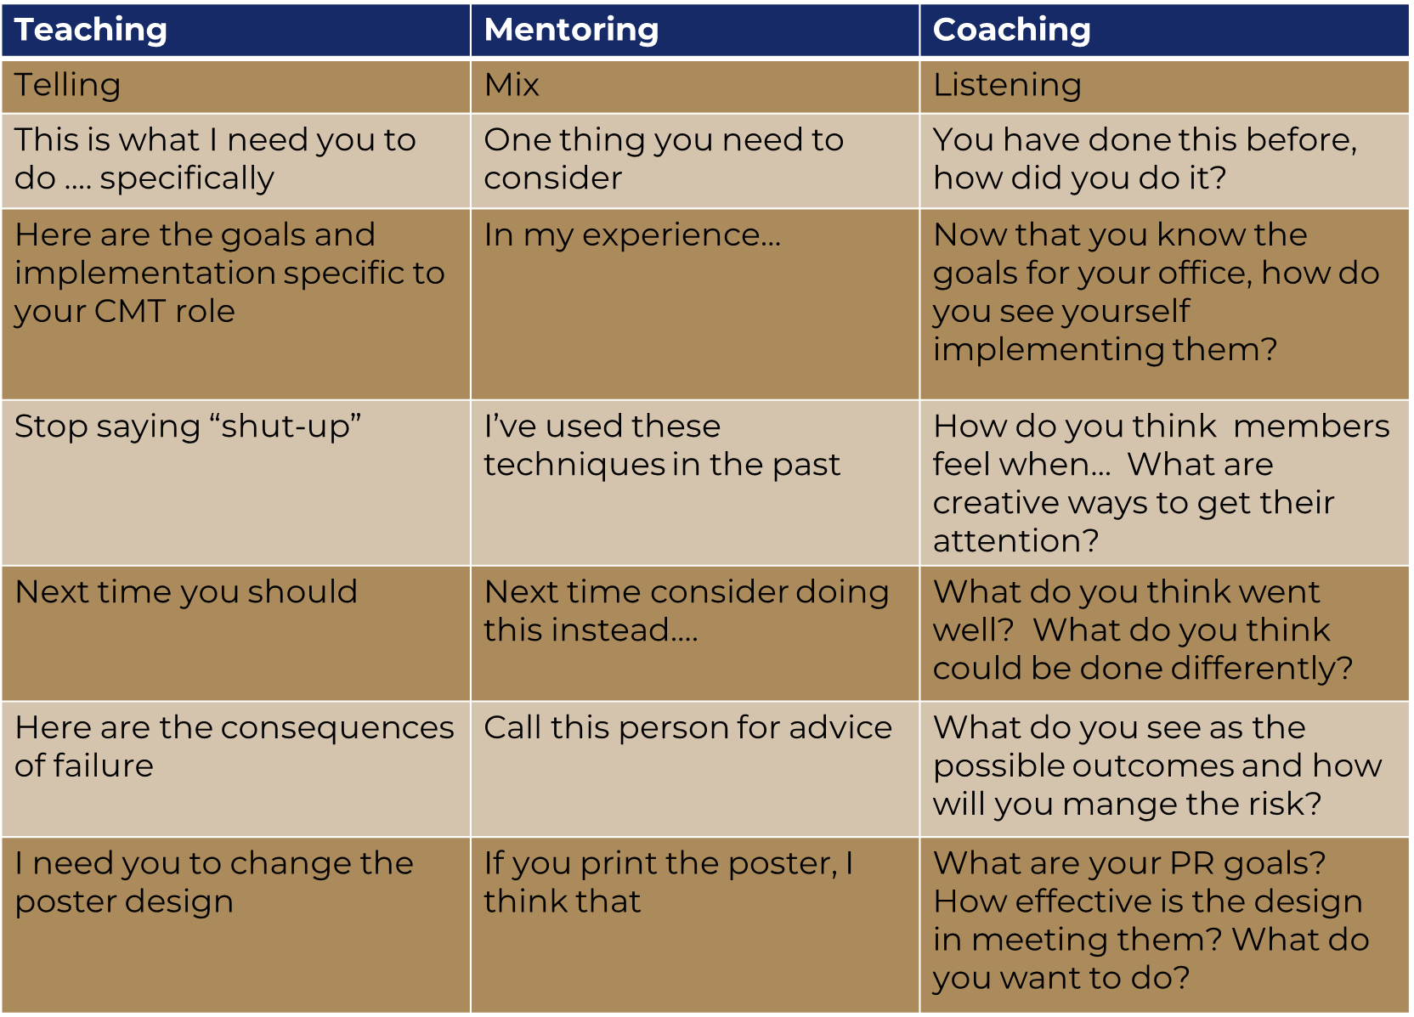

Notes:
Coaching & Mentoring (8 minutes)
Here is a graph that might be helpful when distinguishing what it means to coach, mentor, or teach someone.
Teaching can sometimes feel as being told what to do, Coaching involves a lot of listening, and Mentoring should be a mix of the both.
We are hopeful as a Leadership volunteer; you are seen most as a mentor or a coach.
When is it hard to not “just tell” someone what to do?
When do you find yourselves being more of a coach or a mentor?
Without question, there are times you will move across this graph. Ideally, you are aiming to be a mentor or a coach most of the time.
In order to coach and mentor in a positive way, you need to have trust. Let’s have a conversation around trust.

Slide 40
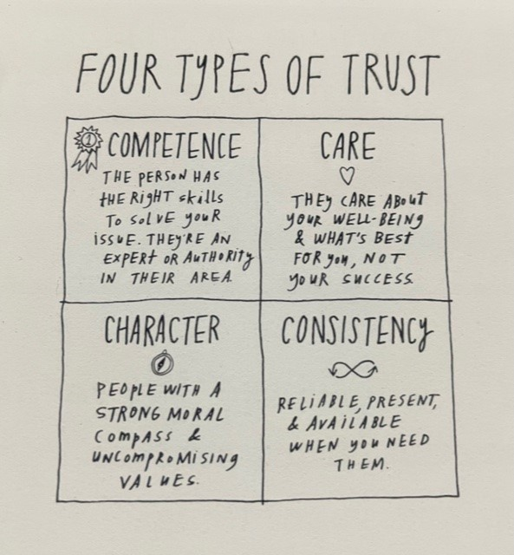
Notes:
Trust (10 minutes)
In his book, Think Like a Monk, Jay Shetty proposes that there are four types of trust. Those are presented by this chart on the slide.
Competence, care, character and consistency. He shares that in order to have a trust that lasts, not all 4 categories need represented, but that we can make an effort in all 4 categories.
As coaches and mentors, it is important to trust the people you work with so that you can remain at 30,000 ft. If you don’t trust, or are made to not trust, your team, you will feel more inclined to be involved with the details and chapters, rather than coaching the specialists.
Ask:
What do you think you can do to build the competence category of trust?
Character?
Care?
Consistency?
Remember that the actions of other volunteers or chapters/groups are not indicative of your performance as a volunteer.
Trust is a mutually beneficial experience. You believe they will do the work, and they feel connected to you. Trust fuels engagement, engagement fuels trust – it is cyclical. This level of trust also sets the foundation for you to be able to provide your team feedback.

Slide 41
Why is Feedback Important?
Notes:
Feedback (10 minutes)
Ask:
What are some of your reactions to that video?
What tips and tricks do you have for providing feedback to your teams?
Share if not mentioned:
Set a feedback agreement with the team at the very start. This can sound like “we are in this to do good and consistently seek to be better together. Can we agree now to provide each other feedback when it is needed to help us achieve that goal?”
Start early and be consistent.
Ensure you are looking for things the team is doing well and telling them so!
Offer your assistance if there is an area of elevated concern in relation to a team members performance.
Clear is kind.

Slide 42

Questions?
Notes:
Closing and Questions (10 minutes)

