Slide 1
PROGRAMMING ADVISER
Notes:
Total Training Time: 2 hours
Facilitation Key:
(X minutes) - Denotes how long the section takes.
WS - Indicates worksheet/handout needed.
Italics - Marks curriculum you should tell/ask the participants.
Plain text - Indicates instructions for you as the facilitator.
Fac. Note: - Highlights special instructions for the facilitator
Begin by introducing yourself and your role.

Slide 2
Agenda
Introductions
Roles & Responsibilities
Choosing Relevant Programming
Chapter Programming Elements
Calendar Planning
Questions & Tips
Notes:
1 minute
Here is a snapshot of what our time together will cover. We will share important information and resources with you and provide time for you to learn and brainstorm with each other in smaller group break out sessions.

Slide 3
Introductions
Name
Chapter of Initiation
Chapter you work with
What are you hoping to get out of today?
Notes:
(4 minutes)
Let’s start with some introductions!
Fac note: If your group has more than 15 people, we encourage you to do introductions in the chat box. If less than 15, ask attendees to introduce themselves by unmuting and sharing what’s on the screen.

Slide 4
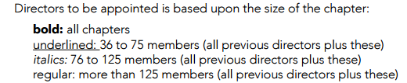
vp: programming
Programming Team
director of senior programming
director of alumnae relations
director of DG Dialogues
Notes:
(2 minutes)
Share that we will start training by exploring how the programming team fits into CMT and JCMT.
The vp: programming has up to 3 directors to work with. We are going to review some of the responsibilities for each director. Due to chapter size, some chapters might not have all of these directors. As the leader of the team, the vp: programming is ultimately responsible for the management and operation of the team, and their responsibilities if you are without one of these directors.
Although the vp: programming has a few well-known areas of responsibility, the position is responsible for many aspects of the chapter. As programming adviser, you may be asked to support the chapter on a variety of different types of events or programming initiatives.

Slide 5
Responsibilities
  Adviser Recognition
  Article II Assessment & Chapter Goals
  Calendar coordination (planning/approval)
  Etiquette education
  Chapter Retreat
  Sisterhood events
  DG Dialogues
Notes:
(1 minute)
Review the list on the slide, acknowledging it is not a complete list and that the attendees likely mentioned more than this list.
It is the responsibility of the programming team to create and maintain within the chapter an atmosphere of trust, understanding and congeniality. The officers you support have an opportunity to create a meaningful membership experience for chapter members. This can require creativity and imagination as well as event management skills. Supporting student leaders in balancing these two things is where you can come in! As programming adviser, you can serve as a valued resource to stay on track and think outside of the box.

Slide 6
director of senior programming
director of alumnae relations
Develops and coordinates senior programming
Helps seniors connect with an alumnae group
Plans senior recognition and senior recommitment ceremony
Develops and coordinates programming for collegians and alumnae
Serves as a contact for alumnae
Maintains list of chapter alumnae
Promotes lifetime membership
director of DG Dialogues
Works with CMT to select relevant programs for the chapter
Selects and trains small group facilitators
Helps create meaningful conversation between chapter members through DG Dialogues programs
Notes:
1 minute
If the chapter you support has these directors in place, here’s some ways that you can encourage delegation of tasks between the programming team officers:
The director: senior programming helps seniors connect with an alumnae group, plan senior recognition and senior recommitment ceremony. She plans/executes senior-specific programming to recognize and celebrate senior members.
The director: alumnae relations works to contact local alumnae/invite to major chapter events, helps plan events with alumnae, maintains list of chapter alumnae, and promotes lifetime membership within the chapter.
The director of DG Dialogues manages the DG Dialogues program through intentional program selection and selecting and training small group facilitators.
Let participants know that the list above is a partial list and could include other responsibilities as outlined by the chapter. Explain that if a chapter does not have the roles listed above these responsibilities fall to the vp: programming.

Slide 7
CHOOSING RELEVANT PROGRAMMING
Notes:
1 minute
We are going to discuss a variety of responsibilities of the programming team today. However, perhaps one of the most impactful things you can do as a programming adviser is this concept: challenging and encouraging our chapters to be intentional about the programming they develop for their chapters.
In the next section we are going to review the programming elements that are required to be on a chapter’s calendar. These will include things like DG Dialogue programs, sisterhoods, collumnae events, etc.
As an adviser you can be uniquely positioned to help officers take a step back and ask why. Why are these items on the calendar and how can we ensure that the programming we provide members is meaningful?

Slide 8
Choosing Relevant Programs
… why do we care? Choosing relevant programming helps to:
increase participation and attendance
Increase engagement
Increase value of membership
Provide opportunities to tackle or address real life concerns or successes for your chapter
Notes:
1 minute
No single chapter is alike. Because of that – it is important to consider programming that resonates with members of your chapter. As vp: programming, we want to empower you to select programs that you your members are excited about and that will add value to your membership experience. This slide demonstrates additional reasons it is important to choose relevant programs instead of focusing on checking off a box when creating your calendar.
Review slide

Slide 9
Article II
The objects of this Fraternity shall be to foster high ideals of friendship among women, to promote their educational and cultural interest, to create in them a true sense of social responsibility, and to develop in them the best qualities of character.
Notes:
3 minutes)
Perhaps the most important thing that should be informing our chapter programming is Article II of the Delta Gamma Constitution.
Read Article II from the slide: The objects of this Fraternity shall be to foster high ideals of friendship among women, to promote their educational and cultural interest, to create in them a true sense of social responsibility, and to develop in them the best qualities of character.
Ask for a few volunteers to answer the following question: How do you think Article II relates to the roles of the programming team?
If not touched upon, share the following sentiment: Article II for Delta Gamma is our mission. It is the statement that guides us and hopefully guides you as you make decisions on programming and events. All programming should connect to Article II. If an event does not align with Article II, then the event should not be held.

Slide 10
Article II Assessment
Article II Confidential Personal Assessment Step (optional – this step is no longer required)
Article II Chapter Assessment Step
Chapter Goals and Watchword Development Step
Chapter Goals and Watchword Presentation
Notes:
(1 minute)
The vp: programming is responsible for this program and its outcomes. Participants should utilize the Article II Assessment and Chapter Goals resource located in the Delta Gamma Library to set yearly goals that feed into calendar planning. The Article II Assessment has good potential to help launch conversations about choosing meaningful programming for the chapter. However, sometimes it is done as “checklist item” by collegiate chapters. We encourage you to ask questions about the Article II Assessment with the officers you work with and explore ways that it can be connected to the events they plan.
Review the slide.

Slide 11
Choosing Relevant Programs
What does your chapter most need?
Is the topic relevant to your chapter?
Would the majority of members or new members find it interesting?
Review your chapter goals.
Review your chapter’s watchword.
What campus requirements or trends may align with one of the four values?
Are there any impactful campus programs your chapter has been wanting to explore? Consider using it to fulfill one of the requirements under campus programs.
Notes:
3 minutes
This slide includes some helpful questions and prompts to ask the officers you work with to help them consider how to select meaningful programming.
Review questions on the slide.
What strategies might the programming team use to ensure they are choosing relevant program topics or activities for the chapter? Ask for answers in chat or for participants to unmute themselves.
Potential responses include:
Ask for input from Honor Board
Survey the chapter
Look at the chapter calendar as a whole – are there any subject gaps?
Review chapter goals for the year. Can any of the DG Dialogue programs help to address them?
Explore the virtual programs offered by Delta Gamma and included on the Connected for Good webpage

Slide 12
PROGRAMMING ELEMENTS
Notes:
Brief Intro
The next few slides will discuss the programming elements that are required on your chapter calendar.

Slide 13
DG Dialogues
Complete four programs over the academic year
  One program on each value in Article II: Friendship, Educational & Cultural Interests, Social Responsibility, and Character
Curriculum provided in Program Guide
director of DG Dialogues (or vp: programming) is responsibility for planning and executing
Notes:
1 minute
The first programming element we will discuss is DG Dialogues.
The DG Dialogues Program Guide is available in the Library. Search DG Dialogues and you will find it. Go ahead and do that now!
Note that new DG Dialogues program have been added to the guide and will be added throughout the academic year.
Review the slide.

Slide 14
DG Dialogues – Scheduling
45 minutes for each program
Schedule during activity/programming meetings
Do not schedule when chapter votes are needed
Hand out chapter announcements, send via email, or project them prior to the meeting
Ensure the focus of the meeting is the DG Dialogue program
Notes:
2 minutes
In most weeks, the chapter should not have more than 1 anchored event per week. This means that they may have to get creative and efficient when using a chapter meeting to host a DG Dialogue program. Also, the DG Dialogue program should be the focus of the meeting. If chapter business must be done during a DG Dialogue, it should be done after the DG Dialogue program to help give priority and focus to the DG Dialogue program.
Review bullet points on this slide.

Slide 15
DG Dialogue Tips
Programs completed in small groups of 10-15
Small groups should be made up of a cross-section of individuals in the chapter
Small groups should represent member classes & member interests
Add new members to existing groups prior to first member education program
Notes:
(1 minute)
In order to allow for more intimate conversations and dialogue, the four educational programs will be completed in small groups of 10-15.
Small groups should be intentionally assigned and should be made up of a cross-section of individuals in the chapter – a mix of class years, hometowns, majors, interests, beliefs, ethnicities, races and other identities. All small groups will be led by DG Dialogues small group facilitators who must participate in a 45-minute training.
Review the slide.

Slide 16
DG Dialogues Small Group Facilitators
Select small group facilitators
Small group facilitators are NOT presenters but rather conversation starters and guiders.
Successful facilitators: prepare prior to the program, are good listeners, and well-respected in the chapter
Note: Facilitator Training is an Anchored Event (to be added to the calendar by vp: programming)
Notes:
3 minutes
One of the most unique elements of DG Dialogues is that all programs are peer-facilitated. Each small group will have a small group facilitator and the chapter should think critically about who they select for this role. They should be members who can be trusted to prepare prior to the program, who can listen and encourage conversation and who are trusted and well-respected in the chapter. The success of these programs and the connection that chapter members make within them is up to these facilitators! They do not need to be a chapter officer and in fact, this is a great way to get non-officers involved.
Each small group facilitator will attend a 45-minute training after they are selected to learn facilitation tips and tricks that will help them lead their small groups.
The vp: programming is responsible for leading this workshop using the curriculum provided.
How has the chapter you worked with previously selected DG Dialogues facilitators?
Facilitators can choose to request the answer to this question via chat or allowing participants to unmute themselves.

Slide 17
How have you encouraged the chapter you work with to choose relevant programs in the past?
Which DG Dialogue programs have been successful?
What is your biggest barrier with DG Dialogues?
Notes:
10 minutes
If you haven’t already, please go ahead and find the DG Dialogues Program Guide in the Delta Gamma Library. You will use it for this breakout session to answer the questions on the screen.
We are going to send you into breakout rooms to have some time to share best practices with one another. There are three questions here on this slide to guide your conversation – go ahead and take a picture of this slide so that you can take the questions into the breakout rooms with you.
Consider together ways in which your chapters ensure (or could ensure) that the programs chosen for your chapter are relevant. Which programs have been successful, and which do you have planned for this upcoming term?
Lastly, talk together about the biggest barrier you have with DG Dialogues in your chapter. Use this time to problem solve and share best practices to help solve each others challenges! Remember to consider both virtual and socially distanced programs!
(ZOOM feature: send participants into breakout rooms for 8 minutes. It is recommended there be about 2-3 attendees per breakout room)
When breakout rooms close, ask for takeaways and questions. Open a discussion for any suggestions based on barriers that are shared.

Slide 18
Collumnae Events
Responsibility of director of alumnae relations, if the chapter has this position
Work with the alumnae group’s vp: programming
Founders Day counts as a collumnae event
Consider options for multi-purpose programming
Notes:
(2 minutes)
The collumnae event should be jointly scheduled and planned with local alumnae group(s) by contacting the alumnae group’s vp: programming. As an alumna member, programming advisers can be helpful in facilitating this outreach or initial communication. Work with the officer to ensure they work collaboratively with the alumnae group and ensure they understand that the outreach should occur with plenty of notice and be a collaborative effort. A collumnae event is considered an anchored event.
Review the slide
Fac Note: Share the Collumnae Event Planning Guide resource in the chat: https://www.deltagamma.org/library/ttdtdm/collumnae-event-planning-guidelines

Slide 19
Collumnae Events
Coffee with collegians
Cookies with collegians
Invite alumnae to attend Senior Recommitment ceremony
Invite alumnae to share sisterhood stories with the chapter
Invite alumnae to help with conversation practice for recruitment prep
Invite alumnae to join in a DG Dialogue (Oath and Me Program or the new Alumnae Engagement program)
Notes:
(2 minutes)
Here are some ideas of collumnae events you could include on your calendar other than Founders Day. Note that these events all fit to be a multi-purpose programming item and be held during a chapter meeting or at an already scheduled chapter event.
Do you have other ideas on effective collumnae events your you or the chapter you have worked with have participated in? Drop those ideas in the chat!

Slide 20
Adviser & Volunteer Recognition
What does the chapter currently do to recognize and appreciate advisers or other Delta Gamma volunteers?
What additional efforts could you implement?
Notes:
(3 minutes)
Advisers and many other Delta Gamma volunteers (i.e., house corporation board members, if applicable) give a collegiate chapter the support they need to accomplish their goals, reach their potential, live their values and see their vision fulfilled. No amount of adviser recognition can thank you and these members enough for their time, talent, and treasure donated to our chapters and the Fraternity.
Have you been recognized as an adviser in a meaningful way? Drop any ideas you have in the chat.
Remind participants that adviser recognition must happen one time per year. Encourage participants to refer to the Adviser Recognition Ideas document in the Delta Gamma Library.
Link to document: https://www.deltagamma.org/library/ttdtdm/adviser-recognition-ideas
Sometimes, our collegiate members don’t realize that advisers, house corporations officers, or regional members are not paid for the work that they do. Encourage them to remember that a word of thanks or a thoughtful note go a long way!

Slide 21
Senior Programming
How are seniors…
  Utilized in the chapter?
  Honored in the chapter?
  Perceived in the chapter?
Notes:
(2 minutes)
Many chapters often report a sense of disengagement from seniors in their chapter. Does this ring true for anyone here? Ask for show of hands.
Thoughtful and intentional senior programming can ensure these members stay engaged and continue to be active alumnae after graduation.
Think about the questions on the slide. Effective senior programming allows chapters to celebrate their senior members and ensure they feel connected to their Delta Gamma experience for their final year and beyond. Often times, our officers don’t pause to think about these questions. Asking these things at the start of the year and using intentional planning can go a long way when graduation comes around.

Slide 22
Senior Programming & Recognition
Recognition
Senior spotlights
Senior week
Awards at Founders Day or Parents Weekend
Programming
Network night
Career/resume workshop
Headshots or senior photos
Mentorship program with alumnae or younger chapter members
Anchored Connections platform
Notes:
(3 minutes)
Effective programming for seniors may mean finding opportunities to both recognize seniors of the chapter and plan relevant activities/programs for them. This slide includes of these ideas. There is a Senior Programming and Recognition document in the DG Library – be sure to check it out for other ideas.
Does your chapter do anything else special for your seniors? Ask for volunteers to share ideas in the chat or unmute themselves to share.
Share link in chat: https://www.deltagamma.org/library/ttdtdm/senior-programming-recognition

Slide 23
Chapter Retreat
May be scheduled during the fall or winter/spring term
Purpose:
  Develop the bonds of sisterhood and friendship
  Renew commitment to Delta Gamma
  Work on chapter goals
Notes:
(5 minutes)
Let’s talk about a chapter retreat. The chapter retreat is not an anchored event. However, chapters may still choose to hold it if it is useful and beneficial for the chapter. The retreat can be sisterhood focused, can work on chapter goals or be used a way to complete chapter programming. Note that there is no one required way a chapter retreat should look.
However, the Chapter Retreat should not be a drive-thru of getting everything done. If the retreat is a day to create opportunities that allow for organized mixing and getting to know one another. It can be overnight but does not have to.
How many of your chapters host a retreat? In your experience, what are elements of a successful retreat? Unmute yourself or drop ideas in the chat.
Take a few responses and thank participants for their thoughts.
The vp: programming should work with CMT, advisers and RCS/CAC/NCC to find what is needed each year for their respective chapter and remind them that the Retreat Planning Guide can be found in the Delta Gamma Library.

Slide 24
Sisterhood Events
Schedule regularly or several times throughout each term
Purpose:
  Develop the bonds of sisterhood and friendship
Notes:
(2 minutes)
Next is sisterhood events. Sisterhood events are opportunities to develop the bonds of sisterhood and friendship. Sisterhood events should be well planned and communicated to the chapter to ensure participation.
These events are more important now than ever! We know that our members stay members because of the sisterhood and that friendship is the number 1 reason why members join. Planning sisterhood events, or events that give members the opportunity to connect, is so important. These don’t need to be large group activities. Encourage sisters to meet for coffee or to go on a walk in socially distanced small groups. Consider affinity groups within the chapter (ex: fitness, STEM, book club, etc.) and utilize a sisterhood event for the affinity groups to meet-up. Consider utilizing campus events (sports, theater – when they return) for sisterhood events. These don’t need to be elaborate or expensive – just create an opportunity for sisters to connect.
There are monthly meet-ups being held for collegiate members by Delta Gamma, which are casual opportunities to come together for connection or around a specific topic – encourage attendance to these to celebrate sisterhood across North America! The schedule can be found on the Connected for Good page.
Ask participants: What elements create a successful sisterhood event?

Slide 25
Sisterhood Event Tips
Be Consistent - hold a variety of sisterhood events throughout the term
Be Flexible - host sisterhood events at different times and on different days
Be Inclusive - survey your chapter for interest & have different members or groups of members plan sisterhood events
Be Creative - host diverse activities such as fitness activities, book clubs, tours of museums, virtual games, group cooking class/DIY workshop, educational opportunities and dialogues, etc.
Be Communicative - let your sisters know when and how to attend
Notes:
(2 minutes)
Here are a few tips regarding sisterhood events that are good reminders to share with officers. It’s easy to feel “stuck” in doing what has always been done or get frustrated when events are not well attended. This list can be shared with officers in those times.
Review the slide.

Slide 26
PROGRAMMING EVENT IDEA SHARE
Notes:
(10 minutes)
(Paste these questions into the chat box!)
What are some ideas of programming events that have been successful for the chapters you work with?
What are your current challenges around programming events?
Remember that even though we are talking about current challenges, we are here to help each other find solutions! Think creatively together.
(Zoom feature: send participants into breakout rooms for 8 minutes. There should be about 2-3 members in each breakout room)
When breakout rooms close, ask participants to place their favorite new idea in the chat box. Encourage suggestion sharing for any challenges that are shared.

Slide 27
Fraternity-wide Programming
https://www.deltagamma.org/news-resources/connected-for-good
Notes:
(1 minutes)
Another avenue to consider as you create your calendar is utilizing programming that is Fraternity-wide. Members of Delta Gamma Leadership and EO Staff have worked to provide opportunities for connection for collegiate and alumnae members. Feel free to keep members up-to-speed on these offerings and to encourage attendance as a chapter function!
Share this link in the chat: https://www.deltagamma.org/news-resources/connected-for-good
The Connected for Good webpage is where you can go to know what has been planned. In addition, watch for social media posts that promote upcoming webinars, panel discussions, meet-ups, podcast episodes and more!

Slide 28
CALENDAR PLANNING
Notes:
Brief Intro
We’ve talked a lot about the different programming elements that make up the chapter calendar. Now let’s talk about another important logistics responsibility of the programming team – leading the calendar planning process!

Slide 29
Calendar Submission Deadlines
March 1 spring quarter
April 1 for fall semester/quarter
November 1 for spring semester or winter quarter
Note: Quarter schools have the option to plan and submit winter and spring terms together
Notes:
(1 minute)
Calendar Planning is a multi-stepped process. This process has many steps, requires coordination, and can be a thank-less job for the vps: programming who lead it. As programming advisers, it’s important that we help to encourage and remind officers that the calendar is the core of what our chapters do! Calendars will be submitted twice a year or three times a year depending on the campus calendar.
Review the slide.

Slide 30
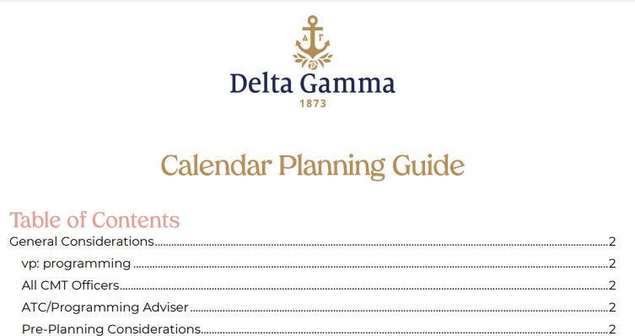
Notes:
(1 minute)
Ask participants to locate the Calendar Planning Guide in the Library: https://www.deltagamma.org/library/ttdtdm/calendar-planning-guide
A Calendar Planning Guide document can be found in the DG Library and is a one stop shop resource to support the programming team in executing calendar planning. In this document you will find pages of information – including details about the process. By completing this document, chapter officers will have all of the information needed to complete the chapter calendar in Anchorbase.
Explain that as it is outlined on page one of the Calendar Planning guide, it’s important to note each CMT officer has a role in the calendar. The vp: programming’s role is to share the information and hold officers accountable for securing dates and planning chapter functions that align with Article II and the Fraternity Standards.
As programming adviser, you should plan to review the final calendar with the vp: programming prior to submission to the RCS/CAC/NCC.

Slide 31
Prepare for Calendar Planning
Consider feedback and needs of chapter
Review chapter goals
Review BLSR
Distribute calendar planning guide to CMT officers
Gather calendars
  Academic calendars
  University sports/special event dates
  Panhellenic & IFC calendars
  Area alumnae group dates
Notes:
(1 minute)
Share that prior to the calendar planning meeting it will be helpful to remind the officers you work with of the following things:
Utilize chapter committees and focus groups to discuss programming ideas. Explain that although it is the responsibility of the vp: programming to create the calendar with input from CMT, your chapter will benefit by having input from many constituent groups.
Keep in mind other important Panhellenic, university and sports schedules, academic, and alumnae and house corporation (if applicable) dates. Encourage participants to gather these calendars prior to the calendar planning meeting in order to avoid conflicting events or over programming.
When possible, avoid/minimize planning events on weekends to allow members time to work/balance other commitments with Delta Gamma.
We are working very hard in Delta Gamma to be inclusive and respectful of all our members. Please work to look at religious dates before events are placed on the calendar. Be mindful of those holidays that will keep members from attending and/or be a challenge for your chapter/campus culture. Of course, some events will take place on some holidays – we simply ask you are aware of these events and show consideration to the many beliefs represented within our sisterhood.

Slide 32
Calendar Planning Meeting
Led by vp: programming
All officers should come ready with dates for their events in mind
Collaborative effort to consider:
  Chapter goals
  Multi-Purpose programming
All officers will enter respective events in Anchorbase
Programming adviser and ATC should be present
Notes:
5 minutes
Review the slide for some logistics of the calendar planning meeting itself.
What processes have worked well for calendar planning meetings you have attended in the past? What has been a challenge? Allow participants to share ideas in the chat or unmute themselves to have a conversation.

Slide 33
Multi-Purpose Programming
When planning, be sure to think about…
What programs could be planned together to suffice requirements in two areas?
What activities allow for cross officer planning?
Which programs share the same outcomes?
How could you adjust a program or add to a program to support two or more requirements?
Notes:
(5 minutes)
Share: You may have heard the term “multi-purpose programming” before. The definition of multi-purpose says: designed or used for several reasons.
Multi-purpose programming is an important piece of calendar planning. All of our members carry multiple roles and strive for a balanced college experience. Between academic responsibilities, work schedules, and campus life activities, our members need their Delta Gamma time to not only fulfill them, but help them become the best version of themselves.
Think of it like this: You make a list for the store. Do you go to Target or Wal-Mart for your entire list OR do you go each day of the week for one item? Of course you go with your list in hand or your list app on your mobile device to knock out your list in one trip. Think of multi-purpose programming the same way. Most of you do not have schedules that allow for daily Delta Gamma meetings. Can you imagine your retention, chapter culture and scholarship rankings if each of your gatherings were impactful and intentional.
Think about a way you could use multi-purpose programming in your chapter. What programs could be planned together? Ask for volunteers to unmute themselves and share ideas that they have seen work well in the past.
If time allows, facilitator can offer the following additional ideas for multi-purpose programming:
Use a single chapter meeting to conduct all votes.
Invite alumnae to a DG Dialogue as a collumnae event.
Recognize advisers at Founders Day.
Recognize scholarship at Founders Day.
Schedule a service event and a sisterhood event for the same day (ex: volunteer and grab ice cream afterwards)
Hosting a speaker or completing an activity during a regular scheduled time such as chapter meeting.
A chapter retreat that includes sundaes for senior programming, a service project and of course completing chapter retreat initiatives.
Use a meal for an etiquette dinner.
Following Founders Day, coordinate a panel for career networking and internship advice with area alumnae.
Utilize email and paper announcements for what can be read – turn meetings into activities.
Thank all participants for sharing. Acknowledge that there are many ways to incorporate multi-purpose programming within the chapter calendar. Encourage participants to work with other chapter officers to create the most successful pairings of programs and events for their chapter.

Slide 34
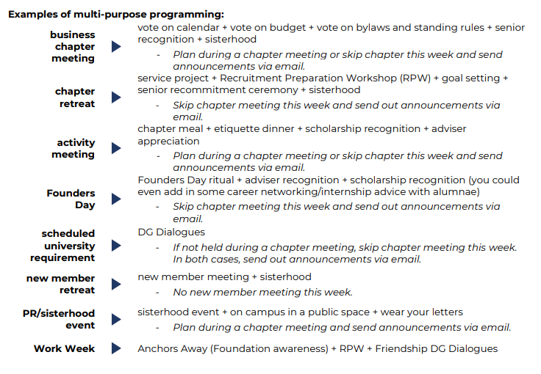
Notes:
(1 minute)
This screen shot is from a resource that you can find on the Library called the “Multi-Purpose Programming Guide.” You can see that it gives ideas for how you can be effective with chapter time.
Give the group a few minutes to review this information after finding it in the Library.

Slide 35
Now that all the events are on the calendar, what questions should you ask officers to ensure the calendar is effective?
Notes:
(4 minutes)
The programming team has the unique opportunity to ensure that everything that ends up on the calendar is purposeful and aligns with chapter goals. In the thick of calendar planning, however, it can be difficult to remember that you should keep the 30,000 ft view of what the chapter is learning and experiencing.
What are some ways you can think of to remain intentional about the chapter calendar? Let’s hear some of your ideas in the chat box.
Call out responses from the chat.
Possible answers:
Look at last years calendar and think about what changes would be impactful on the chapter experience
Ask chapter members casually how they feel about chapter programming
Work with each CMT officer to help her understand how her events fit in with the rest
Ask the following question: What questions should you ask yourself about all the work you’ve done?
Supplement with the following if not answered by the participants:
Does the calendar align with the chapter goals?
Do any of the events not align with Article II?
Are there any weeks outside of recruitment and Initiation where there are two anchored events? [If so, try to readjust the calendar to eliminate an anchored event.]
Do all programming events or DG Dialogues have chapter business associated with them? If so, chapter business needs to keep to 15 minutes and done after the programming event so they focus of the event is on the programming, not chapter business. If not possible, move the chapter business to another meeting or the programming event.

Slide 36
Calendar Submission
Anchorbase Task: vp: programming Calendar Certification
Complete after all officers are finished with their calendar entry task and the calendar has been reviewed with programming adviser and/or ATC.
Certify that:
Chapter Goals
Article II
Calendar Follows Policy and Procedure
Balanced Calendar
ATC/programming adviser approval
Notes:
(1 minute)
When the calendar planning meeting has conclude, all officers should complete their calendar entry tasks in Anchorbase. Before submitting to the RCS/CAC/NCC, you as programming adviser should review the calendar. Your RCS/NCC/CAC will be looking to ensure that all items in the calendar planning guide are reflected in the proposed calendar.
After you have approved, the vp: programming will complete the “vp: programming Calendar Certification” Anchorbase task. This task will the officer to certify that the chapter calendar aligns with chapter goals, that it exemplifies Article II, that it follows all policy and procedure and that it is balanced. It will then ask for you as the programming advisers approval certifying the same.

Slide 37
Review Feedback
Anchorbase task: Calendar Updates and Approvals
Officer receives email if RCS/NCC/CRC “denies” calendar task
Officer needs to review the Calendar Updates and Approvals report in Anchorbase to find RC/NCC/CRC feedback
Make edits and resubmit
Notes:
(1 minute)
Once your RCS/CAC/NCC has reviewed the calendar, she will deny it in Anchorbase if there are any changes she wants you to make. Your RCS will give you feedback based on information in the Calendar Planning Guide. For example, if you have a fundraising event scheduled too close to a social event with alcohol, she would ask for this to be changed. If you have planned multiple anchored events in one week, your RCS would ask you to change this to avoid overprogramming members. Once she denies the calendar, you will receive an email letting you know that information is available from her about her feedback. Once you see that email, the vp: programming will need to login to Anchorbase and view the “Calendar Updates and Approvals” report, which will show the RCS feedback.

Slide 38

Chapter Vote
Notes:
(1 minute)
We have reached the final step- the chapter vote! The chapter should vote to approve the calendar at the first chapter meeting following RCS/CAC/NCC approval. The vote must be recorded in the business meeting minutes.
The chapter should also vote if it is ever proposed that the date of an Anchored event is changed. Anchored events cannot be moved unless voted on by the chapter.

Slide 39
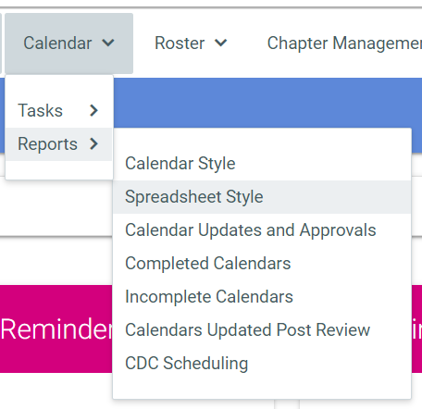
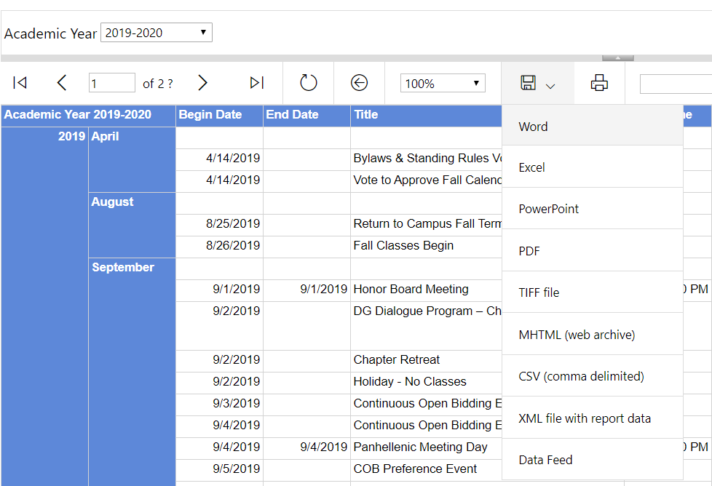
Notes:
(1 minute)
Once the calendar is approved and finalize, you will want to ensure that it is distributed to the chapter and advisory team. Through Anchorbase, there is a report under “Calendar” called “Spreadsheet Style.” The output of this report is in the screen shot on the right hand side of the screen. On this screen, you can see that there is a “download” feature that gives you the options to download the calendar into many different formats. The vp: programming can download the calendar and then send it to all chapter members.
Many chapters will use a Google calendar or another format to share calendar info – whatever works best for the students is great! Don’t forget to ask for advisory team access to that version of the calendar as well and remind officers that all updates made to that version of the calendar must also be made in Anchorbase.

Slide 40
Calendar Planning Key Takeaways
Chapter calendar is based on the needs and goals of the chapter. Utilize Article II Assessment and Chapter Goals resource to set yearly goals that feed into calendar planning.
Prevent over-programming with program flexibility and multi-purpose events.
Limit chapter business to a maximum of 15 minutes when scheduling a programming event and conduct business after the programming event.
Limit the number of weekly required events to one per week to prevent over-programming (with the exception of recruitment weeks and Initiation).
Notes:
(1 minute)
Review the slide.

Slide 41
Questions?
Notes:
Ask for any remaining questions as needed.
If no questions, but time remains prompt further reflection and discussion with these prompts:
Questions:
What are your biggest takeaways from training today?
What are the things you still feel unclear about or on which you still need more information?
What strengths and experiences are you bringing to this role that have set you up for success?
What will your very first step be with the information you learned today?
Who are your allies and partners as an adviser? Who and what are your best resources?

