Slide 1
MEMBER EDUCATION ADVISER
Notes:
(Session time: 2 hours)
Learning Outcomes:
Curriculum Key
(X minutes) - Denotes how long the section takes.
Italics - Marks curriculum you should tell/ask the participants.
Plain text - Indicates instructions for you as the facilitator.
Fac. Note: - Highlights special instructions for the facilitator
(1 minute)
Introduce yourself and welcome them to the Member Education Adviser track at ATA!
Share the following sentiment: Today we will be reviewing a few of the major functions of the vp: member education position while providing opportunities for hands on-experience and idea sharing.
Fac Note: It may be helpful to keep a list to use as a “parking lot.” Keep this parking lot as a reminder of the questions that have come up in the group that may not pertain to the material being presented/presented currently, but could be answered if there is additional time at the conclusion of the presentation.

Slide 2
Agenda
introductions
member education adviser responsibilities
director(s) of new members
director of rituals
director of scholarship
inclusive member education
questions
Notes:
(1 minutes)
Review the agenda.
Here are the broad stroke topics of what we will cover together today. Each step of the way, we will talk through traditional DG policies and procedures and will take time to consider how these pieces of chapter operations have changed due to COVID-19 and a more virtual landscape. We hope you will leave today with a new network of peer advisers and ideas for how to guide the collegiate officers you work with during this time where everything feels new!

Slide 3
Introductions
Name
Chapter of Initiation
Chapter you advise
Your why
One thing you hope to get out of today’s training
Notes:
(5 minutes)
We are going to start with introductions before we dive-in to position responsibilities. Let’s have each person share their name, chapter of initiation and the chapter you advise, tell us why you choose to be an adviser and one thing that you hope to get out of today’s training.
Let each adviser introduce themselves. This can be done by asking each participant to unmute themselves or by asking each participant to type their introduction into the chat box. If there are more than 15 participants, the chat box is recommended due to time constraint.

Slide 4
OFFICER RESPONSIBILITIES
Notes:
(brief introduction)
Let’s move in to the responsibilities in each of the areas in member education. It is helpful for you to have an overview of what each officer is responsible for, but know that you are not expected to do any of this – these are the responsibilities of the officers and you can coach them in these tasks!

Slide 5
Member Education Team & Responsibilities
vice president: member education
Ensures continuing education efforts
Oversees 3 director positions
  director(s) of new members
    Develops and coordinates new member pursuit
  director of rituals
    Coordinates and implements rituals
  director of scholarship
    Develops and coordinates scholarship program
advisers
Notes:
(As the CMT officer, the vp member education has the opportunity to work as a team and collaborate with three director positions.
CMT officers do not own director positions. The have the opportunity to help, ensure their work is completed, serve as a resource and fill in the gaps! What an amazing opportunity to practice delegation skills, teamwork tactics, management skills. We recommend meeting twice a month as a member education team to review the needs ahead and projects on the horizon.
As advisers, it is important to establish a consistent check-in with these officers to touch base about Delta Gamma. We can help the vp: member education to be a coach to this team and we can discuss these meetings prior to when they happen so that she feels prepared.
Ask:
What ways have you found to help you stay in touch with the work of this team? Or what do you think may work?

Slide 6
vp: member education
Chapter Continuing Education
Familiar with resources and policies
  Rituals/Scholarship/New Member Education
  Initiation approval
Evaluations
Anchorbase tasks
Communication
Notes:
(2 minutes)
Let’s talk about the specific responsibilities for the vp: member education.
The vp: member education is NOT the vp: new members – some tend to lose sight of this! Their responsibility is to continue to educate the chapter as a whole. We shouldn’t stop learning about DG at our Initiation. The vp: member education helps the chapter to continue to learn about DG, but also provides education related to Article II to promote personal growth and leadership development of each member.
The vp: member education plays a large role in ensuring all of the tasks associated with Initiation are completed and approved prior to Initiation. We will cover this more in-depth later.
She should be familiar with all Delta Gamma resources and policies related to her direct responsibilities and the responsibilities of the directors she works with. These policies and resources can be found in the CCOM.
Evaluations allow an opportunity to give the chapter a voice. Perhaps the same informal ritual activity has been completed year after year – maybe your chapter would really like to see a change. We might not ever know unless someone is asking though!
Communication – all Delta Gamma officers are expected to communicate regularly with their advisers and with the regional and EO teams as needed. Communication should be professional and timely.

Slide 7
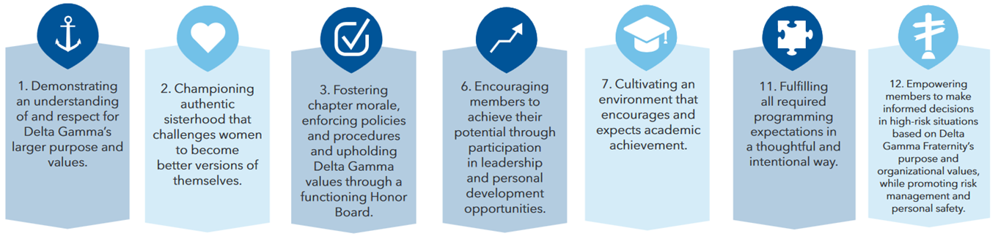
JCMT Members
director of new members
director of rituals
director of scholarship
Notes:
(3 minutes)
The vp: member education can have up to 3 (or 4 if your chapter has two director of new members) directors within the member education team.
We are going to review some of the responsibilities for each director. Due to chapter size, some chapters might not have all of these directors. If your chapter does not have one of these director positions, the responsibilities automatically fall to the vp: member education. The vp: member education, as the leader of the team, is ultimately responsible for the management and operation of the team.
Pictured at the bottom here are SOME of the Fraternity Standards that the vp: member education and directors accomplish. Out of the 12 Fraternity Standards, the member education team works towards 7 of them!
The Fraternity Standards will be marked throughout today’s presentation. You can search “Fraternity Standards for Collegiate Chapters” in the Delta Gamma website Library to see what each collegiate chapter is expected to work toward. The member education team works toward standards 1, 2, 3, 6, 7, 11, and 12.

Slide 8
director of new members
DIRECTOR OF NEW MEMBERS
Notes:
(1 minute)
For most, if not all chapters, the vp: member education serves as a team member for the new member pursuit. The director of new members is responsible for the execution of the new member pursuit and should be managing the weekly meetings. The vp member education can assist by meeting weekly and asking how she can help and support the director. The director of new members acts as a liaison between the members and new members. Sometimes, chapters confuse these two positions. The vp: member education can be helpful to the new member process, but her focus needs to be on the chapter as a whole. The director of new members directly oversees the new member experience.
As part of your pre-work for ATA, you were sent the recording of the webinar that was held in July to introduce the revised New Member Pursuit. Today, while we want to answer your questions and share best practices related to the logistics of the program, we really want to focus on an advisers perspective and talk more with you about the philosophy behind the revisions. Prior to this, the New Member Pursuit had not been updated since 2007. It was certainly time!
How many of you are currently working with the revised New Member Program with the chapters you advise? Let us know just by a show of hands.
Great! We are excited to learn more from you about how it is going and get some tips and tricks for those of us that have not yet interacted with a new member class and program.

Slide 9
New Member Pursuit
What
Why
Notes:
(10 minutes)
There is a definite philosophy shift within this revised New Member Pursuit. To highlight this for us, let’s start by taking a walk down member lane.
What do you remember about your time as a new member? What sticks with you?
Let advisers share answers to this question. Feel free to let conversation go for a few minutes.
Thank you for sharing those things! It is fun to hear that we have fond memories of our time as new members.
What is interesting, and what became important for this revision, is that the things we remember about our time as new members are the connections we made. We remember the people, coming together for meetings, learning who would be our Big, and our new member classes.
(If true, share this statement): None of us mentioned a specific fact of Delta Gamma’s history that we learned or that we specifically remember that Delta Gamma was the first NPC organization to own a printing press. Those items did not make an impression on us – they are not the reason we stayed members.
Our own experiences directly reflect why we shifted philosophy from the WHAT of Delta Gamma to the WHY of Delta Gamma.
When we are able to focus our new member pursuit experience to showcasing the why and the value of Delta Gamma, we are better able to connect our new members to our organization as a whole.

Slide 10
“What” → “Why”
No test
Less focus on history
Complete facilitator guide
Laser focused on creating connections
Small groups required
Big Sister training required
Focus on diversity and inclusion
Notes:
(2 minutes)
Here are some of examples within the New Member Pursuit that exist so that we could focus more on the why of Delta Gamma.
The new member test has been eliminated. Although inherently there was nothing wrong with having the test to help new members retain the information, we reflected that the test was focused on the “what” of Delta Gamma. It is difficult to create a test that gets at the “why,” as this is something that needs to be experienced!
There is a lot less focus on the history of Delta Gamma. Although our history is important, we know that members do not decide to stay members because of what they know about Delta Gamma history. In the new members handbook, there are elements of our history explained, but it will not be the focus of any of the new member weekly meetings.
There is a complete facilitator guide! It is a tremendous resource and sets up the director of new members to ensure and emphasize that new members create connections to each other and to other members, which is the true focus of the new member period.
Small groups are required for new member classes larger than 15. The use of small groups previously was left up to the chapter to adopt or to not adopt. In this upgraded version, chapters are required to utilize small groups, as it makes sense that greater connection could be discovered in a smaller group of people.
We will talk more about this next one in a moment, but there is now a required training for Big Sisters.
Lastly, there is an emphasis on communicating the importance of diversity and inclusion to being a member of Delta Gamma.

Slide 11
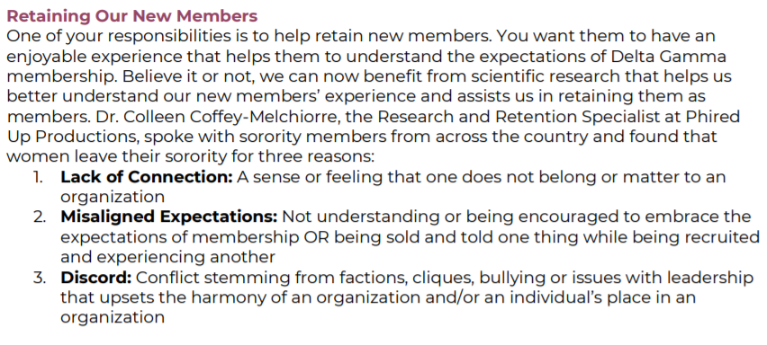
Linking Connection with Retention
Notes:
(10 minutes)
To explore a bit more about this idea of connection, we’d like to take a moment to consider retention. There is a section titled “Retaining Our New Members” within the New Member Pursuit Facilitator Guide. The screenshot on the slide is an excerpt from this section.
This article was originally written by Dr. Colleen Coffey-Melchiorre, the Research and Retention Specialist at Phired Up Productions. In it, she makes a case for why members ultimately leave Delta Gamma. We are going to give everyone a few minutes to read this over and then we will send you to breakout rooms to discuss the role of retention in the New Member Pursuit.
After advisers have had a few minutes to review the content on their own, send them to Zoom breakout rooms.
(ZOOM feature: send advisers to breakout rooms for 7 minutes. It is recommended that there not be more than 4 advisers to a breakout room.)
Once the breakout rooms close, ask advisers to share what they particularly liked from the article and what they talked about in their small groups.
Thank you for sharing these thoughts. Although the revised New Member Pursuit puts connection and retention at the center, these concepts are important throughout the entire member experience. We will revisit them together in different contexts throughout today.

Slide 12
Advising the New Member Pursuit
Encourage planning
Coach on setting the tone
Carefully selecting the small groups and facilitators
Encourage thought around retention
Notes:
(2 minutes)
Let’s talk about your role in advising the New Member Pursuit.
First of all, encouraging the director of new members or vp: member education to thoughtfully plan is vital. They should be prepared for each meeting and be intentional in the ways that they set-up the entire experience. As it says in the facilitator guide – this is not the time to wing it.
You can coach the chapter officers on setting the tone. Have them reflect with you on how important their role is in the development of a love for DG in the new member class. The new members will model their behavior and will adopt their tone and the seriousness with which they take the curriculum.
We want to encourage chapters to be thoughtful about the way that they select their small groups and the facilitators and the way they train facilitators to be effective. There are pointers in the facilitator guide that gets at both of these components. This should be done prior to Bid Day, as the small group facilitators should play a part in helping new members to make connections even as early as Bid Day.

Slide 13
Anchorbase Tasks
Event | Timeline | Approver
Bid Day | 8 weeks prior to Bid Day | member education adviser or ATC
Big/Little Sister Reveal Activity | 6 weeks prior to Reveal | member education adviser or ATC
New Member Retreat | 4 weeks prior to Retreat Date | member education adviser or ATC
Notes:
(1 minute)
As with many DG functions, we want to ensure prior planning and careful implementation of DG’s best practices. On the screen are the tasks the director of new members is responsible for submitting via Anchorbase. These will also require your endorsement and approval.
If the new member retreat is overnight AND hosted at the chapter house/lodge, officers must request permission for overnight activities from the RCS/CAC/NCC. This is in accordance to our Housing Guest Policy. Event Guidelines (without alcohol) is approved by the ATC and are required if the chapter is leaving campus for the new member retreat.
Some of the information you shared with each other for a virtual New Member Pursuit likely also stand for a possible virtual new member retreat!
Please note that in a recent survey of new members it revealed retreats, big/little relationship, spending time with sisters and having fun at meetings were the most important parts of their NMP.

Slide 14
Approving Plans
What should you look for?
Bid Day
Big/Little Reveal
New Member Retreat
Detail
Thoughtfulness
A complete story
Red Flags
  Anything that seems left out
  Anything that could be uncomfortable for new or initiated members
Notes:
(2 minutes)
These plans require your approval because of their significance within the new member period, and due to the high-risk nature trending with these functions. This allows you the opportunity to be sure that the plans set by chapter officers are providing a safe environment that makes new members feel welcomed and included.
What do you think you should be looking for overall as you review these plans? Type some thoughts into the chat box.
Fac Note: answers will appear with your next click
Thank you for your thoughts! Let’s talk about each plan individually and take some time to brainstorm ideas for all three of these events.
Overall on these tasks and plans, we want to encourage chapter officers to be very thorough. We want them to think through every piece of the experience to be sure they’ve thought of everything! They should record details in these tasks that would allow someone uninvolved with the chapter to understand what they’ve planned. If those details are well-done, the next set of officers will be able to access them in Anchorbase, which will help with transitioning.
If you have questions about the technical piece of how to approve these tasks, make sure to watch the training webinar that was done for Anchorbase training. You can find that recording located in the help menu on Anchorbase.

Slide 15
Outdated Practices
Delta Gamma Terminology
  Recruitment not Rush
  New Members not Pledges or Babies
  ITB – not secret ritual!
Wear Letters
  All new members and members wear our letters!
Common Areas | Chapter House
  All common areas of chapter houses are open to new members and members.
No Paddles
  DG committed in 2014 to do away with paddles – all aboard!
Religious Holidays and Observances
  A culture of care starts with respecting and being mindful of our belief systems and obligations.
Notes:
(1 minute)
A few reminders of outdated practices in relation to the new member experience:
Terminology – it’s up to the vp: member education to help educate the chapter on these terms! Look back at your most recent CDC report to see how your chapter may be doing in this area. Remember we do not use the word pledges or babies. Instead we say new members.
Members and new members have the right to wear our letters. New members were selected for membership because they align with Delta Gamma values and thus should be allowed and encouraged to wear Delta Gamma letters. By giving new members a bid we said to them you are reflective of our values. We are not being women of integrity by saying you cannot wear our letters even though your actions and beliefs align with our values.
New members are permitted in all common areas of the chapter house. There shouldn’t be a common space that is for members only.
We should no longer be making or giving paddles. Delta Gamma committed to this in 2014! Here is a link that describes the reasoning for that policy: https://www.deltagamma.org/library/policy/positional-statement-on-the-discontinued-usage-of-paddles-as-gifts
Within some of our collegiate chapters we continue to see a problem involving vp: member education and director of new members providing alcohol to new members. This is against our Fraternity policies. Furthermore, for new members under 21, this is against the law. Officers making such choices could lose their office, be placed on probation, bring about a review of their membership and most of all lose their integrity within the chapter and region. The university could also hold them accountable for these choices.
Please be mindful of religious holidays and observances when scheduling events. A culture of care starts with respecting and being mindful of our belief systems and obligations.

Slide 16
Adviser’s Role with New Members
Be present!
Be observant
  Watch small groups
  Pay attention and notice trends
  Look for engaged vs. unengaged
  Make suggestions to help all new members feel that they belong
  Give constructive feedback
Notes:
(1 minute)
Here are a few quick notes about your overall role with the new members
It is a function of this role to be present at new member meetings. This is very important because you can play the role of observer in these meetings. It is important that we have an understanding of how the new members are experiencing Delta Gamma in their first days as a member.
You can be instrumental in watching small groups and their leaders. Which new members are engaged? Which were engaged last week but seem to have withdrawn?
If the chapter does any sort of pairing initiated members with new members in an effort to get to know them – do you notice trends in which new members are being requested as partners?
All of this information can help us to get to every new member to help her feel that she belongs with Delta Gamma. Your observation can then translate to information for the director of new members and vp: member education.
In addition, you can give constructive feedback to officers if you feel that new member meetings are not as productive as they could be.
Here are some ways to help determine if members are unengaged in a virtual environment:
At the beginning or end of a meeting, ask new members to put into the chat one word that describes how they’re feeling
Create a short Zoom poll that collects information anonymously that asks about their experience
Watch non-verbals
Make note if certain new members consistently arrive late or leave early
Work with small group facilitators to assess engagement, as well

Slide 17
New Member Retreat
New Member retreats are optional but can be a great way to build a strong sisterhood.
Occurs during Week 4 or 5.
Approved by member education adviser or ATC & must fill out Event Guidelines without Alcohol task.
Especially helpful if university requires a shorter new member period.
Sample agenda in NMP Facilitator Guide
Notes:
(1 minute)
We talked about reviewing the plan for the new member retreat, but here are a few considerations regarding these events.
Review the items on the screen
If a university requires a shorter new member period, the new member retreat can be helpful because during it, the chapter can cover multiple weeks of the new member period all at one time. This way, the integrity with new member pursuits is not compromised – even with a shorter timeline, the new members are still getting all of the information and having all experiences intended for their first few weeks as a Delta Gamma.

Slide 18
Shortening New Member Periods
3-week program- Week 1, 2, and 5
4-week program - Week 1, 2, 3, and 5
5-week program - Week 1, 2, 3, 5, and 7
6- week program - Week 1, 2, 3, 4, 5 and 7
7-week program - Week 1, 2, 3, 4, 5, 6, 7
Notes:
(1 minute)
Some campuses require the new member program to be shortened. Rather than require more of new members in trying to complete the entire new member program in shortened time, we have outlined which weeks need to be covered prior to Initiation. It is then required that the new member pursuit be finished after Initiation so that new members do not miss out on these experiences.

Slide 19
BIG/LITTLE RELATIONSHIP
Notes:
(3 minutes)
The big/little relationship is one of the most treasured friendships many members will have during their college days. Events surrounding the Big/Little relationship are also often some of the more stressful times within the year. We also see that Big/Little time in chapters tends to be among the most risky.
Are there any practices surrounding Big/Little that puzzle or worry you?
Just take responses from the advisers at this time, rather than brainstorming solutions to their concerns.

Slide 20
Big Little Program
What does the Big/Little Program look like in it’s optimal form?
How can you help the chapter to focus on the intention of this relationship?
Notes:
(10 minutes)
To continue a theme of our conversation related to the New Member Pursuit, let’s brainstorm together the “why” of the big/little relationship. The discussion on the Big/Little relationship begins on page 87 of the New Member Pursuit facilitator guide. Scroll to that page to consider the new format during your discussion. When we come back, we will ask for your thoughts and suggestions and best practices for each other related to the questions on the screen.
(Zoom feature: send advisers to breakout rooms for 5 minutes. It is recommended that there are not more than 5 advisers in each breakout space.)
When the breakout rooms close, facilitate a conversation based on their suggestions related to the questions prompted on the slide.
If not mentioned by advisers, please say:
In the updated New Member Pursuit, those interested in becoming a Big Sister must attend the facilitated interest meeting. To impress the importance of this role and to ensure that all understand the expectation of Delta Gammas in this role, there should be no exceptions to this!
The Big Sister interest meeting uses the word “friendtor” to describe the role of a Big Sister – this is a combination of a friend and a mentor. This is an intentional word and should convey that it is not necessary for Big Sisters to be a Little sisters best friend…but she is meant to be a compassionate guide.
Retention! The Big/Little relationship can be instrumental in helping new members to feel connected to the organization, therefore encouraging her to invest in her Delta Gamma membership.

Slide 21
Big/Little Matching Process
Be organized and follow a process.
If possible, participate in the process as their adviser.
Reveal – Week 6
  Things to consider:
    New member should be the top priority in the process.
    Special consideration for new members you’ve observed who may be having a challenging time
    “Twins” for larger new member classes
Notes:
(3 minutes)
Big/Little matching can be a challenging process for some chapters! Members tend to put a lot of weight on the big/little relationship so matching with their top choice can be an emotionally charged process. It is important that the chapter is organized and transparent as possible. We also encourage you to participate in this process – both matching and the reveal, which will now happen in week 6 of the New Member Pursuit.
There are a couple of things here to consider and then we are going to review a sample matching process.
First, new members should be the top priority in the matching process. It is always ideal for the new member to get their top choice, when possible. When a new member indicates to us who she has connected with, she is giving us a clear indication about her wishes and feeling of connectedness to the chapter. We should honor this, if at all possible!
As the adviser, you have a unique, 30,000 ft perspective. You likely have identified trends that the students haven’t seen, which could include witnessing that some new members are having a harder time finding their place in the chapter than others. If it is possible, and in the name of retention and a positive Delta Gamma experience, it would be ideal to give special consideration to those new members who are having a challenging time.
Lastly, sometimes it is a good idea for chapters to consider twins for larger new member classes.
The New Member Pursuit Facilitator Guide also has a matching process that is recommended for chapters to use.
Ask for any questions.

Slide 22
DIRECTOR OF RITUALS
Notes:
(brief intro)

Slide 23
Director of Rituals
“Your badge is an outward symbol of an inner commitment.” -Maureen Syring
Notes:
(1 minute)
The director of ritual has two primary responsibilities: (1) planning informal rituals and (2) planning formal rituals.

Slide 24
Informal Rituals
Informal Ritual Ceremonies
Think Anchor Deep
Notes:
(3 minutes)
Ask what are informal rituals?
Explain that informal rituals don’t have to take a lot of time or planning. They can be quick poems to remind members of their responsibilities to DG or how special DG can be to longer more involved rituals. Informal rituals do take thought and planning.
Explain that two places to find informal rituals is the Informal Ritual Ceremonies handbook and Think Anchor Deep. Both are resources located in the Library. There are many ideas in each resource that can be adapted to a virtual setting.
Ask: What are some best practices you’ve seen when chapters celebrate informal rituals?

Slide 25
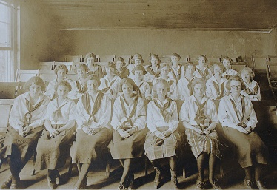
Inspiration & Initiation
Plan ahead
Inspiration and Initiation Outline due 6 weeks prior to Initiation
Notes:
(10 minutes)
It is also the director of rituals responsibility to plan Initiation and Inspiration. Everything from properly saying the terms shared to knowing where to be when, planning is the key to successful Initiation and Inspiration. This is the first exposure to formal ritual that new member will experience… aside from Pi Alpha. They should lead by example so they are invested in the experience that bonds us together as Delta Gamma women. As an adviser, your presence and guidance for Initiation and Inspiration is critical.
The director of rituals is responsible for completing the Inspiration and Initiation Outline. This is due on Anchorbase, 6 weeks prior to Inspiration and Initiation. It is approved by the RCS/CAC/NCC In this report, it asks you a couple of questions:
What are your plans for Inspiration?
What are your plans for 4th degree of Initiation?
New members present their watchword and contribution to fourth degree
What are your plans for the Initiation Celebration?
This is a great opportunity as an adviser to sit down and discuss these questions with the director of rituals before she submits this task.
Let’s break into three groups and discuss best practices for each of these. Please note that we will discuss virtual ritual ceremonies, but want to focus this conversation on Initiation as we’ve typically experienced it.
(Zoom feature: Randomly assign each person to one of the three groups – (breakout 1) Inspiration, (breakout 2) 4th degree, and (breakout 3) Initiation Celebration - and give each group 5 minutes to discuss both best practices and ideas for each of these three events.)
After five minutes has passed, ask each group to report. Ensure the following is mentioned for each group:
Inspiration:
Take a look at the rituals you perform as part of Inspiration.
Do you feel they have been effective?
We want NMs leaving feeling inspired for the sisterhood they will officially join the next day.
Don’t lose sight of the importance of planning for inspiration and only focus on Initiation.
Must be held between 9am and 10pm the day before Initiation and can be a maximum of 90 minutes.
4th degree of Initiation:
Review your 4th degree well in advance.
Do they have everything they need including an updated chapter history? This is a place where the chapter can build a special connection
Is there a special poem or song that has meaning for the chapter?
Is there a special DG informal ritual that could make the 4th degree more special?
Do they allow a time for visiting alumnae to give advice and talk about what DG means to them?
Remember that this should focus on the new members and not on senior members.
Initiation Celebration:
Initiation is an important ritual passage for all Delta Gamma’s we need to make sure we reflect and celebrate appropriately. Cake or brunch is always a hit but is there anything else you can do to make it feel more celebratory?
A slideshow of the new member period? Members write notes to all the new members? Vp: member ed and dir. of new members give speeches about how proud they are of the NMs. It can truly be a special moment in time so don’t let it go without celebrating properly!

Slide 26
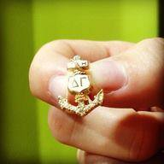
Initiation
Let’s practice…
Notes:
(5 minutes)
Let’s take a few minutes to review the pronunciations and meanings in the Initiation Ceremony.
Review the meanings and pronunciations of the following:
Delta Gamma
Tau Delta Eta
Pi Alpha
Password
And review the meanings of bronze, pink and blue.
Fac Note: If you have any questions, contact Lexie Kiernan

Slide 27
Planning Initiation
Practice makes Perfect
Ideas & Tips for I&I Practice
4th Degree is Key
Notes:
(2 minutes)
Have you ever participated in a ceremony where it didn’t feel like people were taking it seriously? Perhaps the names of people or places were mispronounced or you just get the feeling that it wasn’t a top priority? Every Delta Gamma only gets initiated one time and her attitude and opinion of rituals is often based on her experience at her Initiation. When we spend the appropriate time practicing for Initiation then we ensure that Initiation is special for all.
Ideas:
Ask officers to spend time with the Initiation handbook before the Initiation practice. She should have read through her part multiple times and come prepared to the Initiation practice.
At Initiation Practice, give everyone a notecard where they can write suggestions/feedback on how to make the Initiation ceremony special or portions they think need a little extra practice.
We don’t require the whole chapter to practice anymore, but we do require officers with speaking parts, big sisters, and any member who has another speaking part such as one of the poems in first degree.
Practice the Oath of Friendship with members at the chapter meetings leading up to Initiation (don’t forget to excuse non-initiated members first). It’s important that the new members see entire chapter invested in the Oath of Friendship ritual and not mouthing the words.
Don’t be afraid to discuss the 4th Degree with the chapter officers. If you feel the chapter’s 4th degree is missing that “sometime special” encourage them to talk with local alumnae to see if they have ideas of special readings or songs that may have been performed as a part of 4th degree in the past.
Fac Note: make sure nothing suggested is considered hazing

Slide 28
Initiation Approval
Add Inspiration, Initiation and Initiation Celebration to Anchorbase calendar (director of rituals/vp: member education)
Inspiration & Initiation Outline approved by RCS/CAC/NCC (director of rituals)
Add Bid Day to Anchorbase calendar (director of new members/vp: member education)
Complete Add New Members task (director of new members/vp: member education)
Ensure all new members have claimed their new member account (director of new members/vp: member education)
Complete Manage New Members task (vp: member education, director of new members, vp: finance)
Notes:
(2 minutes)
There are several items that need to be completed 7 days prior to Inspiration & Initiation in order for your Initiation to be approved by the chapters CDS at Executive Offices. The chapter must obtain authorization prior to hold Initiation.
First, director of rituals must add Inspiration, Initiation, and Initiation Celebration to the Anchorbase calendar.
Second, the Inspiration & Initiation outline must be approved by the RCS/CAC/NCC.
Third, the chapter must add Bid Day to the calendar.
Fourth, the director of new members and vp: member education must complete the Add New Members task. This task will automatically send an email to the new members to claim their new member account. New members must claim their new member account before they can be initiated. This is where they will sign the Statement of Obligation. To see the new members who have not yet claimed their account and to provide them a link and code to claim their account, go to the Unclaimed Account report in Anchorbase.
Finally, several officers are responsible for completing the Manage New Members task. The Manage New Members task allows each officer to certify that the new member met various requirements. This is also where the vp: social standards can indicate if a new member resigns.
The main point for you to know as the chapters adviser is that this process has quite a few steps that only the chapter officers can take care of! They need to plan ahead in order to be sure that their Initiation gets approved.

Slide 29
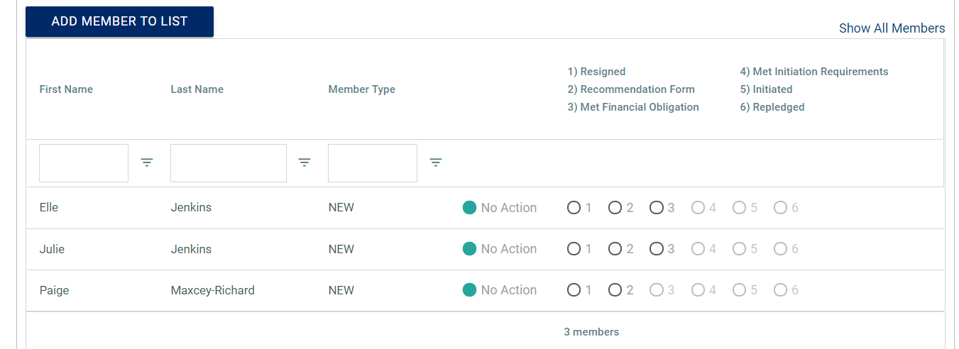
Manage New Members
Notes:
(2 minutes)
Here is what the Manage New Members task looks like.
Note that if the Met Initiation Requirements option is not able to be clicked, it is because either the vp: finance hasn’t completed her task, the recommendation form hasn’t been uploaded, or the new member hasn’t claimed her account.
So for example, the vp: finance hasn’t indicated that Elle and Julie have met their financial obligations so 4)Met Initiation Requirements is grayed out. The Recommendation form also hasn’t been uploaded either for any of the new members since it still clickable (not grayed out).
This is a great example of a time when the director of new members and vp: member education will be collaborating with other officers. It takes a lot of tracking to be sure a woman is prepared to be initiated!
Share:
vp: social standards should choose Resigned if the new member is not continuing her membership with Delta Gamma.
vp: member education or director of new members should choose Recommendation Form to upload the new member's Recommendation Form.
vp: finance should choose Met Financial Obligation only after the new member has signed her Dues & Fees Contract and has paid all Initiation-related fees in greekbill.
vp: member education or director of new members should choose Met Initiation Requirements once the financial obligation has been met, the Statement of Obligation has been signed, part 1 of Xcelasone has been completed with a minimum score of 75%, the new member has passed the Vote to Initiate, and you have confirmed that the new member meets the Fraternity’s and the chapter’s GPA requirements.
If you are unable to choose this option, one or more of the items listed above has not been completed.
vp: member education or director of new members should choose Initiated only after the Initiation ceremony has occurred and you have confirmed that this new member participated and was initiated.
vp: member education or director of new members should choose Repledged if this new member resigned her new membership and returned to the chapter within one year of her initial bid being extended. If her bid was extended more than one year ago, her name will not appear here and a new bid must be extended.
Do you have any questions?

Slide 30
DIRECTOR OF SCHOLARSHIP
Notes:
(brief intro)

Slide 31
Director of Scholarship
Scholarship Report:
Grades Task
University Rankings/Statistics
Scholarship Program and Requirements
Resources:
DG Scholarship Guide in DG Library
Anchorbase Scholarship Reports
Your RCS/CAC/NCC & Director: Member Education
Notes:
(1 minute)
Let’s now talk about the director of scholarship.
The director of scholarship is responsible for submitting multiple tasks in Anchorbase. They are the grades task, one for university rankings/statistics and scholarship program and requirements. We are going to talk through each of these tasks, but listed here are some resources that can help the director of scholarship in completing these task thoughtfully.

Slide 32
Member Accountability
Good Standing for Members: Member must maintain a 2.0 GPA cumulative to be in good standing
  Member who receives below a 2.0 cumulative will receive an APN
  A member receiving below a 2.0 GPA cumulative for the second or more term(s) (not necessarily consecutively) will receive an APN and an SOR
Notes:
(2 minutes)
A few updates have been made to how member accountability and scholarship. Chapters no longer have the ability to set their own unique GPA requirement in their BLSR. All chapter members are simply required to meet the Constitutionally mandated 2.0 cum GPA. If a member receives below a 2.0 GPA cum an APN is filed. Two or more terms initiates an APN and SOR.
Additionally, there are some updates to the terms of probation:
Forfeiture of the member’s vote in chapter meetings with exception of vote to initiate
Loss of social privileges and may not attend social events with or without alcohol
Must attend all anchored events
Terms of probation that are no longer included:
Forfeiture of the members elected or appointed office
Loss of eligibility to take a new little sister

Slide 33
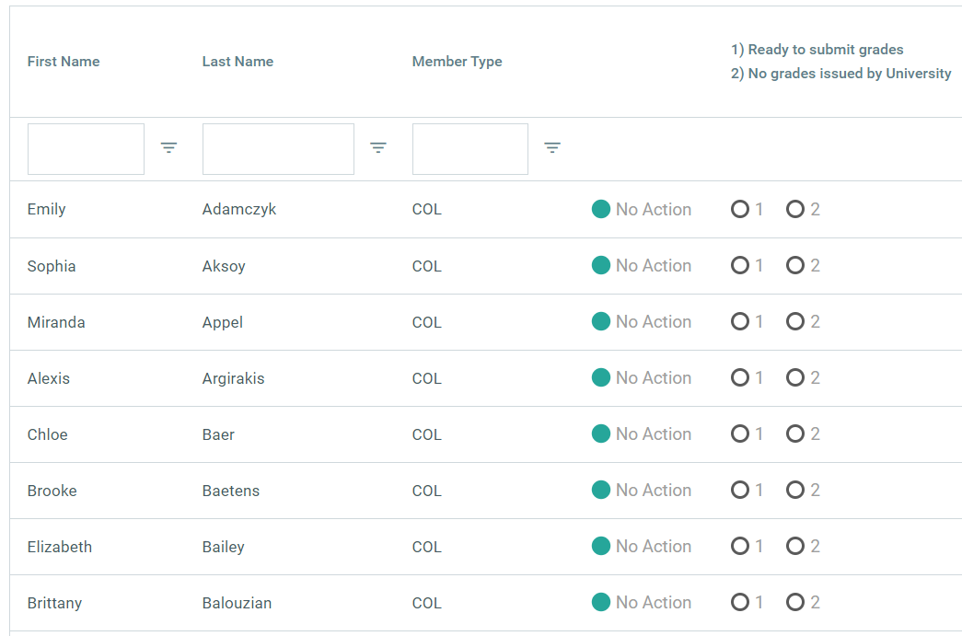
Grades Task
Notes:
(2 minutes)
The first is the Grades task. This task asks the director of scholarship to input grades for each member of the chapter.
The Grades task is due February 15 for fall term grades, April 15 for winter quarter grades, and October 1 for spring grades and should be completed by the director of scholarship. Members and new members are required to submit official grades to the chapter following each term. You may obtain chapter member’s grades each term from:
• the university/college grade report or
• individual members/new members (screen shot of academic transcript suffices), if the university/college does not supply a report.
There is a screen shot of this report here and you can see there are instructions at the top for the director of scholarship to follow.
For each member, she will select 1 of 3 options
Selecting the “1” button tells the system that the director of scholarship has this members grades and is ready to enter them
Selection the “2” button tells the system that the university did not issue grades for this person and the chapter will never have their grades.
Selecting “no action” tells the system that the chapter will have grades for this member, but they are not available to enter at the time of this report. When the grades are received, the director of scholarship should come back to this task and enter them.
As stated in the chapter’s bylaws and standing rules, if a member fails to submit grades by the deadline specified in the chapter bylaws and standing rules, she shall receive an Automatic Probation Notification.

Slide 34
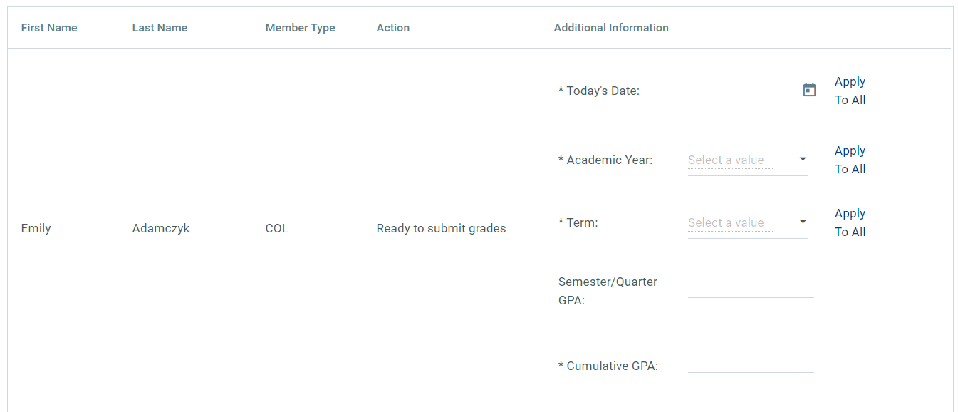
Grades Task
Notes:
(2 minutes)
Here is a screen shot of the next page of the grades task. You can see here that we selected option 1 for Emily, signifying that we were ready to enter her grades. The members who were selected with option 2 or “no action” will not appear on this screen.
The director of scholarship will enter the information on the screen for all members and new members – the date, academic emails, term, and then GPA information.
Do you have any questions about this task?

Slide 35
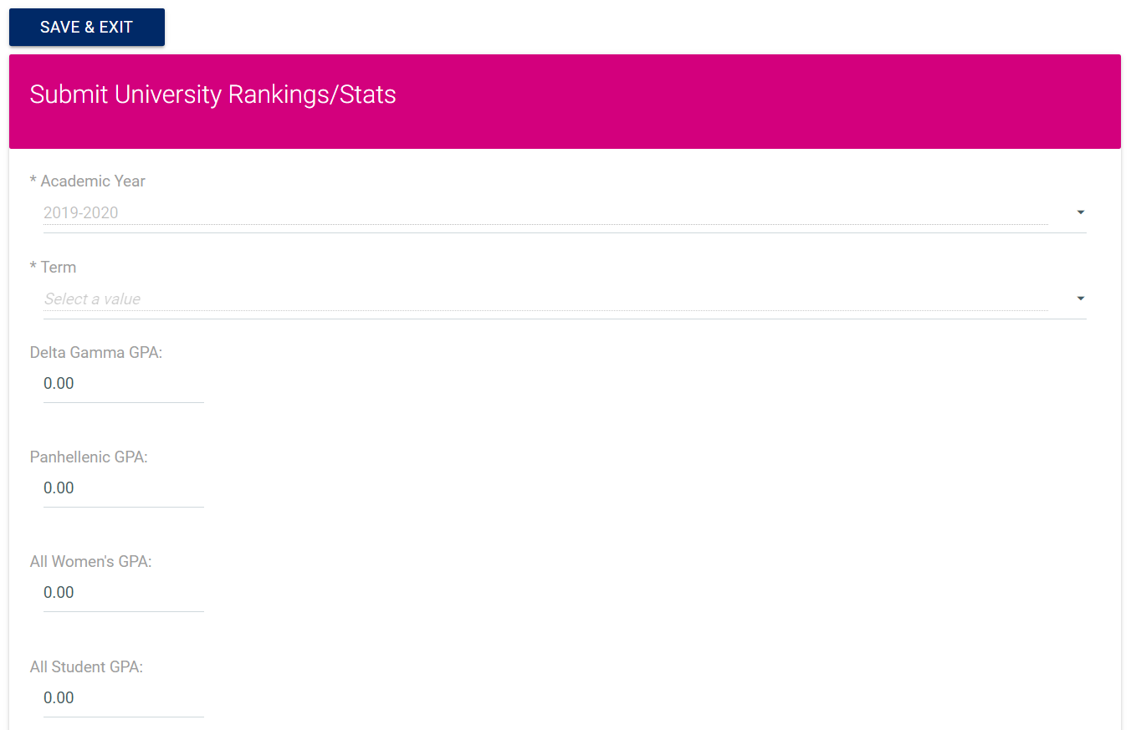
University Rankings
Notes:
(1 minute)
The next Anchorbase task is a simple one – University rankings and statistics. It asks for just that! It is simple reporting on the chapter, Panhellenic and university GPA statistics. The University Rankings/Stats task is due February 15 (fall term grades), April 15 (winter term grades if applicable) or October 1 (spring term grades) and is completed by the director of scholarship.

Slide 36
Scholarship Program Requirements
University Grading System
Chapter’s Formal Scholarship Program
  Incorporation of new members
  Academic resources provided/available
  Incentives and recognition
  Supporting members in poor standing academically
  Member education adviser or scholarship adviser approval
Notes:
(1 minute)
The last task in Anchorbase for the director of scholarship is the scholarship program and requirements task. Listed on the screen here are the items for which the task asks. It asks for the chapters GPA requirements, as approved in the BLSR, information regarding the grading system that the university uses and then information about the chapter’s formal scholarship program. Note that for this year, the chapter voted on a BLSR addendum that changed the GPA requirement, in line with what we’ve discussed already.
This is a task that the director of scholarship can utilize to plan her term and the new programs/resources she would like to consider. It asks for information related to how the chapter is incorporating new members in the scholarship program, how members are incentivized to reach their academic goals and how the chapter recognizes each other. It also asks for information about how the chapter, and specifically the director of scholarship is supporting members that are in poor standing. We are going to brainstorm a bit about this in a few minutes.
Lastly, it does ask for approval from the member education adviser, or the scholarship adviser if the chapter has one. You will be sent a notification via email when the task is ready for your review and approval.

Slide 37
How can chapters support members on probation?
How do we create individualized, helpful development plans?
How does this support relate to the retention and connection built in the New Member Pursuit?
Notes:
(7 minutes)
Although our measures of accountability for scholarship are different during this time, Delta Gamma does still expect our members to engage with their academics. We also still expect the director of scholarship to engage with and support members around their academic efforts.
We are going to take some time here to talk about ways to support members who need additional academic support. Often, chapters take the approach of a one-size-fits-all scholarship plan. We know that this is likely ineffective, due to the fact that we are all different people with different strengths and different needs. We should also help chapter officers consider that a members grades may be impacted by something unrelated to scholarship.
What are some creative ways to support women on probation for scholarship, especially in this virtual world? How can we ensure that our support actually helps her to improve? Lastly, I want to draw our attention back to our conversation about retention and connection, as established in the New Member Pursuit. How might academic support relate to and strengthen this? We’re going to head to breakout rooms to talk about these three questions.
Start a group conversation with some of the questions on the screen. Ask for participants to unmute and share and/or put items in the chat.
Share the following if not said by the advisers:
Develop an individual plan for each woman that fits her needs and provides her the resources to achieve her highest potential
Hold individual meeting with all women on probation. This can still happen virtually. Consider doing the following in the meeting:
set goals for the semester – consider having her set her goal GPA in each class
Discuss her learning style – is she studying the best way for her style of learning
Does she need a mentor? Upperclassmen or alumnae who can help coach and motivate her.
Connect her with the appropriate university resources given her situation. That could be a study skills center, tutoring, writing center, etc. Sometimes this could be a counseling center if there are emotional health concerns impacting her academic success.
Scholarship is a very personal thing and helping women in poor standing identify a plan that is going to help her achieve her highest potential is the goal.
View each member as an individual who learns differently and needs varying support. If the member is taking online classes, she may need help relearning how she studies best or how she takes in class material best.
Ask her! Find out what would be helpful to her as she strives to do better academically.
Understand her “best.” It is unrealistic to expect all members to achieve a 4.0 – we should celebrate each woman achieving their best
Check-ins with the director of scholarship
Encouragement to seek the help that they need – make suggestions and ask for follow-up.

Slide 38
Recognition
Who are we recognizing and for what?
  Different definitions of “best”
  Members who are proud of an accomplishment that week
  Members who have done great research, secured and internship or job
Recognizing staff and faculty
Reference the ideas in the DG Scholarship Guide!
Notes:
(5 minutes)
One of the responsibilities of the director of scholarship is to implement creative and supportive ways to recognize members for a job well done. Many chapter have weekly, monthly and annual ways of doing this. As the chapter is thinking of new ways of recognition or evaluating ones that exist for the chapter already, here are some ways that you can coach them.
Who are we recognizing and for what? This is something we touched on already – it is unrealistic of us to expect that every member is achieving a 4.0. In addition to that, we should be recognizing the members who feel they’ve done their very best that term. To do this, each member could be asked to set her own GPA goal and all members who meet their goals could be recognized.
We can also recognize members weekly for something they feel helped them reach their “personal best.” Scholarship can be more than just GPA – we can celebrate each other for being elected to a leadership role, having a meeting with a faculty member that they’ve been worried about or starting a new job.
We can also learn a lot from each other! Chapters can recognize members for great research they’re doing, for a term abroad, or for securing a job or internship.
Ask:
What are way that chapters are recognizing their members currently?
What are some practices that maybe need updated?
Have you seen any great ways that chapters are recognizing or saying “thank you” to staff and faculty on campus?
Ideas if not mentioned:
Invite to a scholarship recognition event where members are recognized
Invite to the house for a meal
Recognize faculty/staff members of the month with handwritten thank you notes
There are a lot of ideas such as these in the DG Scholarship Guide on the Library!

Slide 39
OTHER MEMBER EDUCATION RESPONSIBILITIES
Notes:
(brief intro)

Slide 40
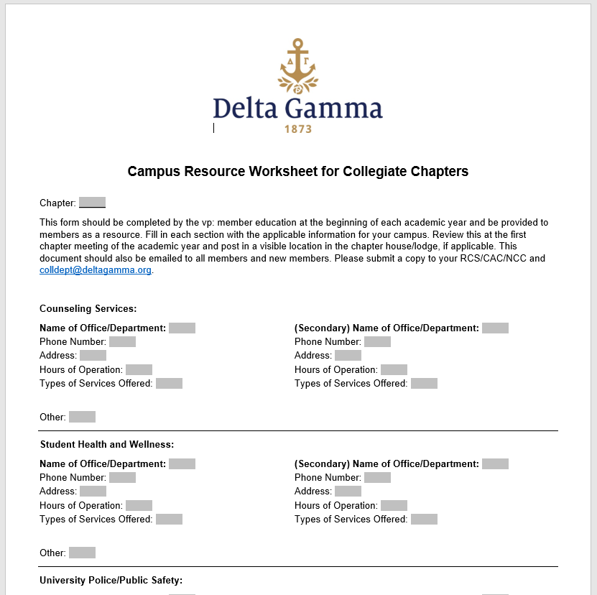
Campus Resource Worksheet
Notes:
(1 minute)
The last responsibility of the vp: member education that we are going to cover today is the Campus Resource Worksheet. On the screen you can see the Campus Resource Worksheet for Collegiate Chapters and you can also find it in the Library. This is to be filled out with specific information for each campus. The vp: member education may need to do some research to complete it. The completed copy should be emailed to the entire chapter each year by October 1. The chapters RCS/CAC/NCC and CDS at EO should also be emailed a copy.
In addition to informing our members of the campus resources, we also have Delta Gamma resources to support members mental health as well as to support survivors of sexual assault.

Slide 41
Member Education Resources
Calendar Planning Guide Collegiate Chapter Officer Manual (CCOM)
Etiquette Handbook
Etiquette Education Ideas
Campus Resource Worksheet
Behavioral Threat Assessment Rubric
Officer Newsletters
Inspiration & Initiation Checklist
Informal Ritual Ceremony
Think Anchor Deep
Rituals Handbook
DG Smart Guide
Anchorbase webinars – in Anchorbase help menu
Notes:
(2 minutes)
Let’s review some additional resources dedicated to vp: member education’s role. We referenced a few of these during our time together today.
Collegiate Chapter Officers Manual (CCOM). The CCOM is a great starting place for many questions that officers have and gives a great overview of their responsibilities.

Slide 42
QUESTIONS?
Notes:
If time allows, respond to questions.
If no one has questions, use the following to prompt further conversation/refelction:
What are your biggest takeaways from training today?
What are the things you still feel unclear about or on which you still need more information?
What strengths and experiences are you bringing to this role that have set you up for success?
What is your vision for the chapter and the chapter officer with which you work?
What will your very first step be with the information you learned today?
What is your vision for your work in this role for this academic year? What do you hope to accomplish?
Who are your allies and partners as an adviser? Who and what are your best resources?

