Slide 1
HONOR BOARD ADVISER (HBA)
Notes:
(Session time: 2 hours)
Facilitation Key:
Total Time: XX | Marks the amount of time the section/slide should take to complete.
Fac Note | Highlights special instructions for you as the facilitator.
Italics | Marks statements or questions that you should say out loud.
Plain Text | Indicates instructions for you.

Slide 2
Honor Board Adviser
Introductions
Share…
Name
Chapter of Initiation
Chapter you advise
Your why
What do you hope to get out of today?
Notes:
(5 minutes)
Welcome to today’s ATA. I am excited to spend the day with you, helping you to understand your role as the Honor Board Adviser.
We are going to start with introductions before we dive-in to position responsibilities. Let’s have each person share their name, chapter of initiation and the chapter you advise, tell us why you choose to be an adviser and one thing that you hope to get out of today’s training.
Let each adviser introduce themselves. This can be done by asking each participant to unmute themselves or by asking each participant to type their introduction into the chat box. If there are more than 15 participants, the chat box is recommended due to time constraint.

Slide 3
Agenda
HBA adviser role
Honor Board basics
Conversation tips
Member well-being
Chapter morale
Scenario practice
Notes:
(1 minute)
Review the agenda.
Here are the broad stroke topics of what we will cover together today. Each step of the way, we will talk through traditional DG policies and procedures and will take time to consider how these pieces of chapter operations have changed due to COVID-19 and a more virtual landscape. We hope you will leave today with a new network of peer advisers and ideas for how to guide the collegiate officers you work with during this time where everything feels new!

Slide 4
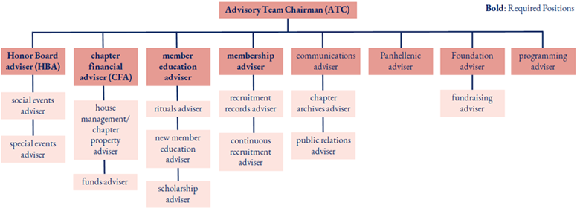
Advisory Team Structure
Notes:
(2 minutes)
Here is a snapshot of the entire advisory team. The ATC is not the only adviser with a supervisory relationship to other advisers.
As we look at the advisory team structure, it’s important to note the collaborative relationship between ATC and HBA. It is the responsibility of the HBA to communicate trends to the ATC and advisory team so that those advisers can use that information to inform discussion with the officers they work with.

Slide 5
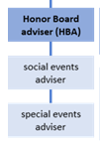
Notes:
(2 minutes)
Here is the HBA line. You will supervise the social events adviser and special events adviser, if the chapter has those positions filled. This is a great opportunity for succession planning and mentoring advisers who may seek another advisory position in the future!
By a show of hands, how many of you have one or more of these positions filled on your advisory team?
Watch for a show of hands and then move to the next discussion.
This transition in the advising structure for Delta Gamma is exciting and an example of how we can learn through our involvement for a lifetime. Let’s take just a couple of minutes here to share with each other some tips and tricks for successful supervising in this volunteer experience. If you do not currently have an adviser in one of the supervised roles, we hope that you will soon in the future, as there are lots of Delta Gammas that want to get involved!
Note: The objective of this conversation is the ensure attendees understand their volunteer supervisory responsibilities, and also to encourage that all advisory positions be filled! The ATC is the person responsible for appointing women to each of these roles.

Slide 6
New: Retention Committee Updates
Retention Committee is moving from the membership team to Honor Board starting with this cycle of SET.
Committee members:
Honor Board Member-at-Large (Chair)
director of DG Dialogues (or vp programming)
director of scholarship
director of new members (or vp member education)
director of continuous recruitment and retention (or vp)
The Committee will be advised by HBA (or ATC)
Notes:
(3 minutes)
New updates have been made to the retention committee.
The retention committee is:
Primary administrative group focusing on the factors that keep women engaged in chapter membership.
Works together to understand the current chapter climate and lead the chapter to a successful realization of its retention goals.
The committee has broad responsibilities for understanding the membership experience, discerning trends around membership resignations, and determining actions that need to be taken to ensure members feel seen and valued by the chapter and its officers.
A new handbook will be provided specifically for the Retention Committee with retention goal setting guidance, resources, meeting agendas, and sample retention plans. Training will also be available for both Committee members and advisors following SET.
Review other items on the slide.

Slide 7
FOUNDATIONS
Notes:
(Brief intro)

Slide 8
Honor Board Purpose & Fraternity Standard 3
Fraternity Standard 3 Fostering chapter morale, enforcing policies and procedures and upholding Delta Gamma values through a functioning Honor Board.
Notes:
(2 minutes)
Ask one person to read to read the excerpt from the Fraternity Standards for Collegiate Chapters .
The Fraternity Standards for Collegiate Chapters outlines expectations for all collegiate chapters. Fraternity Standard 3 refers specifically to Honor Board operations. This standard goes on to outline specific expectations of a functioning Honor Board.
Are you familiar with this resource? If not, it could be helpful to review Fraternity Standard 3 with the Honor Board you work with to assess if there are areas your Honor Board could improve.
Share link to resource in the chat: https://www.deltagamma.org/library/handbookguidemanual/delta-gamma-fraternity-standards-for-collegiate-chapters-full-version/

Slide 9
HONOR BOARD BASICS
Notes:
(Brief intro)
Let’s go over a few of the basics surrounding the operation of Honor Board

Slide 10
Honor Board – the Who
Honor Board consists of the following five elected members:
vice-president: social standards (chair)
chapter president
junior member
sophomore member
member-at-large
Honor Board Adviser (HBA)
The HBA sits on Honor Board as a non-voting member, with exception of a tie during a formal hearing.
If a chapter does not have an HBA, their ATC will serve as the Honor Board Adviser.
Notes:
(2 minutes)
These are the individuals that make up Honor Board.
Review the slide.
Fac Note: When an HBA has been appointed, the ATC may not attend HB hearings nor is she privy to any Honor Board-related matters. No other advisers may attend hearings. CDCs should also not be attending formal hearings, nor should they review Honor Board documents.
Fac Note: A reminder that Honor Board is a collegiate board and the vp: social standards is the presiding officer.

Slide 11
Honor Board – The What
General discussion: examine current chapter morale and areas of concern
Trends to flag with CMT: evaluate common trends – both positive and negative – that exist within the chapter
Positive programming: discuss HB programming that will help to mitigate negative trends and boost chapter morale (e.g., recognition)
Awards: discuss weekly chapter awards and review upcoming Fraternity and Panhellenic award deadlines
Activity Log: review the sanction log and determine if there are members who need to be placed on probation or removed from probation. Includes Excused Status.
Allegation Assessments: review and vote on SORs that have been filed
Notes:
(2 minutes)
Honor Board meets weekly. The agenda for Honor Board meetings is on the screen. This agenda also mirrors the Weekly Meeting Minute template for Honor Board meetings. One Honor Board member should take minutes at each meeting. The weekly Honor Board meeting minutes need to be sent to the RCS/CAC/NCC within 24 hours of the meeting.
Take a minute to note if the Honor Board you advise is doing each of these and where they could use improvement.
Give advisers a minute to assess.
Let’s look at one of the most important tasks for Honor Board: confidentiality.

Slide 12
Confidentiality
True or False: Honor Board procedures are secret to those outside of DG.
True or False: Honor Board’s discussion and private information from hearings are secret.
True or False: Private information can be shared with a member’s parents.
Notes:
(2 minutes)
Read the first true/false questions. Ask for responses in the chat box. After each question, share the correct answer and rationale. Continue this process for each question.
Below are the correct answers and rationale:
True or False: Honor Board procedures are secret to those outside of DG. (FALSE – Honor Board procedures can be shared. Member’s names and their behaviors and sanctions cannot be shared.)
True or False: Honor Board’s discussion and private information from hearings are secret. (TRUE – Member’s names and their behaviors and sanctions cannot be shared.)
True or False: Private information can be shared with a member’s parents (FALSE – Delta Gamma does not disclose member’s behaviors and sanctions with parents, students, or even other Delta Gamma’s outside the Honor Board process.)
If the chapter has a university hearing that involves real or potential Honor Board matters, the chapter president should contact her Collegiate Development Specialist (CDS) at EO immediately.

Slide 13
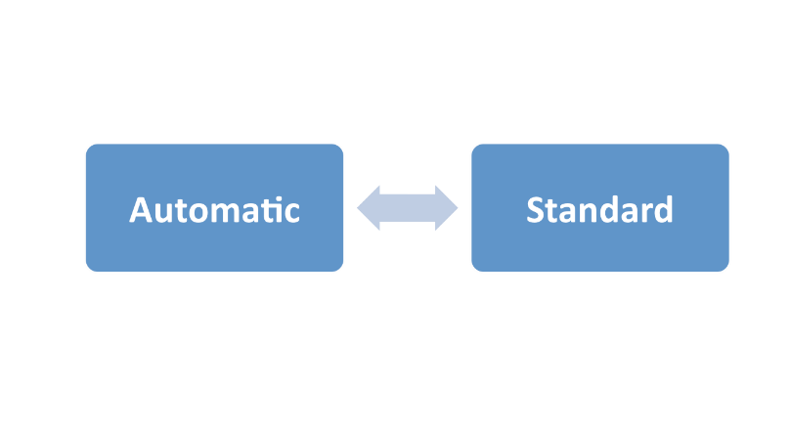
Honor Board Process
Automatic procedure handles issues that are cut and dry.
Standard procedure handles the “gray” or more complicated areas.
Notes:
(1 minute)
There are two procedures to hold members and new members accountable. Automatic procedure handles issues that are cut and dry; whereas, standard procedure handles issues that are gray or more complicated.

Slide 14
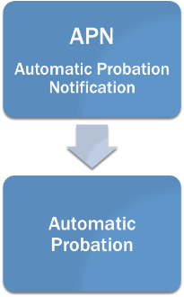
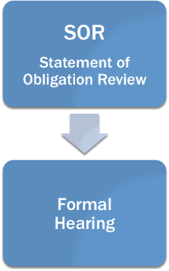
Notes:
(1 minute)
When Automatic Procedure is used, the appropriate officer writes an APN, which leads to Automatic Probation. The APN process takes true officer coordination, as the vp: social standards is not responsible for sending APNs for all reasons. It is recommended that Honor Board invites the vp: finance, vp: communications and director of scholarship to a meeting each month so that all can stay on the same page, although those officers should be including the vp: social standards on those APN notifications as they are sent.
When Standard Procedure is used, a SOR is written, which can lead to a Formal Hearing. Any member can submit an SOR on any other member. A SOR is a statement that draws attention to fact that a member may not be upholding the Statement of Obligation that they made to Delta Gamma.
There is documentation that needs to happen consistently throughout the Honor Board process. We will look in just a few minutes at a chart that will tell us the timing of some documentation pieces. All documentation is described in the Honor Board handbook and templates can be found in the Delta Gamma Library.

Slide 15
KEY COMPONENTS
Notes:
(brief intro)
There are a couple of key components of the Honor Board process that we want to review briefly. We will then give you time to talk with each other about best practices within the Honor Board process.

Slide 16
Allegation Assessment
The vp: social standards shares the SOR with Honor Board at the next Honor Board meeting.
If by majority vote, Honor Board determines there is reasonable cause to believe a violation has occurred, a formal hearing is scheduled.
A formal hearing letter and copy of the SOR is sent to the member with the Honor Board Adviser copied
*Policy: the allegation assessment step in standard procedure is no longer required for cases that transition from automatic to standard procedure. The Honor Board may simply proceed to the formal hearing stage.
Notes:
(2 minutes)
The allegation assessment part of the meeting is important. After the vp: social standards receives a SOR, she will then share it with the rest of Honor Board at the next meeting. 4 out of 5 members must be present. Honor Board will vote to determine if there is reasonable cause to believe that a policy violation has occurred. If the majority votes “yes” then a formal hearing is scheduled.
As we said before, documentation is important. A formal hearing letter and a copy of the SOR should be sent to the member with the HBA copied. They need to have at least 3 days notice between the date of delivery and the date of the formal hearing.
Note that this phase of the standard procedure process is no longer needed if a case is transitioning from automatic to standard procedure. If that is the case, Honor Board knows that a policy violation has occurred.
This piece of conversation with Honor Board is very important, particularly with the allegations they may receive this term and beyond.

Slide 17
Formal Hearing Components
Read opening statement.
Read violations as noted on the SOR.
Member/new member presents her evidence or a written statement, if applicable.
Robust discussion with the member/new member, along with questions from Honor Board.
Member/new member leaves room and Honor Board deliberates on information presented.
Honor Board votes if there is a violation.
If majority believes there has been a violation, Honor Board determines appropriate sanction to recommend to RCS/CAC/NCC.
Member/new member brought back into hearing room.
Member/new member notified of Honor Board’s recommendation
Closing statement read.
Notes:
(2 minutes)
There is a document in the Library called the Formal Hearing Minute template. It lays out the agenda and order of business for how the formal meeting should be conducted. An Honor Board member other than the president or vp: social standards should be tasked with taking minutes.
We are going to narrow in on the 4th step here – “robust discussion with the member/new member,” as we know our Honor Boards are having tough conversations. At a baseline level, this discussion should be just that. It should not be an interrogation, but a fine balance between compassion and objectivity. All of the details of the discussion should be recorded in the minutes, especially the member’s comments.
After discussion member/new member leaves the room or is sent to the virtual waiting room.
Honor Board then deliberates and if by majority vote Honor Board finds there has been a violation, Honor Board determines an appropriate sanction to recommend to the RCS/CAC/NCC. HB’s deliberations prior to their vote should be thoughtful, thorough and objective. All information being discussed by HB officers during the deliberations should have been discussed with the member herself during the hearing. Collegians should lead the discussion and vote; not relying on the adviser.
Member/new member comes back into the room and Honor Board should share their recommendation and read the closing statement in the minutes template document.

Slide 18
What is your role as HBA during a Formal Hearing discussion?
Notes:
(2 minutes)
What is your role during the formal hearing discussion?
Facilitate a discussion on this topic, focusing on being a coach. Have advisers unmute themselves to share or type their responses in the chat box.
Possible answers:
Encourage a robust discussion that explores all angles
Pose questions to help Honor Board think through the entire situation or to help them remain within a caring mindset
Answer procedural questions, if they arise
Empower the vp: social standards to chair the meeting
Advise Honor Board on how to remain fair in their considerations and to think of the member holistically

Slide 19
Sanctions for Members
No Sanction
Warning
Penalty with the following terms __________
Probation until _____________
Expulsion
Notes:
(1 minute)
When Honor Board is determining a sanction for a member, the following are possibilities:
No sanction
Warning
Penalty with the following terms. For a penalty Honor Board determines specific sanctions. Productive and effective terms focus on the root cause of the observed behavior. It is important that Honor Board considers WHY the behavior occurred – although it could seem that the member knew the policy and purposefully violated it anyway, could it be that she violated that policy because she is having trouble finding her place in the chapter? Could it be that something deeper and difficult is going on in her life? If we uncover those root causes, we can assign sanctions that specifically will help with these things – For example, we can ask her to help a JCMT officer with a program to help her feel more included in the chapter, or we could ask her to read an article that will help her understand why the behavior seen is contrary to Delta Gamma values.
Probation until . Depending on the nature of the case, this could be longer than what is received for APNs.
Expulsion. This means you are recommending the member no longer be a member of Delta Gamma. We will talk more specifically in a minute how this process works.

Slide 20
Sanctions for New Members
No Sanction
Warning
Penalty with the following terms ______
Delay of Initiation
Expiration of Calendar Year
Expulsion
Note: The vp: member education attends all hearings with new members
Notes:
(1 minute)
When Honor Board is determining a sanction for a new member, the following are possibilities:
No sanction
Warning
Penalty with the following terms . For a penalty Honor Board determines specific sanctions. This is the same as the member penalty terms.
Delay of Initiation. This should be done prior to the Vote to Initiate. If RCS/CAC/NCC approves, the vp: member education must be notified and must convene a meeting between the new member, vp: member education, director of new members, and ATC to determine which portions of the New Member Pursuit will need to be repeated (at a minimum, the new member must retake the new member exam). Before the end of the delay period, Honor Board must file another SOR and bring the new member to a formal hearing to review progress. Honor Board must then recommend to the RCS/CAC/NCC one of the following:
Member is ready to be initiated
extension of delay
expiration of calendar year
Expulsion
Expiration of Calendar Year. When a new member has already received a Delay of Initiation sanction and continues to fail to show aptitude for Fraternity life, Honor Board may recommend to the RCS/CAC/NCC that the new membership be allowed to expire. A new members bid to Delta Gamma is only valid for one year. If she is not initiated within one calendar year of the day her bid was issued, she is no longer a new member of Delta Gamma. This recommendation may only be made when the calendar year is close to expiration. If this is approved, Honor Board will notify the vp: member education of the decision. The new member should be informed that after one year of signing her MRABA (Membership Recruitment Acceptance Binding Agreement), she is eligible to accept offers of membership from any other NPC organization.
Expulsion. This means you are recommending the new member no longer be a new member of Delta Gamma. We will talk more specifically in a minute how this process works in a minute.
Note: The vp: member education MUST attend all hearings with new members

Slide 21
Standard Procedure Pop Quiz
Who has the authority to place a member on probation?
Can the RCS/CAC/NCC alter the sanction to be more or less severe than Honor Board recommended?
How long does the member have to appeal her recommended sanction to the RCS/CAC/NCC?
How many days after a formal hearing does the vp: social standards have to send the compliance packet to the RCS/CAC/NCC?
What is the difference between Delay of Initiation and Expiration of Calendar Year?
Which officer must attend Honor Board hearings with a new member?
Notes:
(2 minutes)
Okay, as quick review, let’s go over these questions. Type your thoughts into the chat box.
Ask the following questions. If the advisers cannot provide the correct answer, supplement with the correct response.
Q: Who has the authority to place a member on probation?
A: Only the RCS/CAC/NCC can place a member on probation. Honor Board only recommends a sanction.
Q: Can the RCS/CAC/NCC alter the sanction to be more or less severe than Honor Board recommended?
A: Yes. Honor Board only recommends a sanction to the RCS/CAC/NCC.
Q: How long does the member have to appeal her recommended sanction to the RCS/CAC/NCC?
A: 3 days
Q: How many days after a formal hearing does the vp: social standards have to send the compliance packet to the RCS/CAC/NCC?
A: 3 days
Q: What is the difference between Delay of Initiation and Expiration of Calendar Year sanction for a new member?
A: Delay of Initiation occurs when a new member needs to work more to complete their requirements, and expiration of calendar year should only be used for a new member who has already had a Delay of Initiation and when the calendar year is already close to expiration.
Q: Which officer must attend Honor Board hearings with a new member?
A: vp: member education

Slide 22
Reporting
Anchorbase
Tasks to submit meeting and formal hearing minutes
Confirm allegation assessment
View compliance packet report and weekly activity log report
All communication regarding hearings
Delta Gamma Member Site - members.deltagamma.org
Used by all members to submit SORs and action appeals
Notes:
(1 minute)
Review the slide.
All reporting and Honor Board paperwork is submitted electronically. As vp: social standards, you and your Honor Board should be familiar with using Anchorbase. If you haven’t already, please review the Guide to Honor Board in Anchorbase in the DG Library with Honor Board.
Review the slide.
There is weekly activity log in Anchorbase that is also viewable to the ATC. This activity log gives the ATC enough information so that she is in the loop, but protects the confidentiality of the process. As we chatted about before, the ATC is not privy to the details of each case or the conversation that happens in Honor Board meetings.

Slide 23
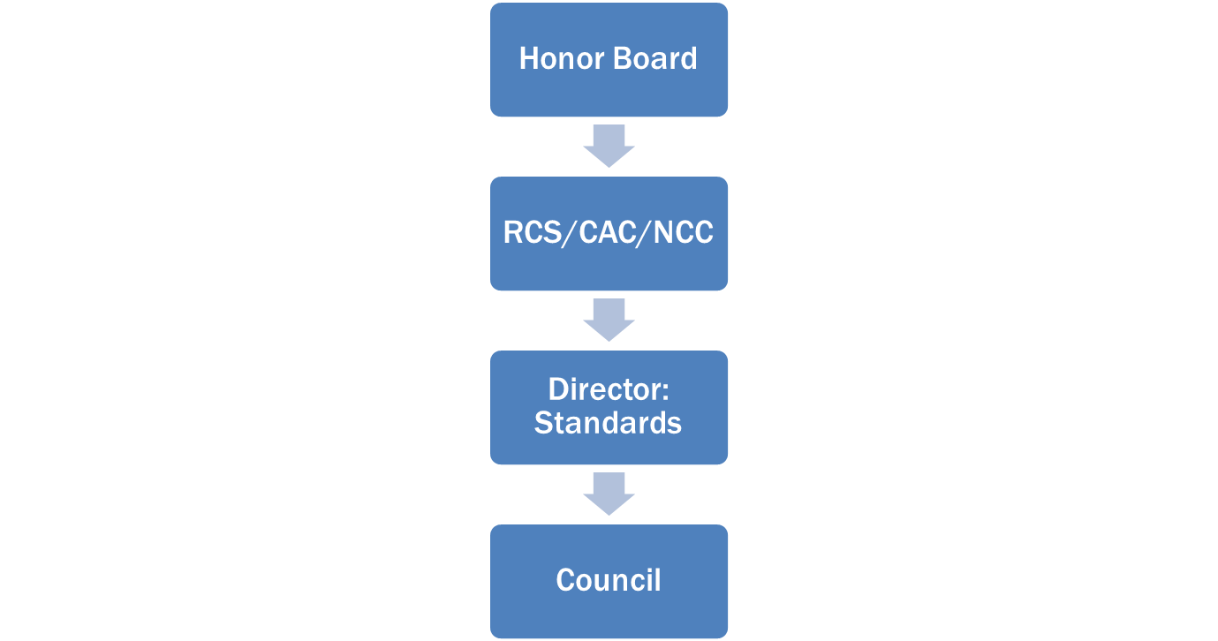
Expulsions
Notes:
(1 minute)
One possible sanction Honor Board can recommend is expulsion to the RCS/CAC/NCC.
The RCS/CAC/NCC will notify the member and Honor Board if she will pursue expulsion. The RCS/CAC/NCC may choose to pursue expulsion even if the Honor Board has not made that recommendation. The RCS/CAC/NCC will send the compliance packet to the Director: Standards for approval.
If the Director: Standards concurs with the expulsion, she will forward it to Council for review.
Only Council has the power to expel a member or new member.
If the member/new member wants to resign at any point in this process, she should be allowed to do so.
If Council does not expel the member/new member, Honor Board may recommend a lesser sanction to the RCS/CAC/NCC.

Slide 24
SHARING BEST PRACTICES
Notes:
(10 minutes)
We are going to send everyone to break out spaces for 15 minutes to discuss both Automatic and Standard Procedure. Try to keep this conversation focused around following procedure, documentation, organization, member accountability, etc. During the rest of the day, we are going to talk more in depth about Honor Board conversations, member status changes and the difficult topics Honor Board is dealing with. To bring any questions back to mind, you can reference the Honor Board Handbook on the Library – pages 19-44 speak to the processes specifically.
(Zoom feature: send attendees to random breakout spaces for 7 minutes. Recommended breakout room size is 3-5 attendees)
When the breakout rooms close, see if there are any questions you can answer about procedure. Remember what is coming up – don’t spend too much time on the details now!

Slide 25
CONVERSATIONS
Notes:
(brief intro)
Does anyone have any procedural questions before we dive-in to strategies for Honor Board conversations?

Slide 26
Resources
Updated Positional Statement on Inclusivity
Member Status Changes
Excused Status
Addressing Racism in Honor Board
Conversation Guide
Honor Board Supportive Programming
Notes:
(1 minute)
What you see here are the documents we are going to reference together today. With each resource and topic, we are going to talk together about how to navigate these conversations and how to coach Honor Board in having them or dealing with these tough topics.

Slide 27
Inclusion & Accountability
Inclusion & Accountability
Keys:
Use open-ended questions.
Create a safe space
Connect back to DG values
Breakout rooms:
Read through
Share experiences
Role play past or anticipated conversations
Notes:
(10 minutes)
Honor Board is often responsible for initiating difficult conversations. These conversations may require Honor Board to hold an individual accountable for their actions. As the HBA, the officers you work with may turn to you for guidance on how to handle these conversations.
The Inclusion & Accountability – Racism in Honor Board resource in the DG Library specifically addresses how to address racism or other bias in the chapter. This resource also includes helpful information and tips on how to navigate challenging conversations in general.
Drop link in the chat: https://www.deltagamma.org/library/ttdtdm/inclusion-accountability-addressing-racism-in-honor-board/
If you scroll through the resource, you’ll notice these three important themes, or action items. We can coach Honor Board to use only open-ended questions and to create a safe space. Ultimately, everything should be tied back to the values of Delta Gamma.
We want to spend some time discussing how to navigate difficult conversations in Honor Board in general. We are going to send you to breakout spaces to discuss experiences you’ve had in seeing tough conversations in Honor Board – and how you as an Honor Board adviser work to coach officers in using open ended questions and creating a safe space. You can review the Inclusion & Accountability resource for other ideas on how to achieve this .
(ZOOM feature: send attendees into breakout spaces for 7 minutes. It is recommended there are not more than 5 advisers in each breakout space.).
When breakout rooms close, ask group to share anything that stood out from the breakout rooms or any questions that came up.
Thank you for engaging in this conversation. Let’s move to another major responsibility for Honor Board – member status changes.

Slide 28
Member Status Changes
What roster changes fall under vp: social standards/Honor Board?
Resignations (initiated member or new member)
Excused Status
Early Alumnae Status (EAS)
Expulsions
Notes:
(1 minute)
These are the roster changes that the vp: social standards oversees. These are often sensitive statuses so it is imperative they review the forms quickly. Until a member’s status is changed, she is responsible for dues and fees to the chapter.
When receiving resignation requests, review it carefully to ensure there isn’t another status better suited for the member. It is also important to review for trends so that the chapter can make any necessary adjustments to its operations if possible.
Often, when roster changes are reviewed at EO, we notice that a woman has resigned for a reason that actually qualified her for a different member status, such as Excused Status or Early Alumnae Status.

Slide 29
Excused Status Philosophy
“The intent is to allow DG collegians to maintain membership while pursuing additional academic and professional opportunities or when experiencing a temporary hardship.”
Notes:
(1 minute)
Although chapters may have navigated resignations and EAS before, all chapters are new to Excused Status, so we are going to explain it thoroughly. Remember that the intent of Excused Status is not to give all members the opportunity to step back from Delta Gamma whenever they choose. The intent is to allow DG collegians to maintain membership when previously, the only choice available to them may have been to resign. Overall, Excused Status is meant to be granted only for extreme circumstances and is a status meant to capture the diverse needs of our members.
A member can seek this status one year following her Initiation.

Slide 30
Excused Status Process
Application
Honor Board Review
Outcome shared with the member
In-person meeting
Notes:
(2 minutes)
Here is some information on the process to follow when reviewing an Excused Status request.
1. Excused Status Application is completed by the member and given to the vp: social standards. Excused Status Applications may be obtained from the vp: social standards or found on the Library. There is an option for a member to denote that her application is highly sensitive, and therefore it would only be reviewed by the vp: social standards, president and HBA and CFA.
2. Unless the content is highly sensitive, Honor Board reviews the Excused Status Application at the next weekly Honor Board meeting and decides if the application warrants an in-person Honor Board meeting with the requesting member for further consideration. The Honor Board adviser’s attendance is strongly recommended, but not required. Note: Those seeking Excused Status for non-resident/abroad or academic/professional reasons do not require a meeting with Honor Board
3. The discussion and deliberation regarding the Excused Status Application must be memorialized in the Honor Board: Meeting Minutes. The Honor Board: Meeting Minutes are forwarded to the RCS/CAC/NCC.
4. If Honor Board determines that the situation does not warrant further discussion, the vp: social standards will notify the member that the application has been denied and no further action is taken (ignore the following steps). We will talk through how to understand qualification for Excused Status in a moment.
5. If Honor Board finds that this member may qualify for Excused Status, an in-person (or virtual) meeting with the applicant must be scheduled.
6. Honor Board members must agree upon a date, time and location for the in-person meeting– this is generally the same as the regularly scheduled weekly Honor Board meeting. Honor Board should make all reasonable efforts to find a time that the Honor Board adviser can attend or participate by phone.
Granting Excused Status will have financial implications for the chapter. For this reason, Honor Board should partner with the vp: finance to understand these implications. Each reason for Excused Status carries a different level of financial obligation for the member and the vp: finance and CFA should have a better understanding of how those dues structures would impact the overall chapter budget.

Slide 31
Financial Hardship
Required attendance at anchored events
Attendance
Non-Resident/Abroad
Academic/Professional
Should attend no events during this time
Special Circumstances
May attend anchored events.
Expectations will be unique to the member’s situation – attend as much as possible.
Attendance requirements of member mirror any of the above
Cannot attend events with extra cost
Cannot attend events with extra cost
Notes:
(5 minutes)
What does it mean for a member’s involvement if Excused Status is approved? The implications of each category are considerate of the reasons for which the member applied. If a member applies and is granted Excused Status for financial hardship, we want to try to help control her costs for being a member, and therefore her attendance may also change. Here are the implications for each category:
Financial Hardship: Required attendance at all “anchored events”, however, cannot pay to attend events with additional costs, such as elaborate sisterhood events and date functions. Allowing members to attend a high-cost Founders’ Day (which may be “anchored”) or as dates to Delta Gamma social events is addressed in the Excused Status Financial Resource.
Attendance: Attendance expectations will be unique to the member’s situation and agreed to with Honor Board, as the goal is for the member to attend as much as she is able.
Non-Resident/Abroad: Excused from all anchored events and not allowed to attend any events during the effective term of this status.
Academic/Professional: May attend any “anchored events” she is able, however, cannot pay to attend events with additional costs, such as elaborate sisterhood events and date functions. Allowing members to attend a high-cost Founders’ Day (which may be “anchored”) or as dates to Delta Gamma social events is addressed in the Excused Status Financial Resource found at www.deltagamma.org/library.
Special Circumstances: Attendance requirements of the member shall mirror any of those mentioned above, based on the needs of the member’s special circumstances.
Again, as you can see, the financial implications of Excused Status for the chapter are important. Keep in mind that the vp: finance should not be present for an in-person meeting to discuss Excused Status, but should be consulted to understand these implications. The vp: finance should not be asked to provide input on the merit of the application, just the implication for the chapter budget.
What questions do you have about the criteria or procedure for Excused Status? Send us any questions in the chat box.

Slide 32
MEMBER STATUS CONVERSATIONS
Notes:
(15 minutes)
There are two documents we’d like you to find on the Library now. The first is “Member Statuses Guide for Chapter Members” and the second is titled “Honor Board Member Statuses Conversation Guide.”
Repeat the names of the documents until all advisers have located both documents.
We are going to go back into breakout rooms now. Each room will look over one topic from the Conversation Guide. We’d like you to review the resource, talk through it together and role play the conversations within your groups. Each group will have a specific topic. When we come back, we will ask each group to recap their topic so that everyone understands the conversations that go along with each member status.
You will see a breakout room pop up come up in just a few minutes. Take note of the number of the room to which you’ve been assigned:
Breakout room 1: will discuss conversations around Excused Status – page 4
Breakout room 2: will discuss conversations around Early Alumnae Status – page 6
Breakout room 3: will discuss conversations around resignation – page 8
(ZOOM feature: send advisers into 3 breakout rooms for 10 minutes)

Slide 33
Alternative Outreach
Honor Board
Supportive Programming
Notes:
(3 minutes)
https://s3.amazonaws.com/dg-library/Honor-Board-Supportive-Programming.pdf
There is one more conversation resource we’d like to share with you today. The Honor Board Supportive Programming resource…go ahead and find this in the Library. This is a great document for Honor Board to reference and to realize that they have other options available to them other than formal hearings. We encourage them to consider one-on-one conversations and informal check-ins with members they’re concerned about. We also encourage them to be available to members who are interesting in visiting with them! They should make their meeting times known to chapter members.

Slide 34
MEMBER WELL-BEING
Notes:
(brief intro)

Slide 35
Encouraging Self-Care in Honor Board
Image from mindful.org
Notes:
(5 minutes)
Mental and emotional health is a sensitive topic that we hear our collegians talking about and encountering a lot. We have learned that our chapter members do not feel equipped to talk with each other about this topic. Delta Gamma believes this is an important and necessary conversation for us to have and for our members to be able to have with each other openly. At RTDs, chapter officers learned about Be Her Champion. We are going to watch a video about it in a moment and then we will talk about how Delta Gamma is addressing these concerns.
Before Honor Board can care for other members of the chapter, however, they need to care for themselves – and you for yourself! Honor Board is a truly unique leadership and learning experience and one in which situations may be new every week. Honor Board hears stories that their sisters share that can be challenging, and it is easy for them to be in a scenario where they feel they don’t know how to help. This can be very draining.
How can we encourage the members of Honor Board to care for themselves? Has anyone implemented anything that they’d like to share?
Ask advisers to share by unmuting themselves.
Share if not mentioned by advisers:
Be sure to begin every meeting with a general check-in. Spend the first few minutes just being together rather than jumping right in to business
As HBA, make it a goal to check in with each member of Honor Board individually every couple of weeks.
If you notice a member is quiet or clearly struggles during a particular meeting, follow up with her.
Reflect on self-care together. Ask Honor Board to read an article together or to bring a self-care Instagram post that resonated with them to share with the group.
Make self-care a ground rule for the group. Ask each member to share how she is caring for herself during each weekly meeting.

Slide 36
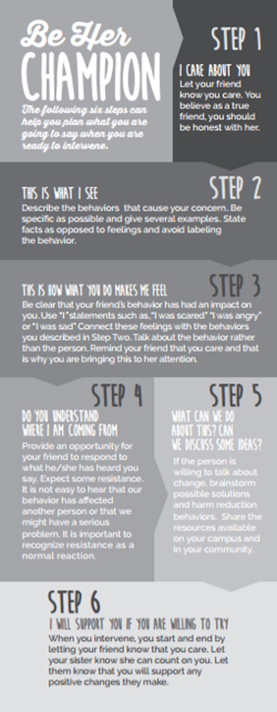
Be Her Champion
Response Procedures:
I care about you
This is what I see…
This is how what you’re doing makes me feel…
Do you understand where I am coming from?
What can we do about this? Can we discuss some ideas?
I will support you if you are willing to try.
Notes:
(1 minute)
These six steps which can also be found in the Library under Be Her Champion. They provide members with a way to have a conversation from a place of care with someone they are concerned about.
Honor Board could and should use this model and the attitude of “Be Her Champion” within the Honor Board process…and not just if they have a concern related to a sister’s mental health.
Review the slide.

Slide 37
Member Follow-Up
Who is the best person to talk with a member you are concerned about?
Big/Little Sister
Roommate
Mentor
Chapter leaders
Advisers
Notes:
(1 minute)
Every Delta Gamma, not just Honor Board members, have a responsibility to care for one another. To pay attention…
To notice who is not showing up for chapter and follow-up with her, letting you know you missed her.
To who is not where they are supposed to be.
To who didn’t pay their bill or complete their service hours.
We need to reach out to these women to let them know we care. To let them know we missed them. To not assume their absence or non-compliance is because of their lack of interest or effort but consider something else may be the cause. We as sisters need to reach out and show we care.
The first key can be identifying who is the best sister to reach out or follow-up with a sister who is stepping away from her membership responsibilities. Consider asking a big or a little sister, her roommate, her mentor in the chapter, or as a chapter leader you need to have the crucial conversation. Can you imagine how nice it would be to get a “We missed you” text following a chapter you missed? Or, a phone call asking you to grab some coffee allowing you to explain what’s really going on rather than assumptions why you haven’t been at events?
We encourage Honor Board to take these alternative steps and to not wait on an APN or SOR before noticing changes in behavior for a member. Honor Board should feel empowered to have one-on-one conversations with members if that is more appropriate than a formal hearing.

Slide 38
Member Care Resources
Behavioral Threat Assessment Rubric
Supporting Survivors Resource Guide
Accommodations and Resources for Survivors of Sexual Violence
Notes:
(1 minute)
A few years ago, The Fraternity endorsed changes to how we support and respond to our members who are struggling with significant mental health issues or are survivors of sexual assault.
Go ahead and look up the first two of these resources on the Delta Gamma Library. Once everyone has these, we will talk through each of them. The third resource lives at the end of the Supporting Survivors Resource Guide.
If you search the title of the documents, you should be able to download them.
Allow advisers about a minute to locate these documents, then move on to the next slide which will explain them.

Slide 39
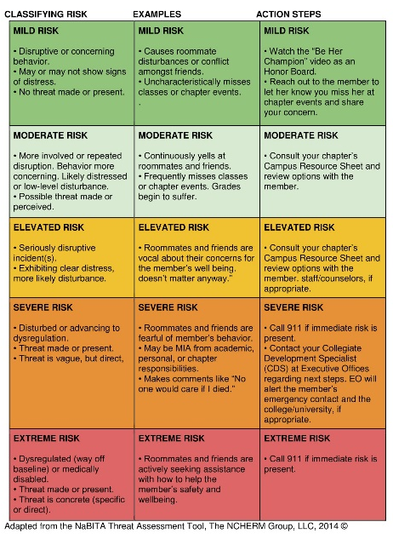
Risk Rubric
There are 3 columns
Classifying Risk
Examples
Action Steps
Levels of Risk
Mild
Moderate
Elevated
Severe
Extreme
Notes:
(1 minute)
This is what the rubric looks like, with all 3 levels of risk displayed.
Before we go through the details of this, it is important to know that this is simply a guide. This is not an end-all-be-all resource or script. This is just to guide response to a member who we are concerned about and gives some context for understanding when we should be concerned.
Ranges from mild risk to extreme risk. Mild risk would be small roommate conflict or uncharacteristic behavior. Extreme risk would be very uncharacteristic behavior such as making plausible threats against themselves or others.
From there, the document gives examples of these behaviors and then action steps that can be taken to address them.
Have any of you used this resource previously? How has it been helpful?
Ask advisers to share via unmuting or in the chat box (chat box will be more time-efficient).

Slide 40
ASSESSING CHAPTER MORALE
Notes:
(5 minutes)
Another responsibility of Honor Board that often gets pushed aside or overlooked is the continual assessment of chapter morale.
What are ways that Honor Board can do this, particularly in this virtual and social distancing era?
Be sure to mention these, if not mentioned by advisers:
Pay attention to number and reason for SORs. If chapter morale is high, SORs will likely decrease. Chapter programming can also reflect trends Honor Board is seeing in an effort to address concerns widely
Make this a point of discussion during weekly Honor Board meetings – discuss any current issues facing the chapter.
Pay attention through participation at all chapter functions
During chapter meetings, assess the moral, spirit and mood of the chapter
Noticing which members are not showing up to meetings, even virtually
Do an anonymous poll at the beginning of Zoom meetings to gauge chapter morale (ex: On a scale of 1-5, how connected do you feel to Delta Gamma right now?)
Note that chapter morale cannot always be “fixed” through a new chapter program. Sometimes, culture change is needed and this is obviously a more involved dilemma. Honor Board should bring these concerns to CMT in order to create a plan for changing the chapter culture.

Slide 41
Social Media Policy
Inappropriate content includes, but is not limited to: vulgar language…photographs or videos depicting illegal behavior that is or may be subject to prosecution in local, state, and federal courts; nudity; distasteful graphics; sexually explicit photographs and wording, including sexual innuendo…cyberbullying; statements that violate the Statement of Obligation, the Oath of Friendship, and Oath of Secrecy or discuss chapter meetings, rituals ceremonies…and content in violation of the Delta Gamma Philosophy and Membership Responsibilities…
Notes:
(1 minute)
Honor Board's spend a lot of time handling social media. This is an excerpt from our social media policy. The entire policy can be found in the Library. Take a few minutes a read this excerpt.
What we are seeing more and more are violations of the social media and Delta Gamma’s position statement on inclusivity.

Slide 42
Social Media Best Practices
What are ways that chapters are monitoring social media?
How are chapters helping members to understand the impact of their social media choices?
Are there any social media policies out there that are really working?
How can we, as advisers, keep up-to-date on all of the social media policies and practices?
Does every “questionable” photo require a SOR?
How are you helping members to understand that the behavior, and not just the post, is problematic
Notes:
(10 minutes)
We are going to set up some breakout rooms so that you all can share best practices around these questions. Take a snap shot of this screen and we will put the questions in the chat box for reference.
(Zoom feature: send advisers to breakout rooms for 7 minutes to discuss their thoughts on these questions)
Be sure to place the questions in the chat box.
When breakout rooms close, ask for any remaining questions – some additional best practices are on the next slide.

Slide 43
Social Media Best Practices
If chapters want to “create their own” social media policy, the language needs to be in their chapter-specific standing rules and must be suggested during the official BLSR process.
When to write an SOR – not every questionable post warrants an SOR! If it doesn’t represent a clear policy/legal violation, or a major character concern: encourage members to have a conversation with each other and use it as a learning moment.
Social Media Policy FAQ in the Library
What about my First Amendment rights? I am legally allowed to say whatever I want. It’s my right.
What if my profile is set to private? Is it still an issue if no one can see what I post?
What if I take Delta Gamma off my social media bios?
Notes:
(1 minute)
Finally, just a few more points for consideration regarding social media. Some chapters have started to create their own social media policies, and should not be doing this. If the chapter wishes to specify social media preferences for their chapter, those guidelines need to be included in the chapter BLSR. They should not create their own standalone social media policy, as the overarching policy to be used is the one from the Fraternity.
And a point for consideration – does every questionable social media post warrant an SOR? As a rule of thumb, if the post doesn’t represent a clear policy violation, or major character concern, honor board does not need to review the post, but it should be discussed with the member. Without a clear policy violation, questions have been raised about chapters not supporting a members individuality.
There is a document in the Library that may be helpful when reviewing Honor Board is reviewing social media concerns with the chapter – Social Media Policy FAQ. It answers questions like the ones here on the screen, and more!
Take any questions.

Slide 44
SCENARIO PRACTICE
Notes:
(25 minutes for Honor Board scenarios)
We have covered so much today! As we start to wrap-up the day, we want to give you more time to brainstorm together, as we always hear that is the most helpful component of ATA. We are going to share a link in the chat that will take you to a Google Doc. That document has a list of possible Honor Board scenarios. We are going to give you 20 minutes in breakout groups to talk through whichever scenarios feel most relevant to you, or whichever scenarios you want to be ready to tackle.
As you talk through these together, remember all of the resources that we covered today! And, when in doubt, visit the Honor Board Handbook! Play out the scenario together – what process should be followed, what is the policy violation, what resources can you use and what might the conversation with Honor Board sound like?
Share this link in the chat before opening the breakout rooms:
https://docs.google.com/document/d/1GgLeo5IvHPWU0ZuYz5LkFno54H1qhuUx4XwesIs938U/edit?usp=sharing
(ZOOM feature: send advisers into randomly assigned breakout rooms. There should be no more than 5 advisers to a breakout room.)
When you close breakout rooms, allow time for any questions that came up.

Slide 45
Helpful Resources
Fraternity Standards for Collegiate Chapters
Navigation Honor Board Online
Honor Board Formal Hearing Minutes
Member Status Guide for Chapter Members
Honor Board Conversation Guide
Honor Board Supportive Programming
Inclusion and Accountability
Social Media Policy FAQ
Behavioral Threat Assessment Rubric
Supporting Survivors Resource Guide
Notes:
2 minutes
Here is a list of some of the resources we covered today – as well as a few others that may be helpful! These are all documents within the DG Library. If you haven’t already, we recommend you familiarize yourself with how to find these resources so you can refer to them if questions arise from the chapter you work with.

Slide 46
QUESTIONS?
Notes:
Take questions as time allows.

