Slide 1

FOUNDATION ADVISER
Notes:
(Session time: 2 Hours)
Facilitation Key:
Total Time: XX | Marks the amount of time the section/slide should take to complete.
Fac Note | Highlights special instructions for you as the facilitator.
Italics | Marks statements or questions that you should say out loud.
Plain Text | Indicates instructions for you.

Slide 2
Introductions
Name
Chapter of Initiation
Chapter you work with
Your why
What excites you most about the upcoming school year and serving as a Foundation adviser?
Notes:
(5 minutes)
Welcome to the Foundation track at Adviser Training Academy! Thank you again for being here – it is my hope that we cover information today that gives you the confidence you need to coach the vp: Foundation toward success for the chapter.
Introduce yourself and your ole in Delta Gamma.
We are going to start with introductions before we dive-in to position responsibilities. Let’s have each person share their name, chapter of initiation and the chapter you advise, tell us why you choose to be an adviser and one thing that you are looking forward to this year.
Let each adviser introduce themselves. This can be done by asking each participant to unmute themselves or by asking each participant to type their introduction into the chat box. If there are more than 15 participants, the chat box is recommended.

Slide 3
Today’s Goals
Understand what the collegiate Foundation teams do
Understand your role in supporting them
Understand whom to contact for help
Notes:
(1 minute)
Here’s an overview of what we hope to accomplish today. As we go along, we encourage you to put any questions you may have in the chat.
Review slide.

Slide 4
FOUNDATION OVERVIEW
Notes:
(Brief Intro)
As a Foundation adviser, part of your role can be helping connect the collegiate chapter officer with who and what the Delta Gamma Foundation is. To start today, let’s review some history and other important information about the Delta Gamma Foundation.

Slide 5
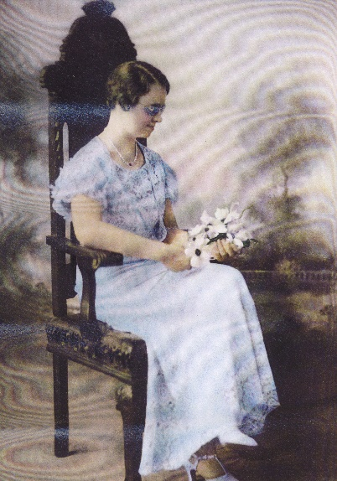
Delta Gamma Foundation History
Official Philanthropy: 1936
1936: Aiding the Blind
1942: Sight Conservation & Aiding the Blind
1995: Service for Sight
Delta Gamma Foundation: 1951
The Delta Gamma Foundation fosters lifetime enrichment for members, promotes Service for Sight, and partners with the Fraternity to ensure the future of our sisterhood.
Ruth Billow, Eta-Akron
Notes:
(2 minutes)
Let’s start with a brief history of the Delta Gamma Foundation. In 1936, Delta Gamma adopted our official philanthropy thanks to member Ruth Billow, Eta-Akron.
Review dates and philanthropy bullets in first section.
In 1951, The Delta Gamma Foundation was formed as we know today.
Read Foundation mission statement.

Slide 6
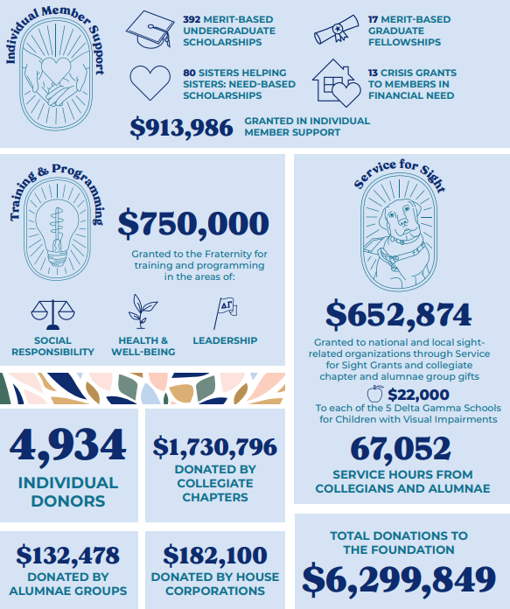
FY22
Notes:
(2 minutes)
Here’s a review of the impact the Foundation made in the last fiscal year.
Pause to allow attendees to review items on the slide. Call out some of the facts that are specific to the collegiate chapters.

Slide 7
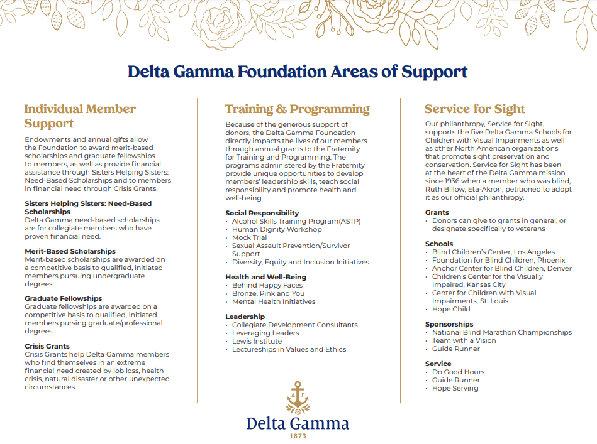
Notes:
(5 minutes)
Some collegians aren’t sure where the money “goes” when they are hosting their fundraising events. The information on this slide illustrates the 3 areas that the Delta Gamma Foundation works to support.
The First area is Individual Member Support. This includes initiatives such as our need-based scholarship, merit-based scholarships and crisis grants. These initiatives directly support both collegiate and alumnae members of Delta Gamma.
Next is Training & Programming. Funds raised for this area directly impact members through providing grants to important programs for members’ that support leadership skills, teach social responsibility, and promote health and well-being. Examples of these programs include: the Lewis Institute, the Collegiate Development Consultant Program, Alcohol Skills Training Program (ASTP) and more.
And last, but certainly not least! Is Service for Sight. This area ensures the Foundation’s commitment to supporting organizations that promote sight preservation and conservation. This is the heart of our Foundation’s Mission. Specific areas that benefit from funds raised here include Delta Gamma’s 5 schools and grants to local organizations that share our Service for Sight mission.
Allow time for any questions about these areas of support.

Slide 8
COLLEGIATE FOUNDATION ROLE
Notes:
(Brief Intro)
Now that we have discussed some important background and context of the Foundation as a whole, let’s chat more about the role collegiate chapters play in the Foundation.

Slide 9
Fraternity Standard #8
Supporting the Delta Gamma Foundation and engaging in service to others in the spirit of doing good.
Chapter has outlined the number of Do Good Hours per member (per term) in the chapter bylaws and Standing Rules.
Chapter members fulfill Do Good Hours, as outlined in the chapter bylaws and Standing Rules.
Chapter holds fundraising events each term that follow Foundation/Fraternity policies.
Chapter officers understand the process of submitting fundraising profits to the Foundation and do so in a timely manner.
Chapter conducts the Foundation Education for Recruitment workshop during Recruitment Prep Week.
Chapter members are aware of Service for Sight opportunities to participate in our Foundation.
Chapter members are aware of the Collegiate Giving Society.
Notes:
(3 minutes)
Fraternity Standard 8 reviews all expectations related to Foundation operations for collegiate chapters. This standard is a great place to turn to in order to understand how to support the chapter you work with in achieving excellence in Foundation operations.
Review bullets of this standard.
We will continue to discuss aspects of this standard throughout our time today. This standard as well as all other collegiate chapter standards, can be found in the DG Library document here: https://www.deltagamma.org/library/handbookguidemanual/delta-gamma-fraternity-standards-for-collegiate-chapters-full-version/
Fac Note: Share link to standards document in the chat.

Slide 10
vp: Foundation Tasks – Service/Awareness
Foundation & Service for Sight Education
Share information about all the programs, support, and opportunities of the Delta Gamma Foundation, including scholarships, fellowships, and Crisis Grants
Lead the education of chapter members about Service for Sight
Let’s Talk Philanthropy
Facilitate workshop during RPW
Utilize the Let’s Talk Philanthropy PowerPoint
Complete the Anchorbase Task
Collegiate Service – Do Good Hours
Lead the planning, management, and organization of Service for Sight opportunities
Manage Do Good Hours tracker
Complete all service Anchorbase tasks (Oct 15, Dec 15, Feb 15, April 15, and last day of classes)
Notes:
(2 minutes)
As we saw in the Fraternity standard, tasks for the collegiate vp: finance is broken up into two categories. The first are tasks associated with service and awareness.
Review slide.

Slide 11
vp: Foundation Tasks – Fundraising
Host Fundraising Events
Lead the planning, management, and organization of at least two fundraisers per school year
Utilize the Foundation Focus, RFNC, and Director: Collegiate Fundraising & Special Events
Pre-Planning Fundraising Event Form (due 6 weeks before event)
Event Guidelines for Events without Alcohol (due 4 weeks before event)
Fundraising Finance Report form (due 2 weeks after event)
Notes:
(2 minutes)
The next aspect of the vp: Foundation’s responsibilities are tasks associated with fundraising. Here’s an overview of what these fundraising tasks entail – we will continue to discuss more about how advisers support these tasks.
Review slide.

Slide 12
FOUNDATION ADVISER ROLE
Notes:
(Brief intro)
Now that we have reviewed responsibilities of the collegiate officer you work with, let’s talk more about your role on the Foundation team as the adviser.

Slide 13
What does the Foundation adviser role mean to you?
Responsibilities?
Important aspects?
Notes:
(10 minutes)
To begin our discussion on the role of the Foundation adviser, we are going to jump into some breakout rooms for you all to do your own brainstorming!
In your experience, what do you perceive you role as Foundation adviser to be? What are your responsibilities? What aspects do you believe are the most important? Discuss these questions in your breakout rooms for about 5 minutes. When we come back, we will ask groups to share out on what they discussed.
Fac Note: Send attendees to breakout rooms for 5 minutes. Use random breakout rooms with 3-5 attendees per room.
Close breakout rooms and ask for a representative from each group to report out on what they discussed. Highlight the similarities that are shared through groups or any differences.

Slide 14
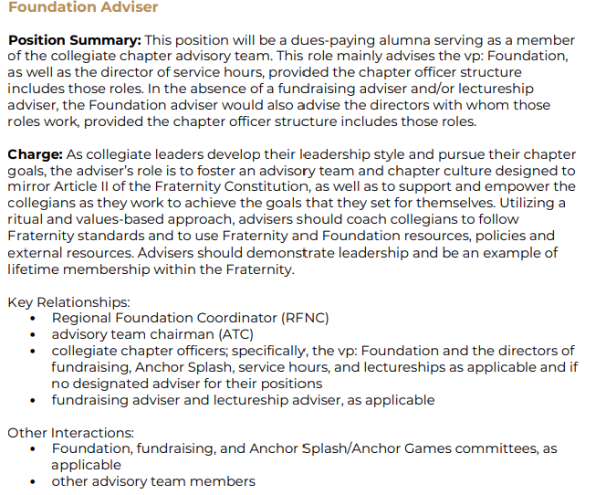
Notes:
(2 minutes)
Thank you for sharing in that brainstorming session. Many of the items we came up with together are also reflected in our official position summary. This is a screenshot of the Foundation Adviser responsibilities from the Adviser Position Descriptions Handbook that can be found in the DG Library.
This outlines the Foundation Adviser’s responsibilities to the chapter, key relationships and other important interactions they will have.

Slide 15
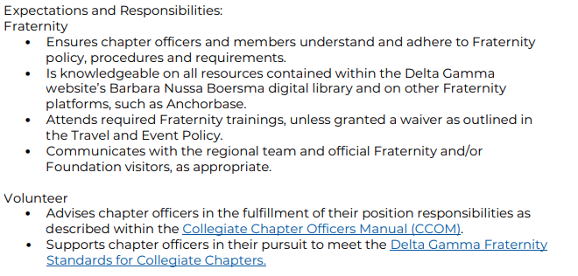
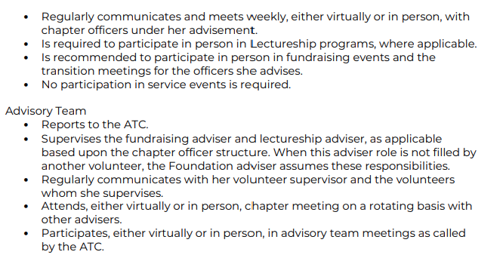
Notes:
(2 minutes)
Today we will discuss and dig deeper into different areas of your role and job description as a Foundation adviser. Other helpful resources are the Collegiate Chapter Officers Manual (CCOM) and the Fraternity Standards for Collegiate Chapters documents. These resources outline items that the vp: Foundation you support should work on during their term as an officer. Some of the bullets listed in the position description on the prior slide and here can seem vague – we are going to discuss deeper during our time together today.
Share links in chat:
CCOM: https://www.deltagamma.org/library/handbookguidemanual/collegiate-chapter-officers-manual-ccom/
Standards doc: https://www.deltagamma.org/library/handbookguidemanual/delta-gamma-fraternity-standards-for-collegiate-chapters-full-version/

Slide 16
Other Adviser Tips
Advisers should know how to…
Guide officers to avoid risk, minimize expenses and increase income for fundraisers
Help look for service opportunities
Help the vp: Foundation ensure chapter is educated on the Foundation all year and not just during recruitment prep
Notes:
(2 minutes)
Outside of the procedural tasks that Foundation advisers support as outlined in our position descriptions, here are some other areas advisers should be ready to support.
Review slide

Slide 17
COLLEGIATE FUNDRAISING
Notes:
(Brief Intro)
Let’s talk more about collegiate fundraising opportunities and things to be aware of so that you can best support the chapter you work with as an adviser.

Slide 18
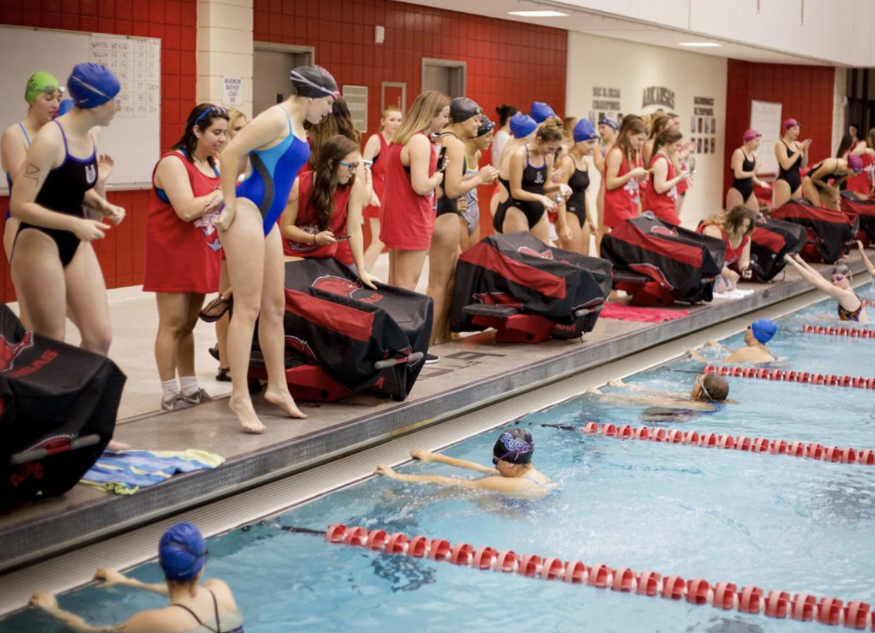
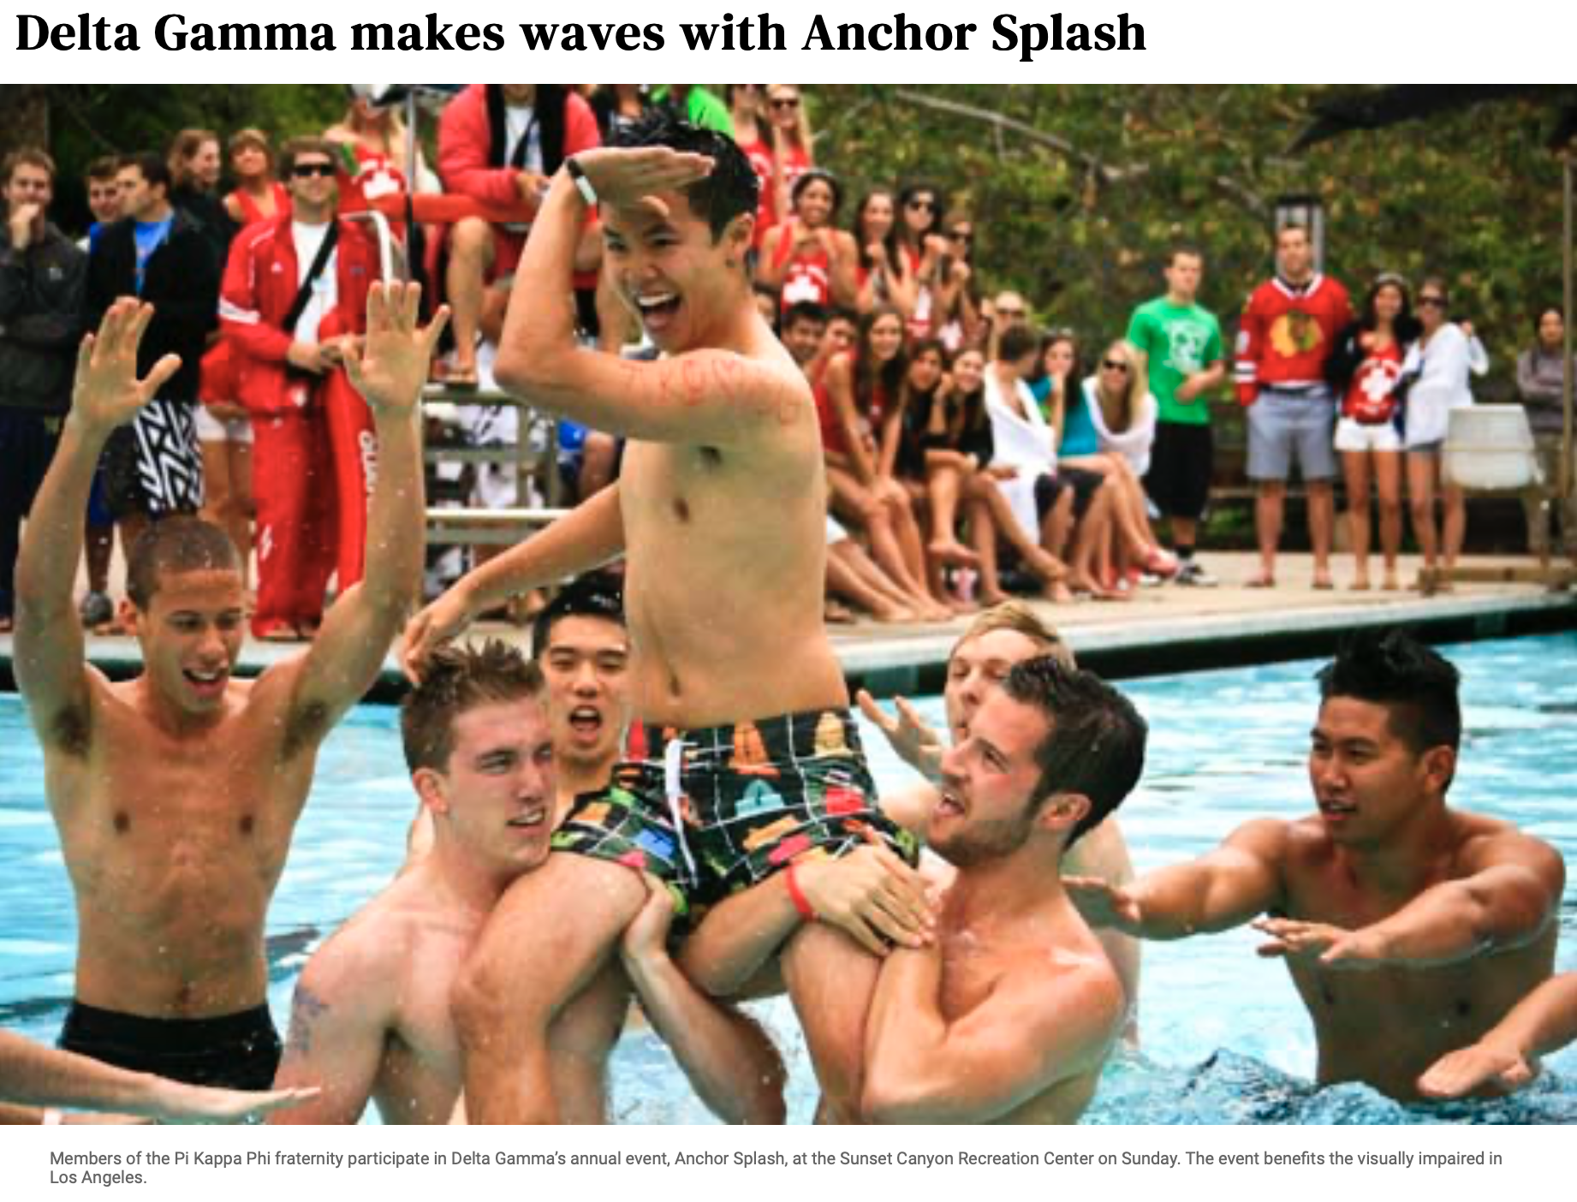
Collegiate Fundraising
Signature Fundraiser Event Examples
Anchor Splash
Anchor Bowl (football or bowling)
Anchor Slam (basketball or volleyball)
Anchor Dash (5k race)
Anchor Tee-Off (golf)
Notes:
(5 minutes)
Let’s begin by discussing signature fundraising events. The signature event is the primary event and is listed on the chapter's Anchorbase calendar accordingly. The signature event is what generates other Anchorbase tasks.
Review examples of signature fundraising events on the slide. Ask participant to share in chat or unmute themselves to share other examples of signature events they’ve seen or participated in.

Slide 19
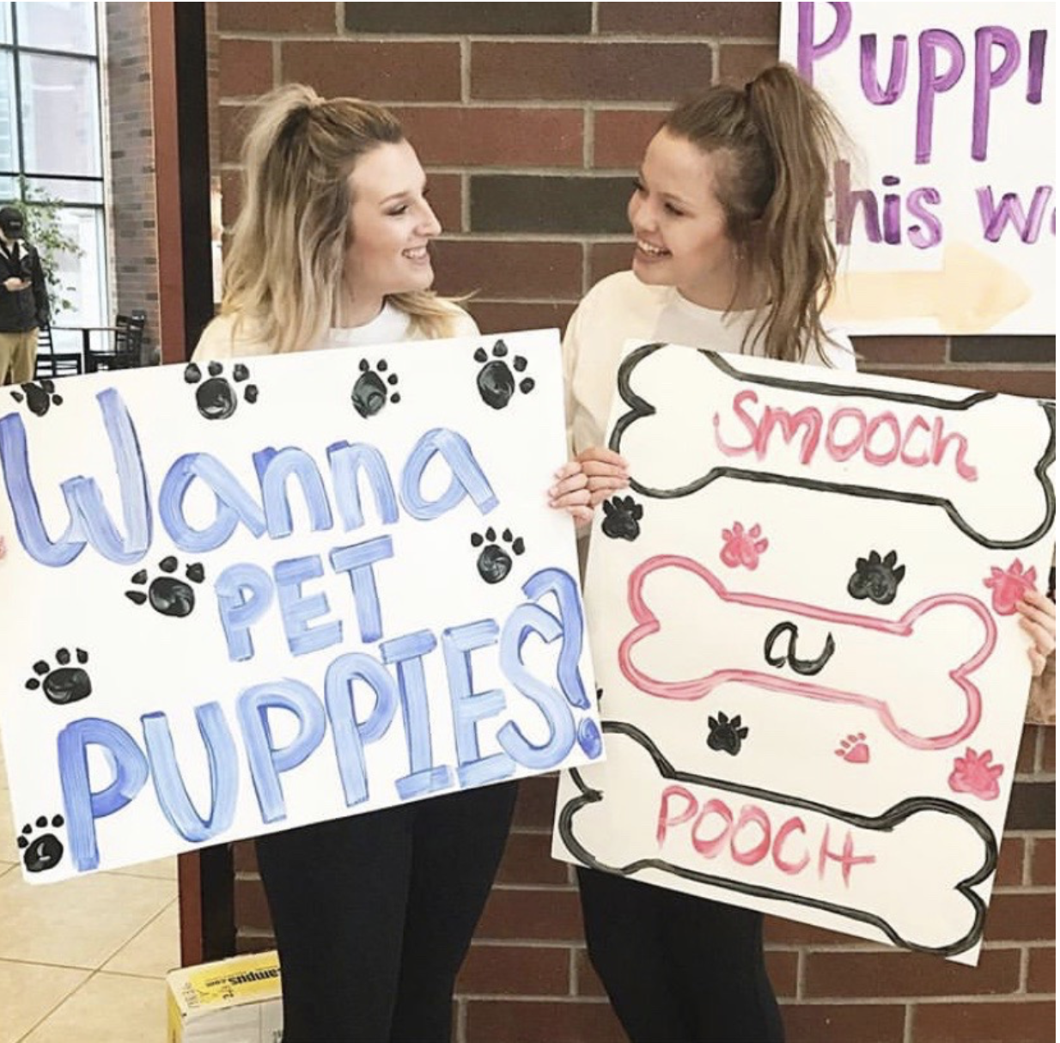
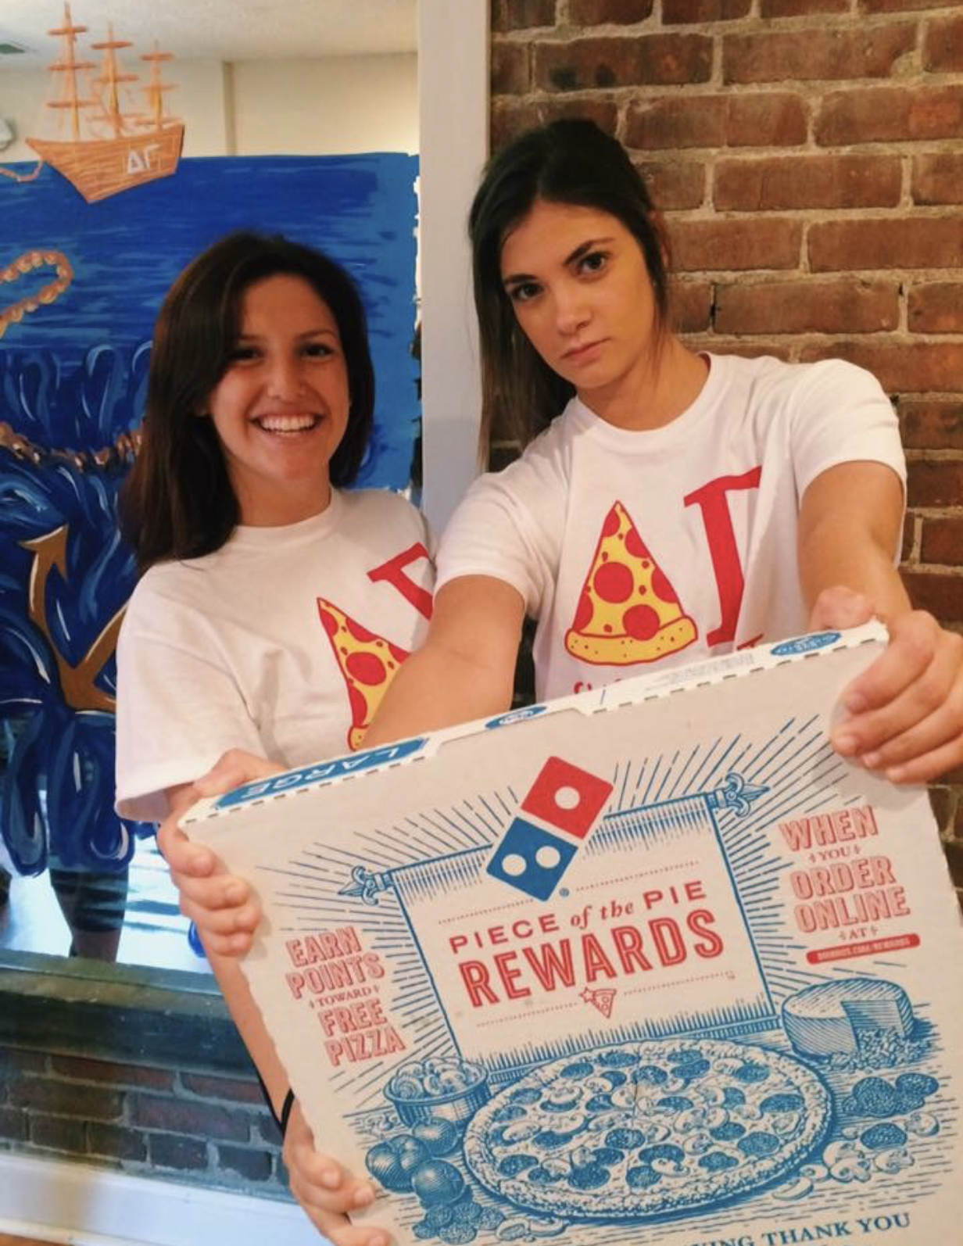

Additional Fundraising Event Examples
Donuts with DGs
Delta Gamburger
Desserts with DGs
Service for Slice/Slices for Sight
Puppies and Pizza
Hoops for Troops
Restaurant % nights
Note – No__ a DG (dunk/pie/splash, etc.)
Notes:
(5 minutes)
Events other than the chapter’s signature fundraising event are what we called “lead in events”. Lead-in events may occur prior to the main signature event – for example, if a chapter hosts a percentage night leading in for the main Anchor Splash event. Last year, the Foundation received over $40,000 from restaurant percentage nights – these work!
Read examples of other fundraising events on the slide. Ask for participants to share other successful or creative fundraising events they’ve seen before in the chat.

Slide 20
Fundraising Forms in Anchorbase
Pre-Planning Fundraising Event Form
  Due 6-weeks before the event
Event Guidelines for Events without Alcohol
  Due 4 weeks before event
Fundraising Finance Report Form
  Due 2 weeks after the event
  Collaboration with the finance team
Notes:
(5 minutes)
As we mentioned, there are Anchorbase tasks and forms associated with fundraising events. When a signature fundraising event is put on the chapter calendar, these Anchorbase tasks will automatically populate for the vp: Foundation to complete. The first two listed here should be completed before the event occurs. As adviser, discuss the pre-planning fundraising event form and the event guidelines form with the officer you work with early on in the planning process.
The last form listed here is to be completed after the fundraising events occur and is a collaboration with the finance team. This form summarizes the amount of money the event raised, the expense the event incurred, and the amount of funds to be sent to the Delta Gamma Foundation accordingly.
Allow time for questions on these forms. Can also pull up on Anchorbase and demonstrate where to find these forms.

Slide 21
Five Fundraising Tips for Advisers
Plan early!
Know updated terminology
Timeliness is key
Merchandise sale reimbursements are no longer permitted
Proper Venmo use
Notes:
(5 minutes)
We know there’s a lot to keep in mind when it comes to fundraising events for advisers. Here are the top 5 tips for you to takeaway:
Plan early! As we saw on the previous slide, there are tasks due on Anchorbase up to 6 weeks before the event. Be sure to communicate with the officer you advise early on in the planning process to ensure that you are on the same page and that the event can be successful.
Know updated terminology when it comes to fundraising events. For example, collegiate chapters are asked to use “Champion of the Anchor” in place of using “Anchorman” for any competitions associated with fundraising events.
Timeliness is key – there are due dates for Anchorbase tasks and deadline expectations for sending funds to the Foundation. Help ensure that the officer you work with stays on top of these deadlines.
If the chapter you work with sells merchandise as a part of their fundraising efforts – keep in mind that the Foundation will no longer be reimbursing for merchandise sales. This means that chapters should plan on setting up pre-paid order forms for any merchandise they wish to sell so that they can receive funds directly for those items.
Lastly, please ensure that as an adviser you are aware of proper use of Venmo for fundraising events. Individual chapters and events should NOT set up or use Venmo for fundraising events. Instead, the chapter should work with Mary-Michael from Executive Offices to use the Venmo integration tool associated with their Member Planet event.
Allow time for questions

Slide 22
COLLEGIATE SERVICE
Notes:
(Brief Intro)
We talked about the fundraising aspect of your role in supporting collegiate officers, let’s transition now to focus on the service and education aspect.

Slide 23
Types of Service Hours
Do Good Service for Sight
It will be strictly defined as supporting the community of persons who are blind or visually impaired, promoting sight conservation, or volunteering with organizations whose philanthropic mission is to support the community of persons with blindness or vision impairments or to prevent, treat, or advocate on blindness or vision impairments.
Do Good Non-Service for Sight
It will be defined as volunteering in support of any organization or cause to which the member feels connected.
Notes:
(2 minutes)
There are two types of Service Hours: Service for Sight hours and Non-Service for Sight hours.
Ask for volunteers to read the description of each type of service hours.
Great! Members are expected to complete a minimum of 8 Do Good Hours each year, and Service for Sight should be prioritized. It is the responsibility of the vp: Foundation to arrange service opportunities for chapter members and to help them explore and understand where they’d like to do good. Let’s dig in more about the Service for Sight hours in particular.

Slide 24
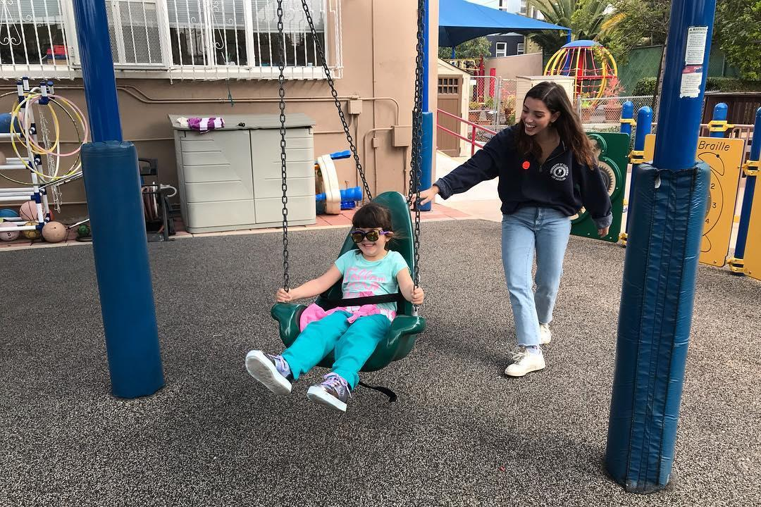
What are Do Good SFS Hours?
Three major categories to think about service:
Help someone with blindness or low vision
Help an organization support the blind community
Educate communities about Service for Sight, eye health, sight preservation, and the experiences of people living with blindness.
Notes:
(2 minutes)
When it comes to Service for Sight hours, there are 3 major categories of service opportunities that fall under this umbrella.
Review 3 categories on screen
As Foundation adviser, you can provide guidance in helping collegiate chapters identify new opportunities for members to fulfill Service for Sight hours. Let’s dig in more about what types of service fall into these categories.

Slide 25
Help Someone with Blindness or Low Vision
Serve as a sighted/human guide or assist students who are visually impaired
Host vision screenings
Assist persons who have impaired vision with daily living chores or read to them, talk to them and play games with them
Develop a supportive relationship with people at risk for visual impairments, such as the elderly living in a local retirement or assisted living facility
Install the Be My Eyes app and remotely assist people who are visually impaired
Teach others how to make their social media accessible by using best practices as recommended by AFB
Serve as guide runners and guides during 5Ks, marathons, and other outdoor activities with athletes who are blind or visually impaired
Babysit or sponsor a special occasion party for children who are blind or visually impaired
Notes:
(5 minutes)
This slide outlines service opportunities that fulfill the first SFS category – helping someone with blindness or low vision.
Review examples on the slide. Ask for volunteers to share any other service opportunity they have experienced that may also fit into this category

Slide 26
Help an Organization Supporting the Blind Community
Volunteer with guide dog organizations and help raise guide dog puppies
Volunteer at schools for children who are blind or visually impaired
Work with a local school for the blind to:
  Make “touch and feel” books, musical/beeping Easter eggs
  Host and facilitate a mock interview/resume-building program
  Hold a braille spelling bee
  Assist with computer technology sessions, reading to the blind, or support in other daily tasks
Recording textbooks/audiobooks with Learning Ally
Offer to help with administrative work or fundraisers for local agencies serving people who are blind or visually impaired
Make guide dog chew toys
Notes:
(5 minutes)
Next, are service opportunities that help an organization that supports the Blind community. While these service opportunities may be more indirect as they are not working directly with members of the blind community, these service hours help ensure that the organizations who complete this important work are able to be successful.
Review examples on the screen. Allow for participants to share any other examples in the chat.

Slide 27
Educate Communities about SFS
Participate at campus or community health fairs by setting up a “Facts About Eyes” booth. Distribute information about visual impairments
Assist the Lion’s Club with White Cane Safety Day vision screening
Distribute brochures or start a social media campaign for the many vision and eye health awareness months throughout the year
Allow people to write their name in braille using a slate and stylus or with muffin tins and tennis balls
Invite a guide dog organization to bring puppies to campus to make others aware of the process of training and placing a guide dog
Create a blind awareness social change campaign to demystify blindness and break down the barriers to inclusion.
Notes:
(5 minutes)
Last, but certainly not least – the third category are service experiences that allow us to educate communities about our service for sight mission.
Share examples on the screen and allow for other examples to be shared in the chat.

Slide 28
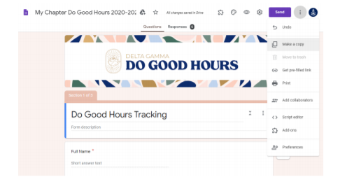
Service Tracking
Tracking of Individual Hours
Chapter members submit their hours through the chapter-specific Google form provided by the RFNC team
Form includes logic to help members identify if their hours are SFS or Non-SFS
Notes:
(3 minutes)
Our collegiate members are completing important and engaging service hours – now what?! Individual members should use the chapter-specific Google Form received from the to track their individual hours. A helpful tip is to create a QR code for this Google form so it is easy for chapter members to log their hours individual throughout the semester.
Fac Note: Share link to video in chat: https://youtu.be/mdtNwYyFRWs
Here is a video you can use to understand the administration of the Google Tracking form and how to pull the spreadsheet to upload to the Anchorbase task.
You can find more information about this Google Form and the Anchorbase task in the Foundation Focus handbook.

Slide 29
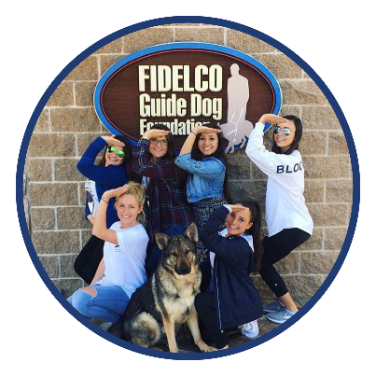
Chapter Service Hour Submission
Submission in Anchorbase
Chapter must report their service hours 5 times per year in Anchorbase:
  Oct 15, Dec 15, Feb 15, April 15 & last day of classes
Notes:
(2 minutes)
The vp: Foundation is responsible to make sure the Do Good Hours are tracked for the chapter and submit them via an Anchorbase task 5 times per year. If the chapter has a Director of Service Hours, the Anchorbase and google form tasks are good collaboration points.

Slide 30
Multipurpose Programming & Fundraisers
Host a service event for all campus participants as a “lead-in event”
Share details about Service for Sight and Do Good hours during fundraising events
Host a chapter-wide service project as a sisterhood event
Notes:
(2 minutes)
When you discuss service and education opportunities with the officers you work with, another helpful item to guide them to consider is multi-purpose programming. How can we integrate service or education into the programming we already have planned? This slide outlines 3 opportunities to do this.
Review slide.

Slide 31
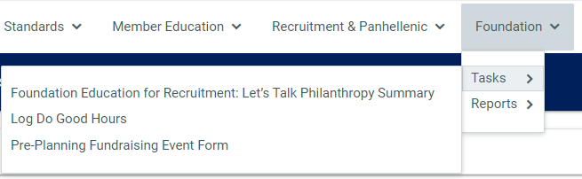
Service Anchorbase Tasks
Log Do Good Hours
  Five times per year
Foundation Education for Recruitment: Let’s Talk About Philanthropy Summary
  Affirms presentation was held and collects optional feedback
Notes:
(2 minutes)
We discussed the service hour log task in Anchorbase, but there is one additional Anchorbase task to be aware of related to service and education. The vp: Foundation is responsible for completing the Foundation Education for Recruitment: Let’s Talk About Philanthropy Summary. This task records that the chapter held this presentation during recruitment preparation and allows for the chapter to input any other feedback or comments.

Slide 32
Collegiate Service Accountability
Prioritizing points for Community Service in BLSR
Increasing Housing points for above certain number Do Good- SFS hours
Consideration for future positions
Fines
A Certain number of SFS hours to attend events (1 SFS before each date night/party, 3 SFS hours by fall semi-formal, etc.)
SOR if not met chapter minimum service hours
Notes:
(3 minutes)
Chapter officers may ask for advice and tips on what we can do to hold members accountable in completing their 8 required Do Good hours. This slide outlines opportunities for ways to hold members accountable – some of these examples could be helpful recommendations when chapters are reviewing their Bylaws & Standing Rules
Review slide. Ask participants to share other ways they have seen chapters incentivize or hold members accountable for completing their service hours.

Slide 33
Service for Sight Dates to Remember
January: National Glaucoma Awareness Month
February: AMD/Low Vision Awareness Month
April: Women’s Eye Health & Safety Month
August: Children’s Eye Health & Safety Month
September 4-10: Do Good Week
October 13: World Sight Day
October 15: White Cane Safety Day
November: Diabetes-related Eye Disease Month
Notes:
(2 minutes)
This slide outlines some helpful Service for Sight dates to remember. Foundation education and awareness efforts can be connected to these dates to help educate the chapter or community on our service for sight mission.
Review slide

Slide 34
Three Service/Education Tips for Advisers
Discuss service opportunities that are offered each semester
Encourage connection to Service for Sight organizations in the community
Ensure service hours are submitted by the deadlines throughout the semester
Notes:
(3 minutes)
Here are the top 3 takeaways to consider as an adviser when it comes from service and education:
Revisit service opportunities each semester – as the officer you work with what plans are for the service opportunities to be offered to the chapter. Encourage the officer to consider multi-purpose programming opportunities here too!
Assist the officer in brainstorming ways the chapter can engage in service opportunities and/or support organizations in the community that are related to service for sight.
Lastly, ensure that the chapter officers you work with have a plan for collecting service hours from individual members and complete all Anchorbase submission tasks in a timely manner.

Slide 35
Foundation Team Contacts
Regional Foundation Coordinators (RFNC)
R1: Alex Furr (RFNC1@deltagamma.org)
R2: Christine Rocchio (RFNC2@deltagamma.org)
R3: Jordan Crawford (RFNC3@deltagamma.org)
R4: Staci Rudge Skoog (RFNC4@deltagamma.org)
R5: Rachel Hamil (RFNC5@deltagamma.org)
R6: Teena Tabor (RFNC6@deltagamma.org)
R7: Staige Davis Hodges (RFNC7@deltagamma.org)
R8: Jen Grantham (RFNC8@deltagamma.org)
Notes:
(2 minutes)
You are the best resource for the vp: Foundation at the chapter you support. The next closest resource for you is the Regional Foundation Coordinator or RFNC. There is one RFNC per region – this slide lists the names of the coordinator in each region and their email address. These are knowledgeable and helpful resources to you and the vp: Foundation you serve.
Allow participants time to review slide and share an example of a way that RFNCs support collegiate chapters or advisers.

Slide 36
Foundation Team Contacts
Director: Collegiate Service
Kierstan Knaus Dufour (collservice@deltagamma.org)
Director: Special Events & Collegiate Fundraising
Morgan Youngs (fundraising@deltagamma.org)
Senior Chapter Fundraising Finance Specialist
Mary-Michael McClure (mary-Michael.mcclure@deltagamma.org)
Notes:
(2 minutes)
In addition to the RFNC team, this slide shares 3 other important resources available to you. Kierstan and Morgan are Foundation directors that specialize in areas related to collegiate Foundation operations. Kierstan oversees collegiate service and Morgan oversees collegiate fundraising.
Mary-Michael McClure is an EO Staff member and is the chapter’s direct contact for all questions related to fundraising.
You may be cc’d on emails that come from the RFNC team, Foundation Directors or EO Staff. Your help in ensuring that collegiate officers respond and/or complete tasks referenced in these emails is greatly appreciated!

Slide 37
Recognition & Awards
Individual
Collegiate Giving Society – temporarily on hold
Chapter
Regional Foundation Award for Collegiate Chapters, Excellence in Philanthropy: Service (Determined by RFNC)
Regional Foundation Award for Collegiate Chapters, Excellence in Philanthropy: Fundraising (Determined by RFNC)
Top 10 (Determined by Director: Collegiate Service, Top average service hours per member)
H.K. Stuart Spirit of Service Award – biennial (Application based – determined by committee)
Notes:
(2 minutes)
Collegians and collegiate chapters are able to receive recognition and awards related to their efforts in Foundation service and fundraising. These recognition opportunities include:
Review slide

Slide 38
Brainstorming
What strategies could you use to help keep collegiate officers on track in planning fundraising events?
How can we help collegiate members understand the impact of their service hours?
How might you encourage a chapter to use multi-purpose programming to infuse Foundation education?
Notes:
(12 minutes)
We are going to do some brainstorming and discussion in breakout rooms to close our time together today. We’ll send you to breakout rooms 3 times – in each breakout, you’ll have an opportunity to discuss each of the questions on the screen. You’ll have 3 minutes to chat in the breakout before we come back together and send you to a new breakout room to discuss the next question with a new partner/group.
Send participants to random breakout rooms with 2-3 participants each for 3 minutes. When the time is up, close breakout rooms and bring participants back to main room before re-opening breakout rooms with new partners to discuss the next question. When this has been done 3 times, bring attendees back to main room and ask for volunteers to share any takeaways.

Slide 39
QUESTIONS?
Notes:
Use remaining time to answer any questions that the group may have.

