Slide 1
COMMUNICATIONS ADVISER
Notes:
(Session time: 2 Hours)
Facilitation Key:
Total Time: XX | Marks the amount of time the section/slide should take to complete.
Fac Note | Highlights special instructions for you as the facilitator.
Italics | Marks statements or questions that you should say out loud.
Plain Text | Indicates instructions for you.
Begin by welcoming everyone to the communications adviser track and introducing yourself and your role in Delta Gamma.

Slide 2
Introductions
Name
Chapter of Initiation
Chapter you advise
Your Why
Something you are excited about for today’s training
Notes:
(7 minutes)
We are going to start with introductions before we dive-in to position responsibilities. Let’s have each person share their name, chapter of initiation and the chapter you advise, tell us why you choose to be an adviser and one thing that you are looking forward to this year.
Let each adviser introduce themselves. This can be done by asking each participant to unmute themselves or by asking each participant to type their introduction into the chat box. If there are more than 15 participants, the chat box is recommended.
After everyone has introduced themselves, begin the training by showing this video. Ensure you have selected “share computer audio” when you screen share!
https://vimeo.com/430502244
After the video, mention: Our collegiate chapters play a vital role in telling the Delta Gamma story, as represented in our new brand. As the communications adviser, you serve as a guide and encourager in ensuring this is done in an intentional way. Today, we are going to talk about many specific responsibilities of the communications team which all contributes to being a brand ambassador.

Slide 3
Agenda
Communications Team
Collegiate Officer Responsibilities
  Meeting minutes
  Attendance
  BLSR
  Roster
Branding Guidelines
DG Style
Website & Social Media Review
Notes:
1 minute
Here’s a snapshot of what we will discuss today. A recording of today’s training and the PowerPoint slides used will be available afterwards. We will have time at the end for questions, but please feel free to ask questions as we go in the chat. We also encourage you to answer each other’s questions or provide ideas throughout our training today.
Review slide.

Slide 4
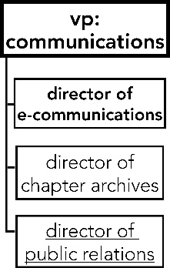
Communications Team
Who else could be seen as members of the communications team?
Notes:
(3 minutes)
As vp: communications, you work with a team to care for the brand of the chapter, both internally and externally. You may oversee and lead up to 3 different directors depending on your chapter size, all shown in this image. No matter your chapter size, you should have a director of e-communications. Today, we are going to talk about responsibilities of each of these directors, but please know that it is up to you to delegate these responsibilities and to encourage your directors to fulfill them, rather than do them yourself!
Before we dive in, considering that the communications team involves the work of e-communications, archiving chapter history and the big topic of public relations, who else can be seen as a member of the team looking out for the brand of the chapter?
Ask for ideas either via unmuting or the chat box.
Answer: all members! It is important for the communications team to educate the chapter on the topics we talk about at RTD. Similarly, the vp: communications should be partner in telling the story of the work of all CMT officers.

Slide 5
COLLEGIATE OFFICER
RESPONSIBILITIES
Notes:
(Brief Intro)

Slide 6
Chapter Minutes and Attendance
Taking Effective Minutes
Effective minutes should give someone who was not in attendance a snapshot of the meeting and cover the important takeaways from the business conducted.
Notes:
(2 minutes)
The first vp: communications responsibility we will discuss today is their role in taking meeting minutes. This may be a task that gets overlooked, but ultimately is important both in keeping record of events occurred and used for other important business operations.
Share link in chat: https://www.deltagamma.org/library/ttdtdm/guidelines-for-taking-effective-minutes
There is a resource in the DG Library that I have shared in the chat that is a great document to review with the officer you work with. This is the Guidelines for Taking Effective Minutes resource.
Effective minutes should give someone who was not in attendance a snapshot of the meeting and cover the important takeaways from the business conducted. We will now take a few minutes to go over the guidelines for taking effective minutes and review scenarios.

Slide 7
Chapter Minutes and Attendance
Taking Effective Minutes: Motions
Use a bullet point to show the motion
Write the name of the person that makes the motion (no need for second’s name)
Record whether the motion passed or failed
Do not record the amount by which it passed or failed
Notes:
(2 minutes)
A key element in ensuring your minutes are complete is accurately recording motions that are made during your meetings. On the PowerPoint slide, and in the Guidelines for Taking Effective Minutes document you will find information on how to accurately record motions.
Review items on the slide.
During the next few minutes we will be reviewing how to record motions and key votes.

Slide 8
Chapter Minutes and Attendance
Identify the errors in the following motion:
Motion to approve the approve the Bylaws and Standing Rules as presented. Motion failed.
Jane doe moved to approve the Bylaws and Standing Rules as presented. Motion failed.
Notes:
(2 minutes)
Fac. Note: The corrected motion will appear when you click.
Read the incorrect motion record from the PowerPoint slide: Motion to approve the approve the Bylaws and Standing Rules as presented. Motion failed.
Ask for a volunteer to identify what should be changed in the original version in order for it to be accurate. Once a volunteer has identified the mistake, click ‘enter’ for the correct version to appear on the slide.
If not mentioned, sharing the following: When a motion is made, the name of the person making the motion should be recorded in the minutes.

Slide 9
Chapter Minutes and Attendance
Identify the errors in the following motion:
Jane Doe moved to approve the Bylaws and Standing Rules as presented. Motion passed with a 75-15 vote.
Jane doe moved to approve the Bylaws and Standing Rules as presented. Motion passed. With a 75-15 vote.
Notes:
(2 minutes)
Fac. Note: The corrected motion will appear when you click ‘enter’.
Read the incorrect motion record from the PowerPoint slide: Jane Doe moved to approved the Bylaws and Standing Rules as presented. Motion passed with a 75-15 vote.
Ask participants to identify the error. Ask for a volunteer to identify what should be changed in the original version in order for it to be accurate. Once a volunteer has identified the mistake, click ‘enter’ for the correct version to appear on the slide.
If not mentioned, sharing the following: When a motion is recorded, the amount by which it passed or failed should not be included.

Slide 10
Chapter Minutes and Attendance
Taking Effective Minutes: Chapter Votes
Example: Jane Doe moved to spend $100 from accumulated surplus on adviser appreciate gifts. Motion passed.
Example: Jane Doe moved to charge each member of the chapter $15 to cover the loss of income due to quota being 10 less than budgeted. Motion passed.
Notes:
(2 minutes)
Let participants know that when it comes to financial votes, the vp: communications must record votes to move funds and assess new charges in the minutes or funds cannot be moved or assessed. Remind participants that as with all other motions, the minutes must indicate whether the motion passed or failed and must not include the amount by which it passed or failed.
Direct participants to review the examples on the PowerPoint slide and in the guidelines for taking effective minutes handout.

Slide 11
Chapter Minutes and Attendance
Taking Effective Minutes
The best time to review, edit, and tidy minutes is directly after the meeting has occurred. Take five to ten minutes to review the notes while they’re fresh.
Ensure that details are minimal, remove any discussion or debate, and focus on actions assigned and the decisions made.
Be sure you are only including the facts and removing any opinion.
Notes:
(1 minute)
Reiterate the following points from the PowerPoint slide:
The best time to review, edit and tidy minutes is directly after the meeting has occurred. Take five or ten minutes to review the notes while they’re still fresh.
Ensure that details are minimal, remove any discussion or debate, and focus on actions assigned and decisions made.
Be sure you are only including the facts and removing any opinion.
Please note that chapters DO NOT need to submit their minutes weekly, but DO need to keep them locally.

Slide 12
Attendance Accountability
Update: APNs are no longer issued for attendance.
New: Two unexcused absences initiates an SOR filed by the vp: communications
Notes:
(2 minutes)
The last component of effective minute taking is taking attendance. The vp: communications should be taking attendance at all chapter meetings.
There is an element of accountability here – however some of these attendance policies have changed. APNs are no longer issued for attendance purposes. Instead, a member will receive an SOR after they have two unexcused absences. The vp: communications will work with vp: social standards to file this SOR.

Slide 13
BYLAWS & STANDING RULES (BLSR)
Notes:
(Brief Intro)
Next up: Bylaws & Standing Rules! We will now take a few minutes to review the Bylaws & Standing Rules (BLSR) process.

Slide 14
Bylaws & Standing Rules (BLSR)
Model BLSR sent out in the spring by Director: Chapter Operations.
The vp: communications works with CMT to collect changes and update the model to reflect the changes.
This is submitted to the RCS/CAC/NCC via Anchorbase, she reviews it along with other regional team members.
Notes:
(2 minutes)
Explain that the model BLSR will be sent out to all vps: communications and presidents in the spring by the Fraternity Director: Chapter Operations via the collegiate officer newsletters. After the new model is received, the vp: communications works with CMT to collect changes. Share that as vp: communications, they should be the officer filling out the model document based on the past BLSR, and including the changes that CMT/the chapter want to implement. The vp: communications drives the process. The only places where the chapter can change the BLSR is where there is a blank.
The communications adviser and ATC should work together to support the chapter officers in this process. As advisers, we should encourage and guide officers to think of the BLSR beyond a set of rules. How can we make updates to the document that accommodate and improve chapter operations? In addition, perhaps some of the material in your BLSR is outdated; BLSR revision is the perfect time to figure out what is working for the chapter and what is not. In short, you want to make sure your BLSR help the chapter, not hinder.
Let participants know that after changes have been made, the updated BLSR should be submitted to their RCS/CAC/NCC via Anchorbase task, which you will review in a moment. The RCS/CAC/NCC will be responsible for informing you of the due date they have chosen. After your RCS/CAC/NCC receives your updated BLSR, she, along with other regional team members will review it.

Slide 15
Bylaws & Standing Rules (BLSR)
Once RCS/CAC/NCC provides feedback and approves all changes one week before the chapter vote.
Chapter votes on BLSR. If chapter does not approve, revision process is repeated.
The vp: communications notifies RCS/CAC/NCC if BLSR have passed or if additional changes need to be made.
Notes:
(2 minutes)
Share that after the RCS/CAC/NCC provides feedback (inside of the task where they upload the BLSR on Anchorbase) and approves all changes. Chapters no longer have to present the BLSR changes in chapter meeting. Instead they can disseminate the BLSR Proposed Changes Template one week prior to the vote.
Share the following points about the chapter vote:
Vote must be 2/3 in the affirmative. If the chapter does not vote 2/3 in the affirmative, the revision process is repeated.
Chapter must have one week to review the BLSR before taking a chapter vote. It is important to send the chapter the BLSR one week prior to the vote.
The BLSR must be approved and voted on BEFORE the chapter leaves for the summer.
Chapter president and vp: communications should educate the chapter on the changes before the chapter votes.
Remind participants that the chapter vote must be recorded in the chapter minutes the day the vote took place.

Slide 16
Bylaws & Standing Rules (BLSR)
The approved BLSR should be submitted on and uploaded to greekbill.
Members are required to log into greekbill and e-sign the BLSR.
Notes:
(1 minute)
Once the BLSR are approved by the RCS/CAC/NCC and by chapter vote, the vp: communications should submit it via Anchorbase task. Let participants know that we will review this process next.
The BLSR should then be uploaded to greekbill as well. After this step is completed all chapter members are required to log into greekbill and e-sign the BLSR. The vp: finance can assist with uploading to greekbill.

Slide 17
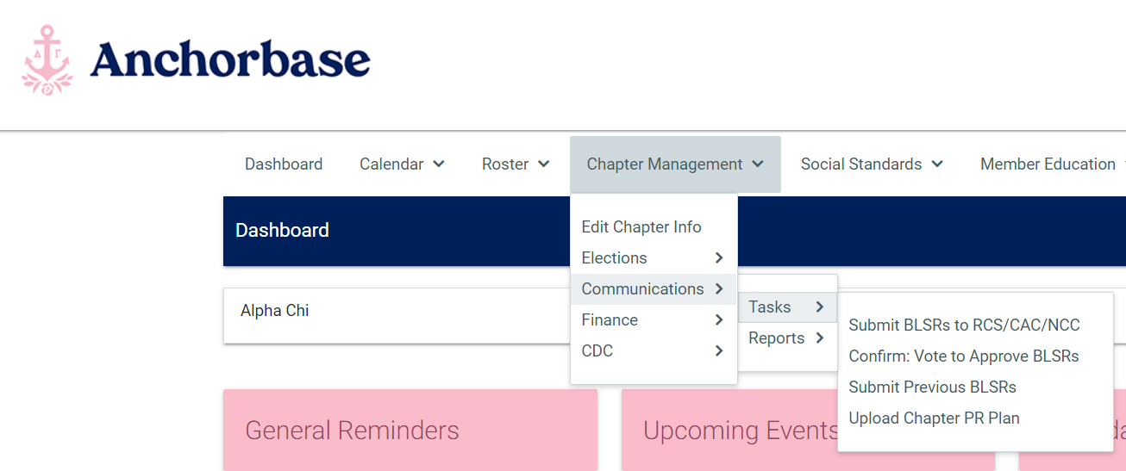
Bylaws & Standing Rules (BLSR)
Notes:
(1 minute)
On Anchorbase, you can see here that there are a few tasks related to the BLSR. You will use the first one “Submit BLSR to RCS/CAC/NCC” to submit them to your regional team for approval. Once they are approved, you will then confirm the vote taken with the chapter to get their approval on the BLSR. This task asks for a report of the outcome of your vote.
If your RCS/NCC/CAC feels that changes need to be made to your BLSR, she can deny your submission and ask you to make those changes. When the officer has a new revised version of the BLSR, they will upload that new version to Anchorbase within the same task.

Slide 18
ROSTER CHANGES
Notes:
(Brief intro)
Next up is roster changes. The vp: communications is responsible for ensuring the chapter roster is up-to-date and accurate. We are going to discuss a variety of roster changes and the process of adding or removing members to the roster.

Slide 19
Roster Changes
vp: social standards
Resignation of Membership
Expulsion
Early Alumnae Status
Excused Status
vp: communications
Member Transfer
  Outgoing
  Incoming
5th Year Alumnae Status
Graduate
Delta Gamma Library: “How to Update your Anchorbase Roster”
Note: Removal from Roster Process
Notes:
(5 minutes)
Fac Note: Share link in the chat: https://www.deltagamma.org/library/handbookguidemanual/anchorbase-how-to-update-your-roster/
A chapter’s Anchorbase roster is their official roster. Therefore, it is, like all other things we talked about today, very important that your Anchorbase roster is up to date. There are several roster change processes and they are overseen by either the vp: social standards or the vp: communications. I’ve shared a resource in the chat that is a one stop shop on all aspects of updating the Anchorbase roster.
Please also note the removal from roster process. It is to be used when members are absent from the chapter for at least one academic term and the chapter officers have been unsuccessful in contacting the member after repeated attempts. When submitting the roster change, officers have to verify that they have made multiple attempts to contact the member, state whether she is in good financial standing, and state if she has pending Honor Board action. This roster change is approved by both the ATC and the collegiate development specialist (CDS) at Executive Offices. This should only be used as a last resort to remove a woman off the chapter roster.
Next, we are going to review a few roster scenarios that may come up. These can be confusing at times, so the officer you work with may reach out for guidance on how to handle varying situations. Let’s practice!

Slide 20
Roster Changes: Scenario 1
It is February 2023. Emily is an initiate of Alpha Alpha and is transferring to Fake university in August 2023. She would like to become an alumna member now.
What options are available to Emily?
  She can become an alumna member now.
  She can resign her membership.
  She can join another sorority at Fake University.
  She can remain a collegiate member and become an alumnae member when the spring 2022 term ends.
Notes:
(2 minute)
Read each scenario and answer choices. Then reread each answer choice and ask each person to put the letter of the correct answer into the chat box.
Share that the correct answer is that she can be a collegiate member through the spring and obtain alumnae status when she actually transfers at the end of the semester.

Slide 21
Roster Changes: Scenario 2
Aria was initiated into Delta Gamma in the Fall of 2021. Fall of 2022 will be her 9th term in college. She will be student teaching this term at a high school that is 2 hours away, and doesn’t have time to participate in Delta Gamma activities.
What is the best option for Aria?
  She can request Excused Status from Honor Board and ATC
  The ATC can grant her 5th year Alumna Status.
  She can remain a collegiate member, and be fined for the activities she misses, if she is not excused.
  She can resign her membership.
Notes:
1 minute
Read each scenario and answer choices. Then reread each answer choice and ask each person to put the letter of the correct answer into the chat box.
The correct answer is she can apply for Excused Status. She cannot have 5th Year Alumnae status because she has only be active in the chapter for a year.

Slide 22
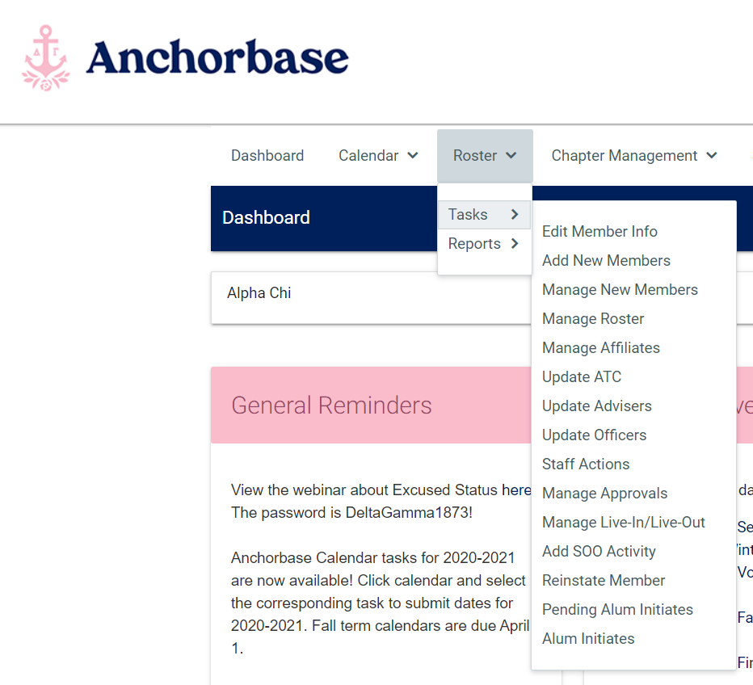
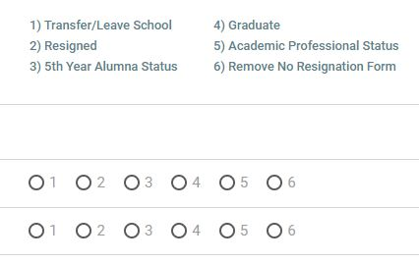
Roster Changes: Anchorbase
Notes:
(1 minute)
Here are a couple of screen shots of the Manage Roster task in Anchorbase. This task can be found under the Roster tab. When you click into it, a screen will appear with a listing of your chapter’s current roster. The screen shot on the right shows what changes you can make from this screen. You can see that possible status changes are here, and you will have the option to select one of these changes for any member in the chapter.

Slide 23
DELTA GAMMA STYLE GUIDE
Notes:
(2 minute)
Now that we have covered the operational tasks associated with the communications team – let’s move into our next portion of today’s training. For the remainder of our time today, we will be discussing the critical role communications advisers and collegiate communications advisers have in telling Delta Gamma’s story.
Just as APA or MLA writing and citation styles exist, Delta Gamma has its own Style Guide. The Delta Gamma Style Guide dictates what phrases we use and how we compose our communications. For example, whenever we write out the title of our magazine, the ANCHORA, it is in all caps and italicized, if possible. Let participants know that we will spend the next few minutes practicing Delta Gamma style. Indicate that it is important for the to be aware of DG style since you and your team are responsible for all communications coming from the chapter.
Fac. Note: Let them know that it can be found in the Delta Gamma Library. Can share link in the chat: https://www.deltagamma.org/library/handbookguidemanual/dg-style-guide/

Slide 24
Delta Gamma Style
Identify the errors in the following sentence:
Since Sally is the VP Finance she budgets for alcoholic events.
Because Sally is the vp: finance, she budgets for events with alcohol.
Notes:
(2 minutes)
Share that for the next few minutes participants will practice writing in Delta Gamma style. Give everyone 1 minute to identify the errors in the sentence on the slide.
Once 1 minute has passed ask how they believe the sentence should be worded.
Fac Note: The correct answer will appear when you click “enter”.
If not mentioned, share the following points:
Because vs. Since: Use “because” to show cause and effect. “Since” can also who a cause-and-effect relationship, but the effect doesn’t necessary have to follow the cause.
Collegiate officers: Lowercase, with two exceptions: “vice president: Foundation, “ “vice president: Panhellenic.” Vice president may also be abbreviated “vp:” A colon always follows vice president or vp.
Events with alcohol, not alcoholic events.

Slide 25
Delta Gamma Style
Identify the errors in the following sentence:
The Omega Omega—Test State University chapter has too many actives on their phone during chapter.
Omega Omega-Test State has too many collegians on their phones during chapter meeting.
Notes:
(2 minutes)
Once again, give 1 minute to identify the errors in the sentence on the slide.
Once 1 minute has passed ask how they believe the sentence should be worded.
Fac Note: The correct answer will appear when you click “enter”.
If not mentioned, share the following points:
Omega Omega-Test State
When writing chapter names, we do not have spaces before or after the hyphen. We also have a shortened, standard way of writing each chapter name. You can find how your chapter name should be written by looking in the back of the Style Guide.
Collegian; collegiate:
Collegian- refers to a member in college. Never “collegiate” or “actives” as we hope all members are active.
Collegiate- an adjective but never a noun.

Slide 26
Delta Gamma Style
Identify the errors in the following sentence:
The advisor blames all communications mess ups on the vp panhellenic.
The adviser and vp: Panhellenic disagree on best communication methods.
Notes:
(2 minutes)
For the last time, give 1 minute to identify the errors in the sentence on the slide.
Once 1 minute has passed ask how they believe the sentence should be worded.
Fac Note: The correct answer will appear when you click “enter”.
If not mentioned, share the following points:
Delta Gamma spells adviser with an “e” as opposed to an “o”. Can you advisor with an “o” when referring to your Fraternity/Sorority Advisor.
Panhellenic: Capitalized when referring to a specific group or office title.
Phrasing should be kept neutral and professional.

Slide 27
Delta Gamma Style
Acronyms the Delta Gamma Way
RD
RCS
RCRS
RAS
RFS
RHS
EO
CDS
RFNC
FSA
FHC
BOA
BOT
CDC
Nom Com
NPC
NCC
CAC
Notes:
(3 minutes)
Share that Delta Gamma uses acronyms frequently, and on the slide participants will see a listing of acronyms that are most commonly used.
Let participants know that they will have two (2) minutes to test their knowledge on what these acronyms mean. Ask participants to write down as many as they can think of once the time starts.
Once a minute has elapsed, advance to the next screen to share the meanings of the acronyms.

Slide 28
Delta Gamma Style
Acronyms the Delta Gamma Way
RD: Regional Director
RCS: Regional Collegiate Specialist
RCRS: Regional Collegiate Recruitment Specialist
RAS: Regional Alumnae Specialist
RFS: Regional Finance Specialist
RHS: Regional Housing Specialist
EO: Executive Offices
CDS: Collegiate Development Specialist
RFNC: Regional Foundation Coordinator
FSA: Fraternity/Sorority Advisor
FHC: Fraternity House Corporation
BOT: Board of Trustees
CDC: Collegiate Development Consultant
Nom Com: Nominating Committee
NPC: National Panhellenic Conference
NCC: New Chapter Coordinator
CAC: Council Appointed Coordinator
Notes:
(2 minutes)
Read through the acronyms on the slide and ask participants to look at their list to see how many they were able to identify.
Ask: By a show of hands, was anyone able to identify the meaning of all 16 acronyms? How about 12 or more? 10 or more?
Share that the meanings of all Delta Gamma acronyms can be found in the Guide to Abbreviations document in the DG Library. Share this link in the chat: https://www.deltagamma.org/library/handbookGuideManual/delta-gamma-guide-to-abbreviations

Slide 29
DELTA GAMMA BRAND
Notes:
(3 minutes)
As you likely know, Delta Gamma recently launched a new brand! For our collegiate officers, this brand may be all they know about Delta Gamma – which is great! We are going to spend some time talking about our brand, the brand of the chapter you work with and your role as a brand ambassador.
Say: Can someone please share what they believe a brand to be?
If not mentioned, share the following points:
A brand is both physical and emotional.
Unique qualities that identify a product and differentiates it from its competitors.
Share that a brand is not simply a logo, tagline, colors, popping the gamma or a theme (like nautical).
Then, ask for a volunteer or two to share what they perceive to be popular brands (Disney, Starbucks, Apple, etc.) and what they believe makes these brands successful.
Listen for the following:
They know, and understand, their target audience.
Driven by passion.
Consistency.
Reach audience through multiple channels.
Strong leadership.

Slide 30
Let’s play a game!
Using real-life examples
Let’s use what we’ve learned today to make arguments on what is on brand and off brand on the next few slides
Jot down your answers
20 seconds per slide
A few will be asked to share reasoning
Notes:
(1 minute)
Review the slide which gives instructions to follow for the next 5 slides.
Share this statement: These examples will reference aspects of Delta Gamma brand guidelines. Be sure to have the Brand Guidelines doc downloaded from the DG Library to reference throughout your time as an officer: https://s3.amazonaws.com/dg-library/Delta-Gamma_Abbreviated-Brand-Guidelines_2020-Update.pdf (drop link in the chat)

Slide 31

A. Postcards
Notes:
1 is correct branding
The reason option 1 is correct is that the colors used match those in our brand guidelines (DG Navy) and the message is clear/readable. Option 2 uses a color that is not part of our DG brand and the yellow text is challenging to read on the orange background.

Slide 32

b. Email Signatures
1.
2.
Jayme Detweiler Crowell
Alpha Pi-Arizona
ANCHORA Editor
jayme@deltagamma.org
330-286-3279
Notes:
1 is correct branding
The reason is that the correct fonts are used, the name of the individual is bolded and the brandmark size isn’t overwhelming or drawing attention away from the key information.
A perk of serving in a Delta Gamma volunteer role or chapter officer position is that it provides you with real-world experience. We are now going to cover email signatures, and how to create one that is professional, detailed, and practical. When you email your regional team or Executive Offices, the people you’re emailing want to know who you are. Encouraging chapter officers to do the same can ensure that their detailed email signature helps them to be identified by their position and chapter.
Using the example on the screen, ask participants to write their own email signature and save it to their email.
Once participants have been given time to write their own email signature, ask them to write one for the collegiate officer they work with or for another adviser on their advisory team. Share that seeing signatures may encourage other chapter members/advisers to write email signatures of their own. They could take this activity to their next meeting.
Lastly, share that adhering to Delta Gamma style, and ensuring chapter members are using correct terminology is a component of meeting the Delta Gamma Fraternity standards for collegiate chapters.

Slide 33

c. Handouts
1.
Tips to use GreekBill
Step 1:
Log in
Step 2:
Click “my account”
2.
Tips to use GreekBill
Step 1:
Log in
Step 2:
Click “my account”
Notes:
2 is correct branding
The reason is that our branded Word doc templates are used and the font used, called Montserrat, is on brand and able to be used for body copy, titles, etc. Option 1 uses an incorrect font and our logo is not used on the document.

Slide 34



D. Merchandise/Gifts
2.
1.
Notes:
1 is correct branding
This is correct because the anchor used is our branded anchor and the share of blue used is our DG Navy. The other option represents an image of an anchor fond through an online search that was then placed onto a product and purchased. Note that vendors licensed through Affinity will provide you with on brand anchors and other brand elements, whereas purchasing from a non-licensed vendor does not guarantee brand alignment.
Share the following sentiment: Speaking of anchors, these are the official, branded anchors of Delta Gamma Fraternity. They should be used on invitations to parents or volunteers or EO staff, bid cards, e-mail communication; “trendy” anchors can be used on campus events or date party shirts, etc.

Slide 35
Delta Gamma Brand
What stands out in the brand guidelines?
What aspect of this document would be helpful to review with the officer you advise?
How might you use aspects of the messaging map in your work as a communications adviser?
Notes:
(12 minutes)
Let’s continue our discussion on Delta Gamma brand. There are several resources in the DG Library to help with branding including assets available for you and the officer you work with to download.
Share in the chat: https://www.deltagamma.org/library/handbookguidemanual/branding-guidelines/
I’ve shared the Delta Gamma Branding Guidelines document in the chat. We are going spend the next few minutes in breakout rooms reviewing this resource in pairs. When you get to your breakout room, review the branding guidelines and discuss together. Spend time discussing the questions on the screen here.
Send participants into breakout rooms with 2 attendees each for 8-10 minutes.
Close breakout rooms and bring attendees back to the main room. Ask for any volunteers to share anything that stood out from their conversations and allow time for any other Delta Gamma Brand questions.

Slide 36
ANCHORA
Notes:
(1 minute)
The ANCHORA has been continuously published since 1884, and our collegiate vps: communications have played a major role in submissions! There are now more stories and sections for collegians to be featured within the ANCHORA. We’re now going to discuss deadlines for ANCHORA submissions and what the ANCHORA is looking for regarding photos, content, etc.

Slide 37
ANCHORA
Submission Deadlines:
April 15: summer issue
July 15: fall issue
October 15: winter issue
January 15: spring issue
Submissions accepted via Google Form (sent in officer newsletter and available on DG website under news and resources tab)
Notes:
(1 minute)
Share that when considering submitting to the ANCHORA, participants should keep the deadlines listed on the slide in mind. Ask participants to take a few seconds to input these dates into any calendar (electronic or paper) they have on hand, as well as bookmark the submissions form.
As advisers, your help is always appreciated in checking in with the vp: communications you work with to ensure they meet these submission deadlines!
Let participants know that reminder emails are sent out via the collegiate chapter officer newsletters (you can also share this link: https://docs.google.com/forms/d/e/1FAIpQLSf3iCRtwE-sjn-TuDVKiR2wL5KilLb25HzDgMUX5xDDNfKKxw/viewform); they should ensure their Anchorbase rosters are updated so the reminder emails reach the right person.

Slide 38
ANCHORA
Submitting Chapter Updates
Submitted:
This semester, we had so many super successful events! Our chapter won first place in Greek Weekend overall! This means we had the most members attend the events and win the events. We are also trying to become involved on campus through philanthropies of other Greek organizations and campus events!
Printed:
This semester, Omega Omega-Test State has been working hard to make an impact on campus. They won first place in Greek Weekend. They had the most attendance and chapter participation and won the most events. Sisters are also trying to become involved with the larger community by attending other philanthropic events on campus.
Notes:
(5 minutes)
Ask for two volunteers to read each submission.
ANCHORA submissions should depict how the event was successful, incorporate what alumnae from the chapter would want to know about the chapter, and use the update as a time to highlight something unique. Coach the chapter officers you work with to Treat the submission like a story rather than summarize the term. For example, tell us about a meaningful sisterhood event and why was so impactful, or brag about a stand-out sister and tell us what makes her amazing.
Let participants know that all submissions should be 75 words or less, be written in third person, and should not include exclamation points. Participants should refer to the DG Style Guide when writing submissions.
Ask participants to take 1-2 minutes to write a potential submission for their chapter.
After a few minutes, ask for one or two volunteers to share their potential submission with the group.

Slide 39
ANCHORA
Submit a Story Idea
The ANCHORA is always looking for stories of collegians in addition to their chapter updates in Cable Connection. If you have a story idea (perhaps about a sister doing something outstanding or unique, or maybe about your chapter making a difference on campus), please submit it to anchora@deltagamma.org or use the online submission tool that is shared in newsletters throughout the year.
Who knows – you may just see this story on the cover!
Notes:
(1 minute)
The ANCHORA is always looking for stories of collegians in addition to their chapter updates in Cable Connection. If you have a story idea, please submit it to the ANCHORA Editor for consideration. You never know which story idea could make it to the front cover!

Slide 40
ANCHORA
Photo Submission Criteria
Only submit high resolution photos (at least 300 dpi/ppi and 4x6 inches in size)
Do not take photos from Facebook or Instagram.
Send photos that have been uploaded directly from a camera or smartphone.
Each photo should be at least 1 MB in size when you email it.
Submissions are accepted via email or by using the Google Form (anchora@deltagamma.org)
Notes:
(2 minutes)
While cell phone photos may appear crisp on your device, please coach officers to submit high resolution photos. High resolution is defined as 300 dpi/ppi and 4x6 in size. Taking photos directly from Facebook makes them too small to print, as the website sometimes compresses photos. It’s best to take the image and upload it directly from the camera. Each photo should be at least 1 MB when you e-mail it.
In addition to ensuring the technical aspects of your images meet the photo submission criteria, be sure to keep in mind the following:
Photos should depict group shots
Members should not be wearing sunglasses
Members should refrain from “popping the Gamma,” “throwing the salute,” etc., as it casts shadows on faces.
Members should not be holding any glassware
Do not try to edit the photos or put any kind of filter on the photos. There are professionals at EO who will take care of that for you!
Remind participants to email all photo submissions to anchora@deltagamma.org.

Slide 41
Publishing a Public Statement
Statements must be approved by EO. Drafts can be emailed to media@deltagamma.org for review, feedback and approval.
  No more than 1 page in length, though ideal is ½ - ⅔ page
  Be careful not to speak on behalf of Delta Gamma Fraternity and be clear that this is coming from ______ chapter of Delta Gamma.
  Be direct, not accusatory in your language.
  Outline action steps being taken.
  Drive to other credible resources when relevant.
  The word "statement" can mean an individual member engaging with a reporter, your chapter providing a quote to the media or any public statement shared on social media or other platforms as it relates to a crisis event, social justice or other subjects.
Notes:
3 mins
The chapter you work with may come to you with a desire to publish or release some type of public statement. Consider a public statement when an issue is gaining traction at the campus, local, state or national level, if media are beginning to pick up interest in the topic or if the issue is severe and highly problematic. The chapter president and ATC should be involved in the discussion about whether a statement may be needed.
Statements must be approved by EO. Complete drafts should be sent to media@deltagamma.org along with relevant background information.
Tips for writing your statement:
No more than 1 page in length, though ideal is ½ - ⅔ page
Be careful not to speak on behalf of Delta Gamma Fraternity and be clear that this is coming from ______ chapter of Delta Gamma.
Be direct, not accusatory in your language.
Outline action steps being taken.
Drive to other credible resources when relevant.

Slide 42
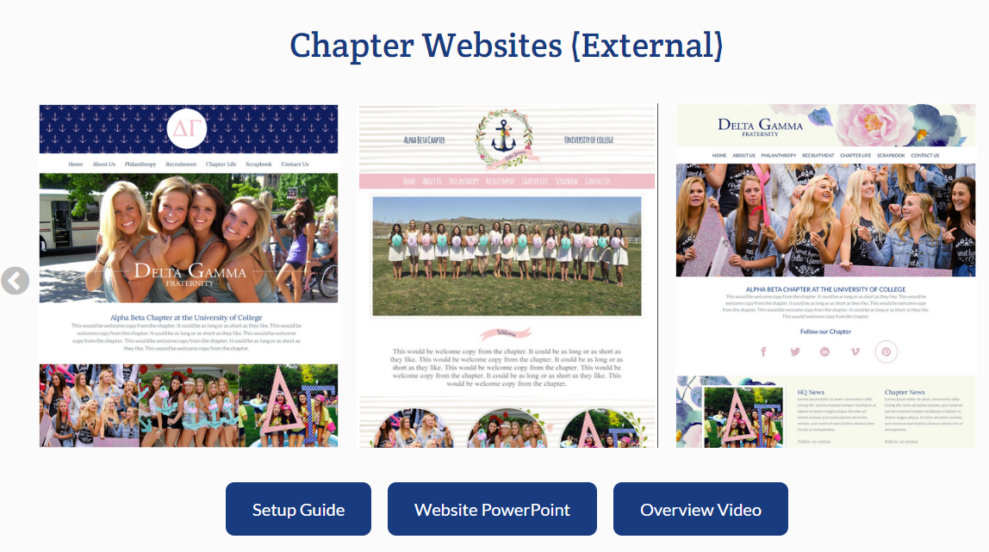
Chapter Websites
Notes:
(3 minutes)
Every single Delta Gamma chapter has a website already created for them, that the Fraternity provides through web vendor OmegaOne. They are designed to include not only Fraternity-wide information about DG as a whole, but to allow for you to create and update specific portions of the website directly related to your chapter.
Let participants know that while we recommend that chapters use these easy-to-update templates, we recognize that some chapters have members who are learning to code or adept at building websites, and want to do on their own. They key to this is making sure that the back end login information is passed down to the next year’s director of e-comm or vp: communications, and that they feel comfortable using that same website management tool.
It is a good practice for chapters to do a large update of the website at the beginning of each school term. Coaching the officer you work with to get into the routine of this practice can help ensure that items on the website are up to date and accurate. While social media is a great way to keep people who already follow you informed, know that chapter websites are still the first results that appear when doing an internet search for a chapter, which is why they are still relevant.

Slide 43
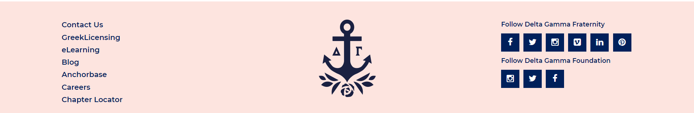
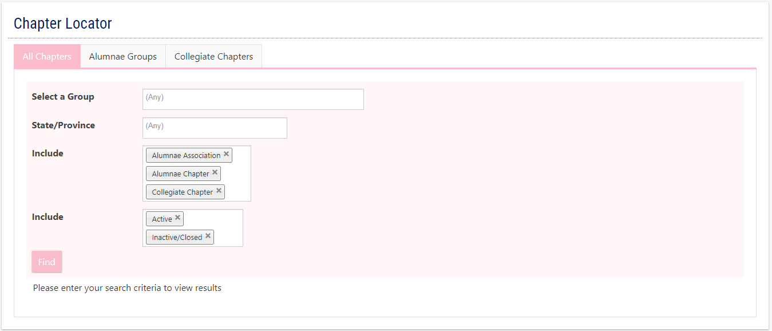
Notes:
(1 minute)
Share that they can check the website that we have listed for their chapter by going to the Chapter Locator at the very bottom DG website homepage. If the website listed there, or any other information, is incorrect, they can update the information for their chapter on their own via Anchorbase: chapter management>edit chapter info

Slide 44
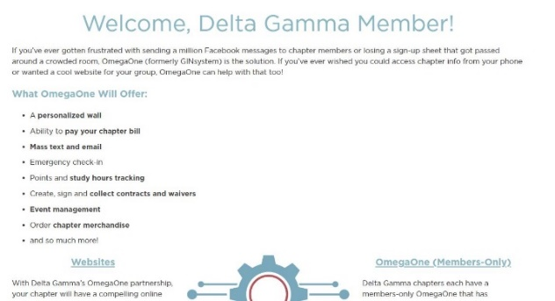
Chapter Website
Notes:
(1 minute)
Drop URL in the chat: https://resources.omegafi.com/omegaone-dg
If the officer you work with does not know how to update OmegaOne or how to use it for the, there is an entire support website that will walk you through each part of the process!

Slide 45
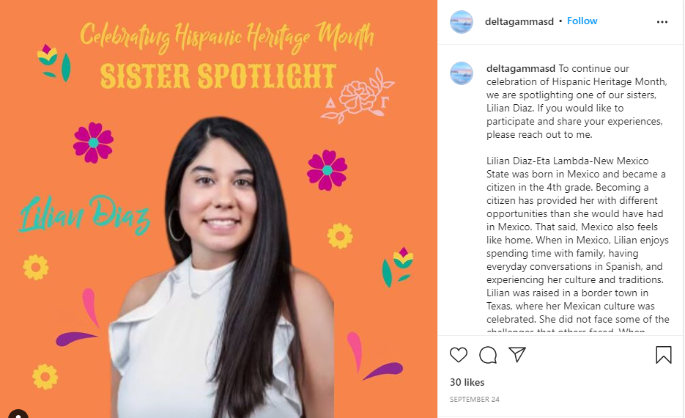
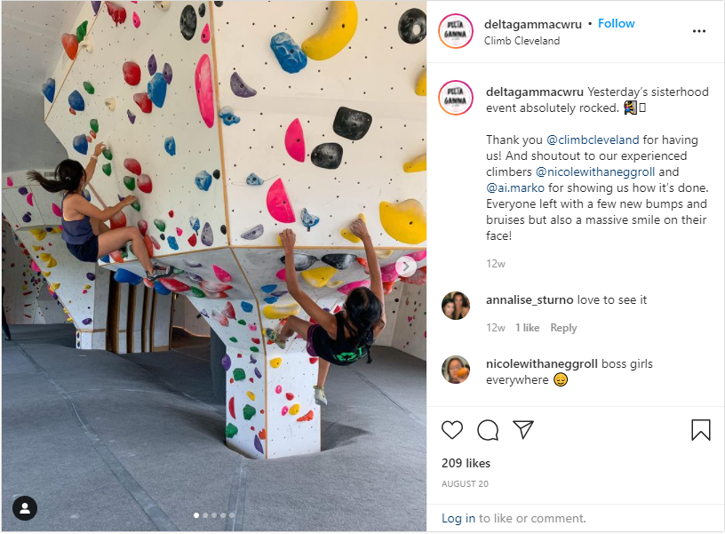
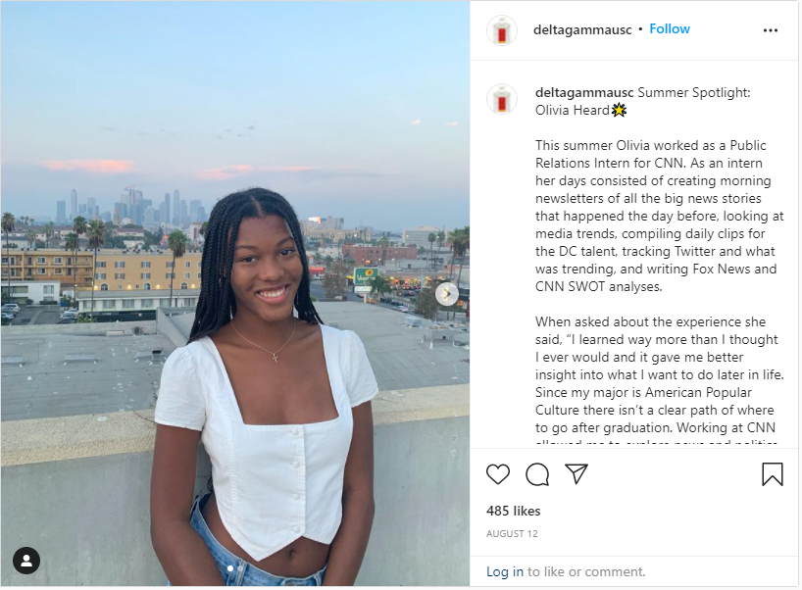
Social Media
Notes:
(2 minutes)
It’s no secret that social media is a huge aspect of the chapter’s communications strategy. Chapter social media should be inspiring, fun, engaging, and educational.
As advisers, we are positioned to help officers take a step back and evaluate social media strategy. It is especially important to carry these messages throughout all chapter social media platforms, not just Instagram or Facebook. In addition, participants should remember your audiences. While you may be reaching a primarily collegiate population on Instagram, you may not be reaching as many alumnae.
Pose questions like these to the officers you work with: Consider how your posts may be received by potential new members. Who are you including vs. excluding? Are you showcasing your entire chapter or just a segment of membership?

Slide 46
Social Media
Addressing inappropriate/conflict posts and Delta Gamma’s Social Media Policy.
Notes:
(5 minutes)
Members acting inappropriately and posting it on social media is something we’ve all encountered within our chapters. It’s very important to address posts that “cross the line.” What are posts that cross the line? Sometimes, they can be hard to identify and easy to gloss over. Posts that discuss skipping class, speaking poorly about professors, use inappropriate hashtags or are something questionable that member merely “liked.” These types of posts all perpetuate stereotypes and reflect poorly on your other sisters. Sometimes inappropriate social media is easier to identify: bigger issues like binge drinking, posting about unregistered events, insensitivity and illegal activity require immediate action.
Share that it is everyone’s responsibility to hold one another accountable. We encourage the individual that notices a negative post to be the one to approach the member about it. A SOR may also need written as well so that Honor Board can formally address the concerning behavior and post.
Remember that the criteria for sending something to Honor Board remains the same. Just because it’s happening on social media does not change that rule. Also, keep in mind that situations occurring within private groups/pages/messages should be handled the same way as those occurring through public pages/posts/comments.
Be consistent in your chapter account’s level of involvement. EO recommends not engaging in social media conflict unless a direct question is asked of the chapter. If the chapter account’s response won’t HELP the situation, there is no need to engage.
Say the following: We know asking members to hold their peers accountable on social media can be difficult. You can find Delta Gamma’s Social Media Policy as well as procedures for responding to inappropriate posts in the Delta Gamma library. Note that sections 5 & 6 of the Social Media Policy are the specific, actionable sections of the policy. Also in the library is an FAQ document of how they can respond if members question why they need to follow a policy.

Slide 47
Social Media
A chapter’s image and reputation is the sum of all individual encounters, in person or electronically, that the community has with its members.
Notes:
(1 minute)
Share the following sentiment: When posting on social media, keep your audience in mind. Additionally, keep in mind that anyone, at any time, can screenshot a post no matter if it is displayed for 5 minutes or 5 hours. Regardless of whether you have your Delta Gamma letters in your bio, cover photo, profile picture, or avatar, you are always a Delta Gamma and you are always representing not only yourself, but 250,000+ sisters around the world.
In addition to Delta Gamma’s brand, it is important to remind our officers they are always “selling” their own personal brand.
Say: The takeaway? We want to ensure that our collegians take this message to heart: Your chapter image is the sum of the individual encounters, in person or electronically, that the community has with your members.

Slide 48
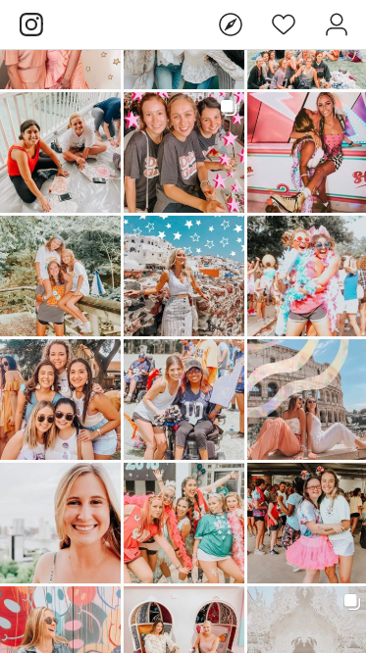
CONTENT REVIEW ACTIVITY
Notes:
(12 minutes)
When scrolling through a chapter’s feed or website, Article II should be represented as a whole. Not just one or two aspects of it.
We are going to do a quick activity to help each other review this concept. We are going to send you to breakout rooms with 2 other people. Exchange chapter Instagram handles or websites for the chapters you work with. Take a few moments to scroll through each other’s feeds or website, and write down 2-3 words that come to mind right away to describe the chapter. Do this based on what you see and without opening any individual posts.
Share the feedback you have and discuss ways the chapter could improve their platform.
(ZOOM: Send participants to breakout rooms for 5-10 minutes depending on time available)
Close breakout rooms and bring attendees back to the main room – ask for any takeaways or feedback to be shared.

Slide 49
QUESTIONS?
Notes:
Thank you for your participation during our session today! We will now have time for questions – please unmute yourself to ask a question or type it in the chat.
Use remaining time to answer participant questions.

