Slide 1
Alumnae Officer Track
Notes:
Session Time (2 hours)
Curriculum Key
(X minutes) - Denotes how long the section takes.
Italics - Marks curriculum you should tell/ask the participants.
Plain text - Indicates instructions for you as the facilitator.
Fac. Note: - Highlights special instructions for the facilitator
Advanced Preparation:
Review Fraternity Standards for Alumnae Groups (Long Version)
Welcome, everyone and thank you for being here! I am looking forward to being with you today.
Introduce yourself!

Slide 2
Introductions
Name
Chapter of initiation
Alumnae group and officer position
What would your walk-up song be?
Notes:
(5 minutes)
We are going to start with introductions before we dive-in to our agenda. There will be time throughout the day for networking and getting to know each other. Let’s have each person share their name, chapter of initiation, alumnae group officer position and if you were a professional athlete, what would your walk up song be or the song that would play when they announce your name.
Call out and share some of the responses as they come in through the chat.
We are so glad you are here today! Thank you for saying yes to Delta Gamma and yes to your local alumnae group. We are so appreciative of our alumnae officers and the work they do to provide a meaningful and valuable experience for our members. We know that forming connections and meeting other officers can be the most beneficial parts of these types of training. We encourage you to share contact information with each other so that our conversations can continue after our event concludes today.

Slide 3
Agenda
Introductions
Alumnae Team Overview
Officer Navigation Guides
Fraternity Standards Review
Alumnae Dues
Membership Recruitment and Retention
Programming & Communication
Anchorbase Reporting
Alumnae Group Evaluation Tool
Brainstorming/Idea Sharing
Notes:
(2 minutes)
Here is our agenda for today! After our day together, you will be equipped with ideas and understanding of many of the Fraternity Standards for Alumnae Groups.

Slide 4
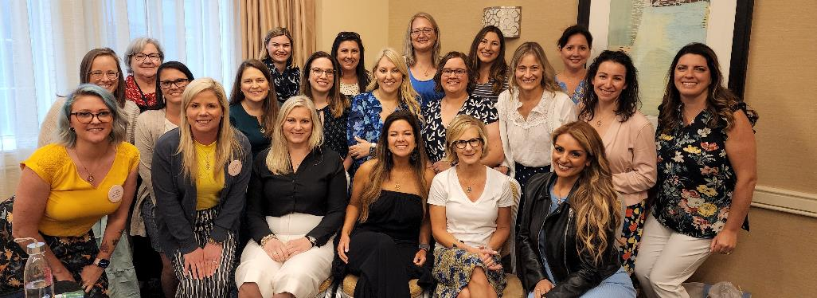
Alumnae Team Overview
Council Trustee: Alumnae, Vanessa Alzate (Central New Jersey) Director of Alumnae Operations, Jennifer Hall (Central Florida) Director of Alumnae Development, Danette Beck (Connecticut-Westchester) Director of Alumnae Engagement, Melissa Thompson (Baton Rouge) Regional Alumnae Specialists (17) & Alumnae Development Consultants (4)
Notes:
(2 minutes)
As we begin our training today, our hope is that in our short time together you will learn about the different resources available to you. One of the biggest resources is our alumnae team and these wonderful women are the first place to go for questions or additional support for your groups. Each of your group’s has either a Regional Alumnae Specialist (RAS) or an Alumnae Development consultant (ADC. These are the women pictured above and are assigned groups within their region.
The Alumnae Directors and Council Trustee: Alumnae are more focused on overall alumnae strategy including engagement, day to day operations and recruitment/retention.

Slide 5
What is the role of a RAS or ADC?
Be an alumnae group’s cheerleader and coach!
Training resource
Brainstorming ideas, tips and tricks around recruitment, retention, programming, etc.
Goal setting
RAS
Regional Alumnae Specialist
ADC
Alumnae
Development Consultant
Notes:
(2 minutes)
The Regional Alumnae Specialists (RAS) and Alumnae Development Consultants (ADC) are volunteers that work with alumnae chapters and associations throughout the Fraternity. Regional Alumnae Specialists are assigned to specific regions and work with groups on brainstorming ideas for programming, member recruitment and retention and are also your first point of contact resource for training and questions.
An Alumnae Development Consultant (ADC) may work with multiple regions and has a more focused approach to working with an alumnae group. They typically work with groups who need additional support or are trying to start from scratch or rebuild.
Both the RAS and ADC are cheerleaders and coaches for you as an alumnae officer!

Slide 6
How You Contribute to the Alumnae Group Experience?
Notes:
(2 minutes)
There are many ways that you contribute to the overall Delta Gamma alumnae experience as an officer. Here are just a few:
As an alumnae officer, you act as an ambassador to your local members on staying connected to Delta Gamma beyond the 4 years of college.
Provide programming that connects Delta Gammas of all ages and stages.
Connect with local collegians, if possible, to model that Delta Gamma is for life.
What other ways can you think of that you contribute to the overall Delta Gamma experience? Feel free to drop them in the chat!

Slide 7
Officer Navigation Guides
Notes:
(Brief Intro)
It is important that each officer knows which Fraternity Standards they contribute to and what their general roles and responsibilities to their board and their group are! The best resource to use for this is the Officer Navigation Guide which pulls out the pertinent information for that role out of the Alumnae officers Manual (AOM) into one easy to understand resource.
Let’s take a look!

Slide 8
Where is it located?
www.deltagamma.org
-> DG Library
-> Alumnae Officer Navigation Guide
-> select which officer position
Notes:
(1 minute)
A great resource to begin using as an officer and to provide a screenshot of your monthly and yearly to-dos is your respective “Alumnae Officer Navigation” Guide. This two-page resource has helpful reminders, to-dos and a list of resources for each of the 6 main Executive Board positions.

Slide 9
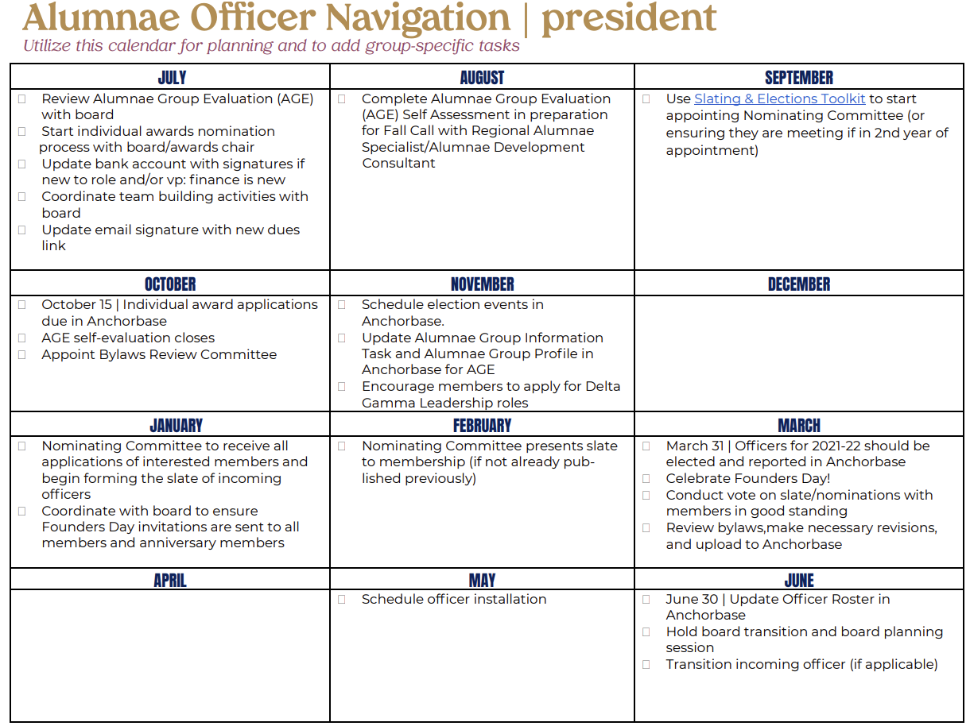
Notes:
(1 minute)
This Navigation Guide also gives you a year at a glance view with checkboxes next to each task that should be completed. This is a quick and easy way to see what items are expected when through the DG year!
Reviewing this resources with each board member at your first planning meeting or when new officers are elected is a great way to get everyone on the same page and off to a great start!
Of course, the Alumnae Officers Manual is also a great resource and lists other roles and responsibilities.
Please make sure you are downloading a new Officer Navigation Guide and Alumnae Officers Manual from the library after each new fiscal year, so you can ensure any updates are captured.

Slide 10
Fraternity Standards for Alumnae Groups
Notes:
(brief intro)
As we get started today, our training will of course be centered around the Fraternity Standards. These are our guideposts as we navigate alumnae operations, programming, service and social connections. The Fraternity standards are also what help us determine areas that our groups excel in our areas that they may need more focus.
If we are always looking back to the Fraternity Standards as we plan, program and report our groups will like be high functioning and a place that all members feel welcome, reconnected to Delta Gamma and have fun!
Ask in the chat who is familiar with the Fraternity Standards and have used them to guide group activities/planning/measuring their goals, etc.

Slide 11
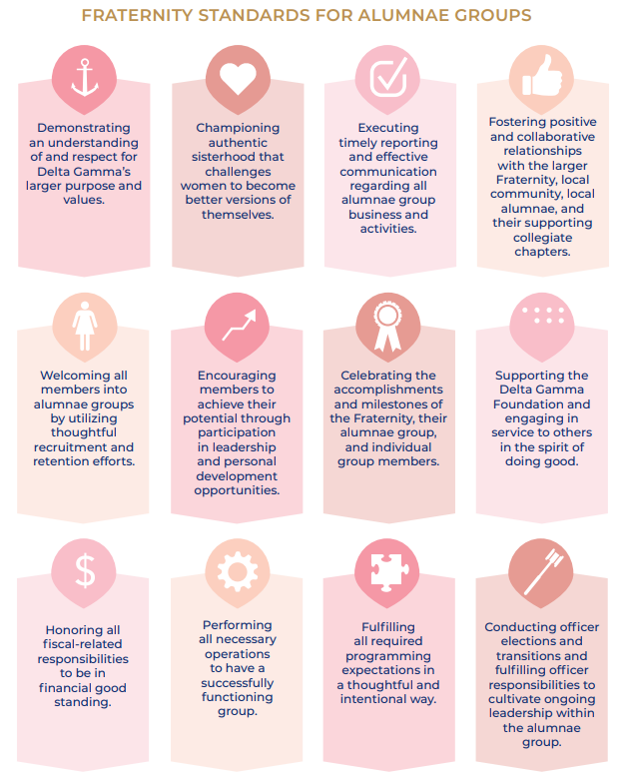
Comprehensive document outlining 12 standards
Mirrors the Fraternity Standards for Collegiate Chapters to encourage consistency
Each standard has an overarching statement with specific performance expectations
Updated to include “big picture” items, in addition to, day to day operations
Rituals, Values, Authentic Sisterhood and Inclusivity
Guide to measure groups objectively and consistently across the Fraternity.
Notes:
(5 minutes)
There are 12 Fraternity Standards for Alumnae Groups.
They look similar to the standards for collegiate chapters. This is intentional, with a goal that if collegiate members are exposed to the Fraternity Standards during their time in their collegiate chapter, when they become alumnae there will be similar elements to help with a smooth transition to alumnae group membership.
The standards include big picture goals for our groups, but also reflect day-to-day operation. They cover the full spectrum of alumnae group life – ritual, values, sisterhood, inclusivity and group operations
They serve as a way to measure groups objectively and consistently
Each standard has tasks associated with it to help you achieve each one. You can view the full version of the Fraternity standards on the Delta Gamma Website Library
Share that the standards can be found in the DG Library. Drop link in the chat so that attendees can pull up for themselves: https://www.deltagamma.org/wp-content/uploads/2022/02/Fraternity-Standards-for-Alumnae-Groups-Full-Version-2.pdf

Slide 12
Fraternity Standards in Action
Notes:
(Brief Intro)
We will spend the rest of our time together discussing a few Fraternity Standards in more detail and how you can put these standards into action to ensure the success of your alumnae group!

Slide 13
Alumnae Dues
Honoring all fiscal-related responsibilities to be in financial good standing.
Notes:
(Brief intro) – Strategies for increasing local dues paying members
The concept of Alumnae Dues connects to Fraternity Standard 9 which involves honoring fiscal-related responsibilities. We will talk through some important fiscal reminders and then go into more detail about alumnae dues.

Slide 14
Strategies for Local Dues
Set a goal and communicate that goal!
Set dues at a realistic amount and communicate the value of the amount.
Consider offering multiple levels of dues based on your membership.
Notes:
(5 minutes)
Before we dive in to how to collect and report local dues, let’s talk strategy. Here are some tips and tricks that are helpful when thinking about local dues.
First, set a goal of how many local dues payors you want to strive for in this fiscal year. A great place to start is to use the budget template for alumnae groups in the Delta Gamma library. Once you decide on a goal, communicate your goal to your membership. You will see some examples of this in a minute!
Second, set your dues at a reasonable amount. Once you develop a budget, you can determine how much you need to collect. Don’t set your dues higher than what you think your membership would be willing to pay. Sometimes lowering dues to an affordable amount can attract more members to pay! Also, communicate what the benefits of paying local dues are to them as a member.
Finally, consider offering multiple levels of dues based on your membership. Some groups offer a low price for recent graduates or 50 year plus members. Other groups offer additional incentives or goodies for paying at the higher level such as admission to Founders Day, branded t-shirts or members only events. Be creative! It is really all about knowing your membership.

Slide 15
Ideas for Dues Collection
Local dues campaign
How are you communicating the value of a virtual Delta Gamma experience?
Notes:
(5 minutes)
Let’s look at a couple of examples of strategies used by some alumnae groups for getting members to pay their dues.
Before we do this, it is important for us to talk together about how your due structures and dues may have been impacted in the past few years because of the Pandemic. How do we start to normalize dues payments again and share the value and importance of this. When asking for dues, how are you communicating the value of participating especially if your group is still holding virtual events?
Let’s look at some examples – remember as you are working on your campaigns that the new Delta Gamma brand elements are available for you to use if you search “brand elements” on the Library.

Slide 16
Notes:
(Slides 16-20: 2 minutes)
This is an example of messaging that would have been included in this groups newsletter. Not only does it remind members to pay their dues as the new fiscal year begins, but it tells a little bit about how the dues are utilized. They also included a quick-access link where members could easily find the page used to pay their dues.

Slide 17
Notes:
This is another great example.

Slide 18
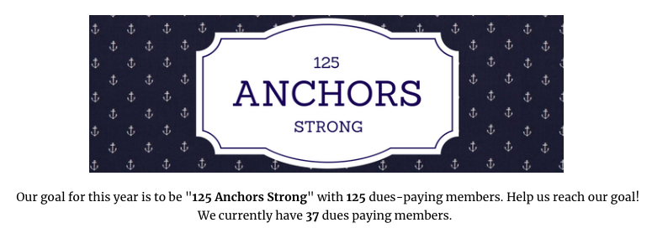
Notes:
One way to monitor your local dues payers is to set a goal and tell them about it. Let your membership know the number of dues payers that you are hoping to see during the year and then update them on your progress! Continually update them on how close you’re getting to your goal so that they can join into the excitement surrounding your work.
Remember to recognize your dues payers by thanking them – you can include them in your newsletter, send individual emails or have a special recognition for members who pay at the highest level. Our members want to know that their involvement is important to the group and that they are appreciated in their alumnae group! Also, send continuous reminders for members to pay their dues – we are all juggling a lot, and can always use that encouragement in the form of a reminder to pay when convenient!
Start small with your goals. For example, if you had 20 local dues payors last year, set a goal to increase by 5 additional payors this year!

Slide 19
Notes:
Here is a dues ask utilizing the new brand

Slide 20
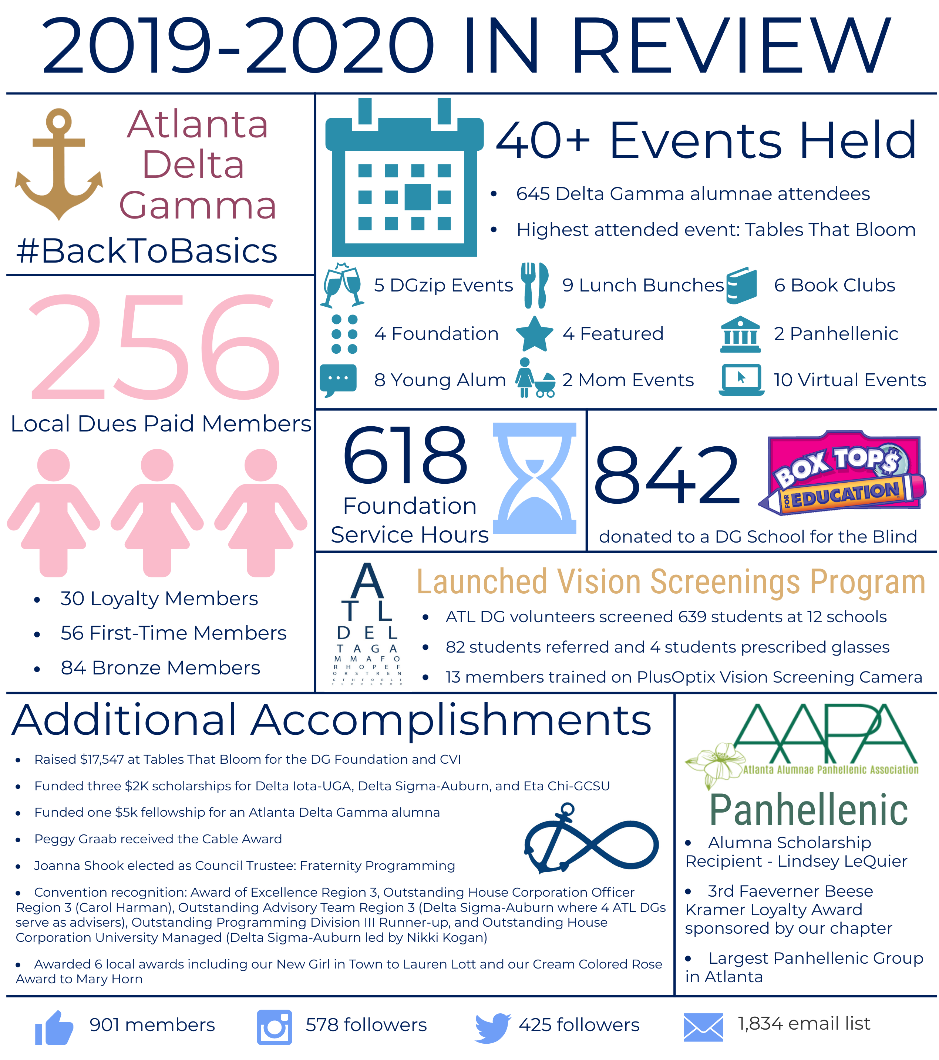
Notes:
Here is a great idea to help members know what their dues go toward each year! It is great to show how paying your dues can provide opportunities to connect and do good together as a group. Please note that you do not need to create something as elaborate as what you see above. Something as simple as a few bullet points in your annual newsletter works just as well!

Slide 21
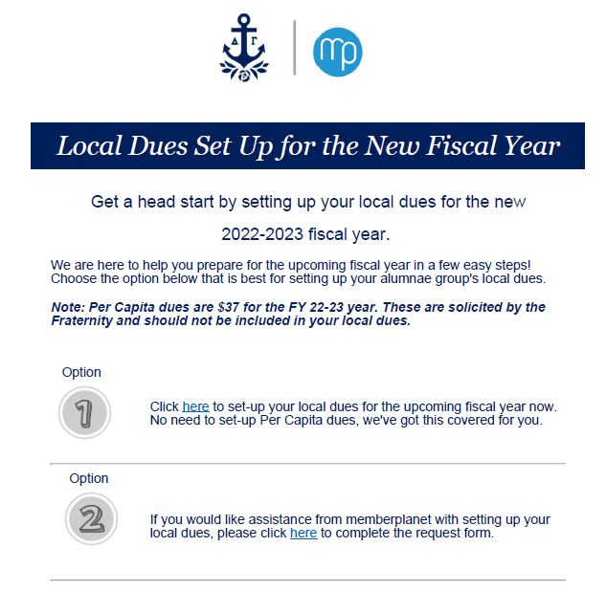
Setting Up
Local Dues
Notes:
(2 minutes)
The most important way to ensure your alumnae group can hold events, celebrate sisterhood and provide meaning membership experiences is by making sure your group’s local dues are set up. There are two ways to do this!
You should have received this email in both May and June, but if you need it again, please reach out to alumnaedept@deltagamma.org. This has two helpful links inside. One will direct you to the memberplanet success site which provides step by step instructions on how to set up your local dues.
The second link is a quick survey you can complete to have these set up for you by member planet. This is a great way to quickly get these set up with no hassle!
It is imperative that your local dues are set up as a Quickpay Invoice. This will ensure that your dues payment sync over to Anchorbase and requires no entry from your vp: finance.

Slide 22
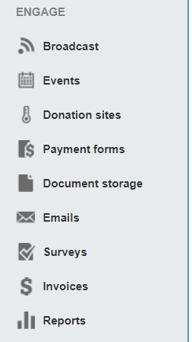
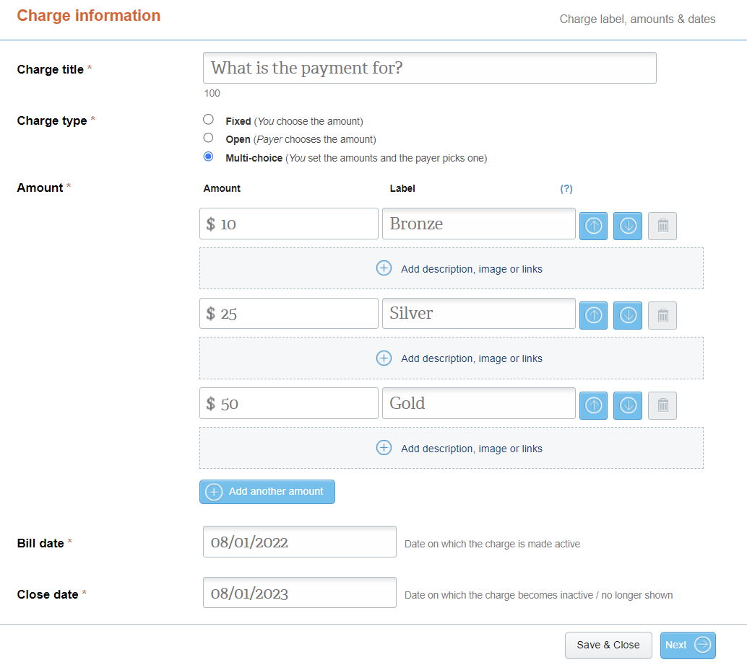
Setting Up Local Dues
#2
#3
#1
Notes:
(2 minutes)
Setting up your local dues is a rather simple process!
Once in memberplanet, you will choose the invoices option. All of your invoices that are currently set up will appear (if any) and you will chose the new charge option from the three blue buttons at the top right corner, Then from there you can fill in the fields on the Charge Information screen. You can choose one fixed amount or a tiered approach if you want offer different dues levels for your membership.
Who offers different dues levels? If so, do you offer any different benefits or incentives at each level?

Slide 23
Fraternity Standard #9
Friendly Finance Reminders
All alumnae groups should be operating on a fiscal year (7/1 – 6/30) including local dues.
You will receive communication from EO about filing your alumnae group’s taxes – must be done by 11/15. Do not file on an April deadline, like your personal taxes.
Upload IRS confirmation to Anchorbase by 11/15
You will also receive an invoice from EO in October for your group’s annual fee, web fee, convention fee and your insurance fee in the fall.
Ensure you have your local dues on memberplanet for the 22-23 year to support the above.
Additional finance reminders can be found in the vp: finance Officer Navigation Guide.
Notes:
(2 minutes)
The roles and responsibilities of our alumnae vp: finance are critical. There are a variety of finance tasks that are connected to Fraternity Standard 9. This slide outlines some of these tasks. We will not be discussing these items in detail today – but you can expect to see future training and communication about these vp: finance tasks.

Slide 24
Welcoming all members into alumnae groups by utilizing thoughtful recruitment and retention efforts
Membership
Notes:
(1 minute)
Our members are the core of our organization. Standard 5 refers to membership – and in the next few slides we will discuss opportunities for finding new members as well as membership retention.

Slide 25
Recruiting New Members
The Recruitment Process – Be Creative!
Utilize personal contact from officers and members—the most effective recruiting tool.
Welcome new members at their first event with a special introduction and small gift. Follow up with a card, phone call, or personal note.
Target younger Delta Gammas who have not participated and alumnae new to the area.
Set goals and develop a written plan for membership efforts and share with your group.
Utilize life-stage (young, senior) or special interest groups to recruit new members.
Encourage women to identify Alumnae Initiates who can contribute to the Alumnae group.
Notes:
(5 minutes)
This is a piece of information from the Alumnae Officer Manual about recruiting new members.
Your members are your greatest recruiters! When local Delta Gamma’s reach out to local alumnae who are uninvolved, their personal invitation is the single most useful recruitment tool. Similarly, when new members do come to an event, follow-up with them via card, phone call or other personal note so that they know they were welcomed.
A helpful strategy is to focus on young alumnae and those who are new to the area. Young alumnae are usually most connected to their Delta Gamma experience and women who are new to the area are often searching for ways to belong. Your group can provide that to them!
Sort your alumnae roster by initiation/grad date and use the DGs New to Town Report to find these women.
Creating goals is helpful so that everyone is on the same page and can be involved with achieving them!
Ask:
Have any of your groups had success with creating life-stage or special interest groups?
Allow for a few groups to share best practices related to this question either by unmuting themselves or typing into the chat box

Slide 26
Retention
Involve new members on a committee or event
Offer opportunities to participate that are not a formal officer role
The power of a “Thank you”
Survey members at the beginning and at the end of the year.
Multi-purpose programming and balanced programming important. Consider offering both in person and virtual events
Be consistent with your calendar and communicate the calendar early and often!
Encourage members to contribute ideas
Use a ritual or inspiration from Rituals Handbook or Think Anchor Deep at the beginning and close with the Oath of Friendship, when possible.
Notes:
(2 minutes)
Once you have members involved, as you all do, retention becomes vital. While we always have room to practice recruiting new members, keeping the members we have recruited is just as important.
What do you know about the keys for retention from your days in your collegiate chapter or from your post-graduate life? What is important or what are some keys to retention, in general?
Take feedback from a few of the attendees. Upon your click, additional information will appear.
Share these items if the conversation did not mention them:
Do introductions at the beginning of each event
Involve new members on a committee – if people feel they have a purpose, they will remain more engaged.
“Thank you” – say thank you to members and praise them for their contributions!
Survey members about what they liked and did not like about events
Encourage members to contribute ideas
Use a ritual or inspiration from Rituals Handbook or Think Anchor Deep at the beginning and close with the Oath of Friendship, when possible.

Slide 27
Our Communication & Events
Must be engaging
Must be thoughtful
Must be affordable
Must be social
____________________________
Women need a reason to fit us into their busy schedules. By providing programs and communication that fit the above traits, we provide incentive for members to attend, contribute, and continue their membership.
Notes:
(5 minutes)
So much about recruiting members is about what we communicate and how we tell the story of what it means to be involved. Our communication and our events need to be engaging, thoughtful, affordable and social. Understanding that we need to work to be sure that the alumnae group is worth our valuable time, what else might you add to this list? What other characteristics are important?
Take a few responses from the group.

Slide 28
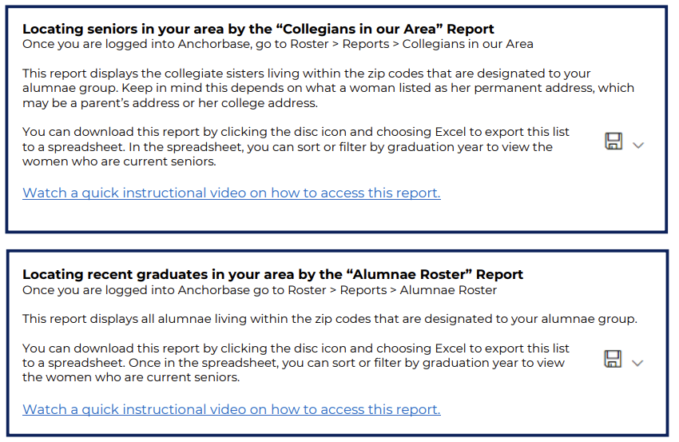
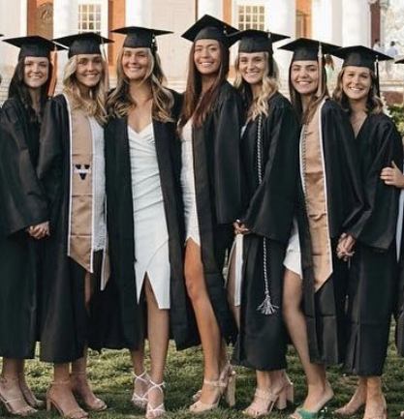
Engaging Recent Graduates
Notes:
(5 minutes)
As we know, COVID really altered the senior year experiences of Delta Gamma members over the past few years. It is more important now than ever before that we work to connect graduates to Delta Gamma alumnae groups so that they can be offered the opportunity to continue their active Delta Gamma experience seamlessly. Although this is great practice for every year, it feels most important now as we recover from a few years of not being able to connect with collegiate chapters.
Two helpful reports in Anchorbase to help you connect to recent graduates include the “Collegians in Your Area” report and the “ALumnae Roster” report.
For the Collegians in Your area, something to remember is that not all collegians change their address from their parent’s address or their college address to their permanent alumnae address.
For the Alumnae Roster report, it lists women in zip codes that are part of your alumnae group.
Ask for volunteers to share their favorite idea for engaging recent graduates.

Slide 29
Fraternity Standard #5
Resources
The Fraternity's Positional Statement on Inclusivity
“DGs New to Town” Report in Anchorbase
Engaging Recent Graduates Resource
Collumnae Event Planning Guide
Notes:
(1 minute)
Here are some resources to help you in achieving this fraternity standard.
Remember and share the positional statement on inclusivity with the rest of your officer board.
There is a “DGs New to Town” report in Anchorbase that will update you when a member changes her address to align with the zip codes that are assigned to your group.
The engaging Recent Graduate Resource we just reviewed is in the DG Library along with Collumnae Event Planning Guide and Alumnae Group Programming Ideas resource.

Slide 30
Fulfilling all required programming expectations in a thoughtful and intentional way.
Programming
Notes:
(Brief intro)
Next is Fraternity Standard 11. This involves fulfilling all required programming expectations for alumnae groups in a thoughtful and intentional way.

Slide 31
What are the Requirements?
What are the Requirements?
Groups that are alumnae chapters hold at least six events per year. Groups that are alumnae associations hold at least three events per year.
Group officers plan a variety of events that are inclusive of all generations utilizing events focused on each of the programming areas: sisterhood, membership, community, Foundation and networking.
Group officers actively seek feedback from members on programming satisfaction.
Group officers have added all alumnae group events to their group’s Anchorbase calendar
Group officers communicate events utilizing a variety of methods and in a timely manner to promote attendance.
Notes:
(2 minutes)
There are the programming requirements for alumnae groups. You can see that it involves chapters hosting 6 events and associations hosting 3 per year. Alumnae groups are expected to utilize the Programming Model and officers should attend all events. The programs should be unique and inclusive of all generations, and the officers should seek feedback from members on their satisfaction with the programming of the alumnae group. All events, even virtual ones, should be on the Anchorbase calendar.
Which one of these requirements tend to be the hardest to accomplish?

Slide 32
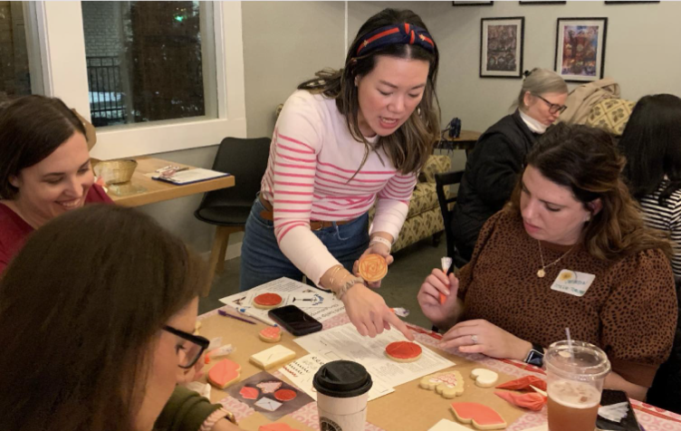
Programming
Library Resource:
Alumnae Programming Ideas
Sisterhood
Membership
Community
Foundation/Do Good
Networking
Special Interest Groups
Notes:
(5 minutes)
The Alumnae Programming Model aims to focus alumnae group programming around goals related to sisterhood, membership, community, Foundation and networking. It is designed to serve as a guideline for alumnae groups to create calendar events and develop programming that focuses on fun, friendship, sisterhood and “Doing Good” while increasing membership. The intent is to streamline programming and alumnae group operations.
All alumnae groups must include programming from within all Five Star categories. To achieve this, it is helpful for group officers to set their goals around these elements, as well. At least one goal from each of the five categories should be included with each event on the calendar.
We will have time to share ideas a little later, but for now please share in the chat what is one signature event that your group hosts every year or what is your favorite event that your group hosts every year?

Slide 33
Newsletter
Communicating with your membership
A report of information and ideas distributed to a group of people
Highlight member accomplishments or exciting or an area for exciting updates
Interactive and engaging
Typically, 2-3 pages long
Can vary considerably in cost, quality and content
Notes:
(1 minute)
One of the best ways to communicate information and upcoming events to group members, or other alumnae in the area is through a newsletter. Please note that you do not need to mail copies of the newsletter and that they can be distributed only electronically.
How many of you are currently utilizing a newsletter?
Great! Here are a couple of tips.
Review slide.

Slide 34
Why Create a Newsletter?
To update and educate
To announce events
To build cohesion
To increase interest and participation
To provide a forum for information exchange
To reduce the amount of time spent on information sharing during meetings
To collect dues
To spotlight officers/members
Notes:
(1 minute)
Newsletters are great to use as a one-stop shop. They can be utilized for everything listed here.
Review the slide.

Slide 35
Communicating to Membership
Why use memberplanet?
Readers can view entire newsletter directly in email
42% of emails are deleted when they cannot be read on smartphone
memberplanet provides Smart Content links and buttons to events and payment forms
Links to a newsletter document stored in Box, Google docs, etc may not always be accessible if subscriptions are not renewed
Notes:
(1 minute)
By a show of hands, how many of your groups are currently utilizing memberplanet for your member communications?
Here are a couple of reasons why memberplanet can be helpful.
Review the slide.
It is helpful to communicate and post on your group’s social media, but a newsletter is the best way to communicate to your members who are not following you on social media outlets.

Slide 36
Fraternity Standard #11
Resources
Programming resources – DG Library
Alumnae Group updates in the ANCHORA
Each other and other group’s social media
Alumnae Officers Facebook Page
Notes:
(1 minute)
Here are some resources that are available to help you with Fraternity Standard #11.
Review the slide.

Slide 37
Anchorbase Reporting
Executing Timely Reporting and Effective Communication regarding all alumnae group business and activities
Notes:
(1 minute)
Delta Gamma uses a reporting system called Anchorbase. Utilizing Anchorbase is a great tool to provide you with information about the members, while it also being a way for you to track important milestones and provide necessary information back to alumnae leadership, your regional team and Executive Offices.
Now that you have learned a little more about some of the Fraternity Standards, let’s review the system and show you how you can share information with your RAS/ADC about the great things happening in your alumnae group and be a useful resource for future alumnae officers!
You can also learn a bit more about Anchorbase reporting in Fraternity Standard 3 – Executing timely reporting and effective communication regarding all alumnae group business and activities.

Slide 38
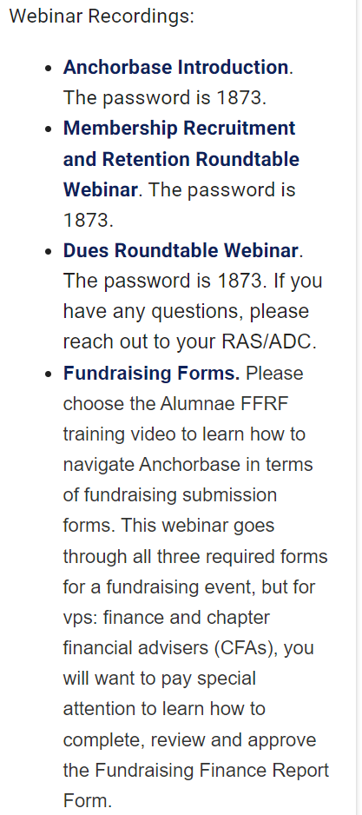
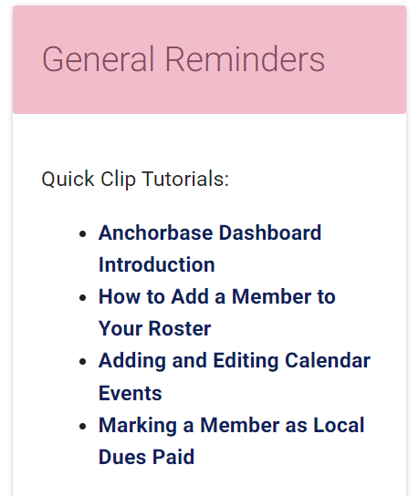
Anchorbase Resources
Notes:
(1 minute)
The best way to get yourself acquainted with Anchorbase and completing necessary tasks or utilizing reports is to explore the tutorials or webinar recordings you can find on your dashboard under General Reminders. Here, you will find Quick Clip Tutorials which are 2-5 minute videos showing you how to complete an important task like filling out your alumnae group calendar or adding a member to your roster who may not be appearing because they live out of the area.
You will also notice help text and directions at the firs step of each task or at the top of each Anchorbase report. Please take time to read this as to eliminate any frustration or questions that you may have. Any bold, navy blue text is a link that you can click for an additional resource.
We are going to briefly walk through adding a member to your roster and marking a member’s dues as paid.

Slide 39
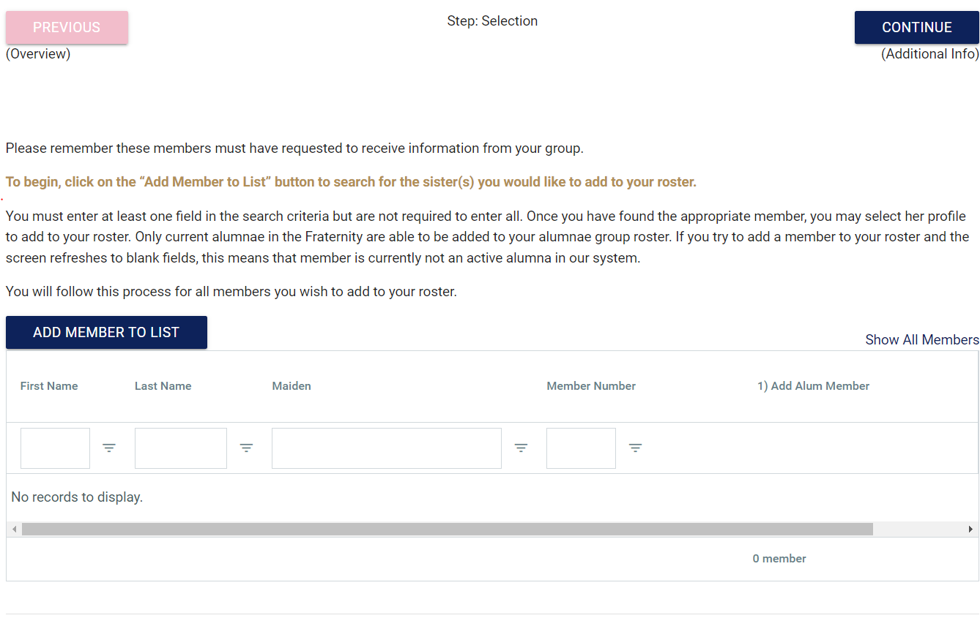
Add Member
Roster>Tasks>Add Members
Notes:
(5 minutes)
It is important that you manually add the women to your roster who are attending your alumnae group events or who would like to attend or receive communication, but do not live in the area. A member can join and pay local dues to any alumnae group regardless of her geographical location. A member can also be a member of multiple alumnae groups. There are many sisters who like to do this so that they have an alumnae group whenever they travel or are at a seasonal address.
If you hear from a member who has recently moved to your area and would like to be added to your roster, please ask her for an updated address as alumnae groups are based on zip code, so she may not need to be added to your roster, but just need her new address added. Once her address is updated to reflected your zip code area she will be automatically placed on your roster.
If a member is outside of the area, you will want to add her by completing the Add Member task under the Roster menu in your Anchorbase.
The trickiest part is knowing where to click once you get to this screen. Before any names populate, you must click the blue “Add Member to list” button. This is where the arrow is pointing in the image.
Once you click on this, you will be able to search a member and their name will appear. All you need to do is select the “1” option for “add alum member”. You can search for several names if you have more than one to add and then select “1” for all members.
After selecting all the members you wish to report, you’ll click “continue” and then will be taken to a new page that will ask you to submit the effective date and the reason for adding this member, any option is okay to select here. Following that, there is a quick validation step and that is it!
What questions do you have about this?

Slide 40
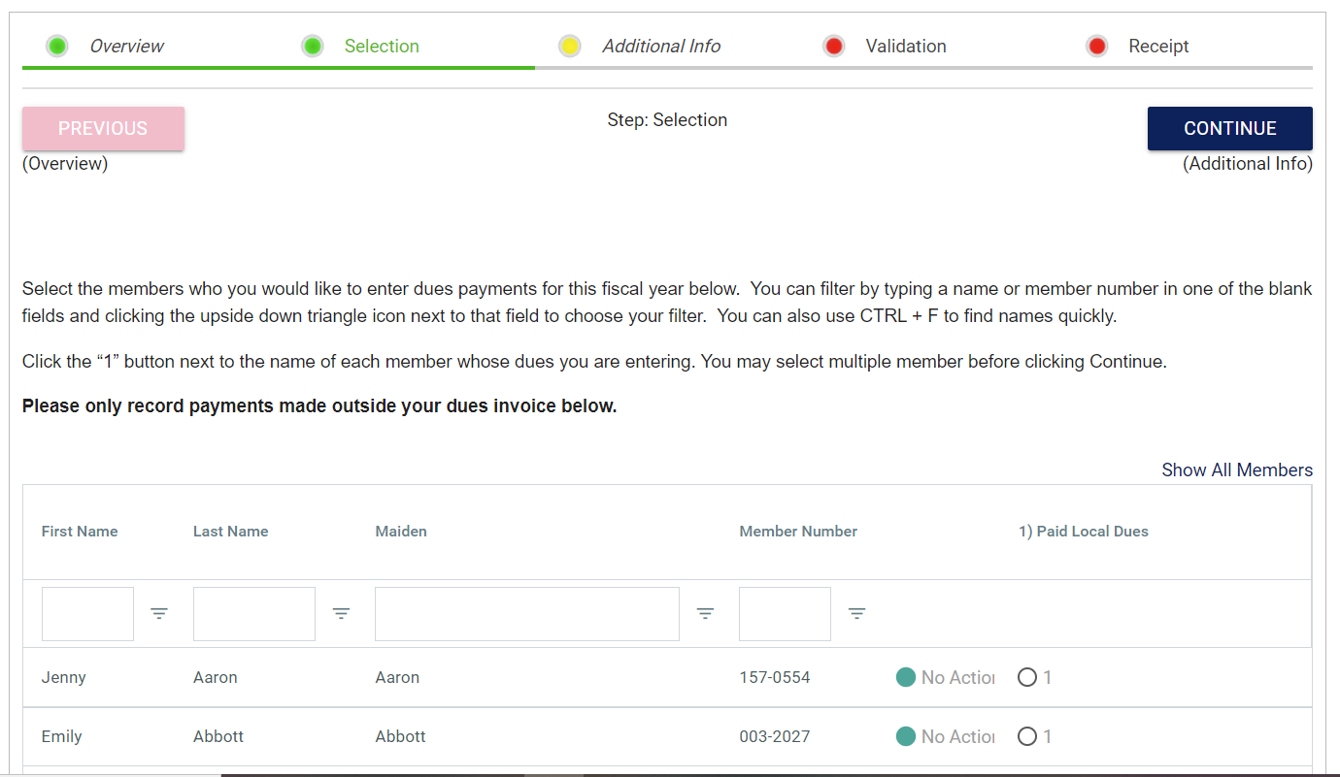
Update Paid Local Dues Task
Finance>Tasks>Update Paid Local Dues
Notes:
(5 minutes)
If you have payments made through an avenue that is not memberplanet, you will need to report those via this task. Feel free to navigate to this task in Anchorbase as we talk through it!
You will go to the Finance tab at the top of the screen, and then tasks and “update paid local dues”
You can see there that the instructions mention that if payments were collected in memberplanet, they do NOT need to be recorded in this task. Those payments will automatically appear in Anchorbase from memberplanet. Please only record payments made outside the dues invoice below.
Some payments made through memberplanet show up in Anchorbase and some do not. If a member uses the quick pay memberplanet invoice it shows up in Anchorbase. If they use a general payment form in memberplanet it doesn't show up in Anchorbase b/c the payment is not connected to the members record. The quickpay form shows up b/c they have logged in to memberplanet to make the payment so that data can be tied to the members record in iMIS and then shown in Anchorbase. Additionally, any per capita dues ask that EO sends out uses the quickpay method, which means if a group’s local dues are set up as a Quickpay invoice they will appear as an option when EO sends out reminders to pay dues!
This screen shot is an example of what you will see when you open the task. All you need to do is select the “1” option for any member that you are reporting. You can search for a members name or just scroll through them. If you are not reporting a members dues, you would leave “no action” selected for them.
After selecting all the members you wish to report, you’ll click “continue” and then will be taken to a new page that will ask you to submit the date and amount of the payment. Following that, there is a quick validation step and that is it! You can submit this more than once and as you receive payments.
Remember there is a recorded tutorial of how to do this on the Anchorbase Dashboard as well.
What questions do you have about this? We will talk a little bit more about alumnae dues next.

Slide 41
Helpful Anchorbase reports…
Calendar > Reports > Calendar Style or Spreadsheet style
Roster > Reports > Alumnae Roster
Roster > Reports > DGs New to Town
Roster > Reports > Zip Codes in my Group
Roster > Reports > Birthday Report
Awards > Reports > Membership Milestone Anniversaries
Awards > Reports > Volunteer History of Alumnae Groups Members
Foundation > Reports > Fundraising – Summary
Finance > Reports > Current Year Local Dues
Finance > Reports > Current Year Per Capita Dues
Notes:
(2 minutes)
Anchorbase is full of helpful reports that will reflect your alumnae group information to you. Whether you are looking for women who have recently moved to your area, the involvement of alumnae in your area or number of other reports, you can find them all by exploring the “reports” tab under each of your available headings. Here are some we recommend exploring more in depth.
Calendar > Reports > Calendar Style or Spreadsheet style – This is where you can see your alumnae calendar in two different views
Roster > Reports > Alumnae Roster – This provides you a report of your full alumnae roster. It is easiest to export it to excel and utilize it that way. Always download a new copy to ensure updates are captured.
Roster > Reports > DGs New to Town – This is where you can get a list of anyone who has moved to your area in the last year.
Roster > Reports > Zip Codes in my Group – This will give you a list of the zip codes that make up your alumnae group so that you can see if you need to complete a zip code analysis
Roster > Reports > Birthday Report – This is a great report to use to send birthday wishes to your alumnae group
Awards > Reports > Membership Milestone Anniversaries – Can be used to recognize your milestone members at Founders Day or other events
Awards > Reports > Volunteer History of Alumnae Groups Members – This is a great way to see what involvement your alumnae group members have so that you can nominate them for Individual Alumnae Awards
Foundation > Reports > Fundraising – Summary – This is a great way to see your group’s fundraising history
Finance > Reports > Current Year Local Dues & Finance > Reports > Current Year Per Capita Dues – Then both of these dues reports will show you your local dues or your per capita dues that have synced over from Executive Officers or from Member Planet.

Slide 42
Alumnae Group Evaluation
Notes:
(Brief Intro)
Now that we have gone over some of the Fraternity Standards and talked about how you can share information with your RAS/ADC as well as with future officers of your group, let’s spend a little time talking about the Alumnae Group Evaluation tool.

Slide 43
Alumnae Group Evaluation Tool
Two-pronged approach to evaluate alumnae groups
Group Self Assessment
Leadership Assessment
RAS/ADC completed annually (based on calendar year)
Ability to celebrate successes and identify opportunities for support
Notes:
(1 minute)
The Fraternity Standards are utilized as an assessment measure for all alumnae groups annually through the AGE – Alumnae Group Evaluation.
There are two pieces to this process. One is a self assessment for your group to complete and the other is an assessment completed by your RAS/ADC. You should have received the email about the Self Assessment on August 1, so you will want to try and complete that to provide your RAS/ADC feedback.

Slide 44
Alumnae Group Evaluation Tool
Groups are categorized based on the performance expectations that they successfully meet:
Bronze – Exceptional
Pink – Successful
Blue – Opportunity
Allows for RAS/ADC to partner with alumnae groups to encourage an alumnae group to be the best version of themselves can be.
Notes:
(1 minute)
The outcome of those assessments are a color score – bronze, pink and blue.
Bronze is assigned if the group is exceptional and goes above and beyond the standard performance expectations, pink if the group is successful and is meeting a majority of the performance expectations and blue if the group has opportunities for improvement and/or is not meeting one of the core elements of an alumnae group. The goal is for all alumnae groups to be pink. Think pink!
This assessment and color outcome serves as a guide for the RAS/ADC when determining how to best support you in the coming year.

Slide 45
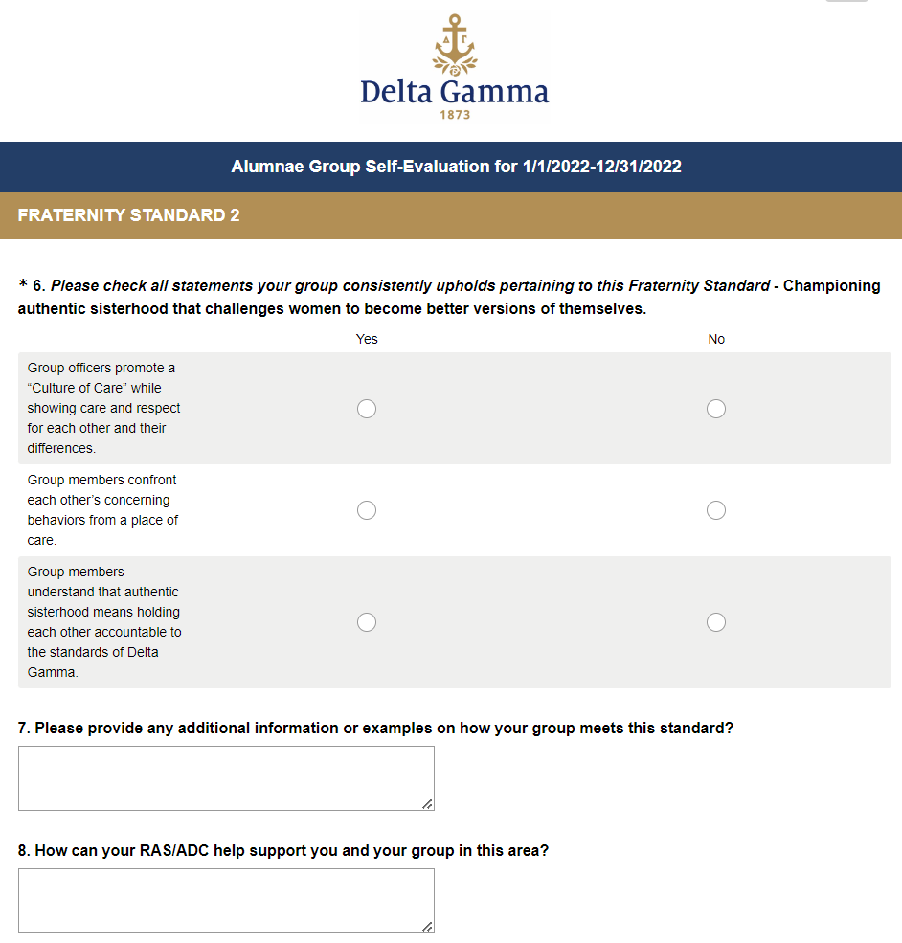
Alumnae Group Evaluation Tool
Completed in Survey Monkey
Similar set up for all 12 standards
An opportunity to share group challenges & successes in the open text boxes
Notes:
(1 minute)
This is a screen shot of the self-assessment that your group will complete ahead of your RAS/ADC submitting an evaluation. You should have received an email on August 1 that the Self-Evaluation is ready for you to complete.. It is best to complete it by November 1 to allow for a less busy end of year/holiday season. The RAS/ADC team will provide their evaluations of each group between October - Jan and then you will be notified of your scoring and recommendations in the spring.
Share link in chat: https://www.deltagamma.org/wp-content/uploads/2022/02/Alumnae-Group-Evaluation-Tool-Worksheet-2.pdf
In the meantime, we encourage you to take a look at the Alumnae Group Evaluation worksheet that can be found in the DG Library. This is a great way to begin evaluating your group’s efforts at upholding the Fraternity Standards.

Slide 46
Brainstorming
Notes:
(30 minutes)
Unfortunately, we aren’t able to cover all 12 of the Fraternity Standards, but we hope this sets you up with some tips, tricks and resources! To close today, we are going to give you time to brainstorm with other officers here today.
Fac Note: You will be launching breakout rooms for this portion of the training. You have two options on how to OPTION 1: Select the “Let Participants Choose Room” option. Create 5 breakout rooms and label each room
OPTION 1: Select the “Assign Automatically” option and select 3-5 attendees per breakout room. Attendees will be assigned randomly to each room.
OPTION 2: Select the “Let Participants Choose Room” option. Create 5 breakout rooms and label each room with size breakdowns of alumnae groups for attendees to self select into
Copy and paste into the chat:
Brainstorming Questions:
What does your alumnae group do best?
What event is most successful for your group? Why?
What strategies does your group use to recruit members? Does this work well, why or why not?
What area does your group hope to improve on most in the next year?

Slide 47
Takeaways
Notes:
(5 minutes)
What is the one tangible goal that you are walking away with from today?
Please feel free to come off of mute to share or share in the chat.

Slide 48
Important Dates to Remember
November 1: Dues/Fees due for all alumnae groups
November 15: Tax Confirmation uploaded to Anchorbase
November 15: All Anchorbase updates should be made by this date
November 15: Foundation Service Hours uploaded to Anchorbase
December 1: Alumnae Group Self Evaluation Closes
May 15: Chapter Giving Contributions due to the Foundation
Notes:
(1 minute)
Here are some important dates for you to remember as you leave here today. All of these dates can also be found in the Officer Navigation Guides. Please take a picture or screenshot of this slide to share with your fellow officers who may not be in attendance today.

Slide 49
Questions?

