Slide 1

Formal Transition Workshop

Slide 2
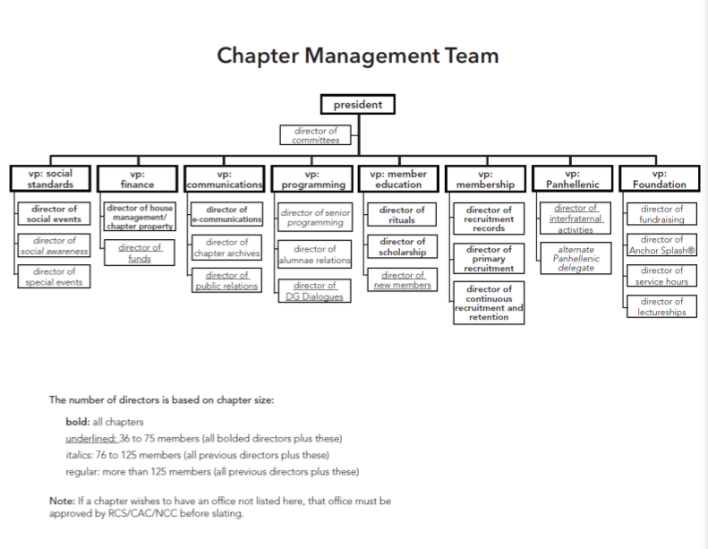

Slide 3
Collegiate Chapter Officer Manual (CCOM)
As you read through your section of the Collegiate Chapter Office Manual (CCOM), write down your thoughts on the following:
Is there anything that you were not aware you were responsible for?
Is there anything that you would like to improve within your position?
What are you excited to do in your position?

Slide 4
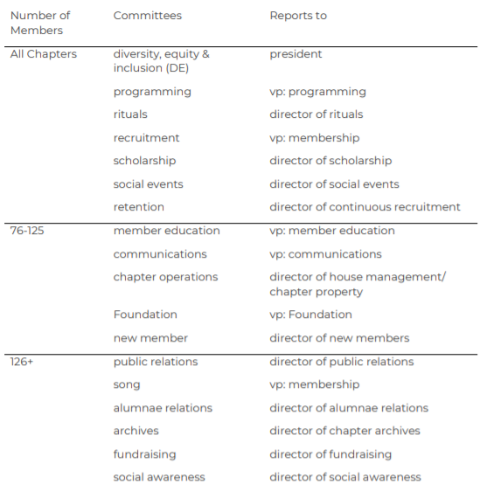
Committees
Help involve chapter members in all aspects of the operation of the chapter.
Exposes general chapter members to areas of the chapter that they may have an interest in exploring, or have natural talents in.
Gives the chapter officers and directors members to assist them with large scale events or activities.

Slide 5
Honor Board
Who is on Honor Board?
vp: social standards (chair), chapter president, junior member, sophomore member, member-at-large
What does Honor Board do?
Assesses chapter morale and attitude
Creates and promotes positive programming
Holds all chapter members accountable to following their Statement of Obligation

Slide 6
Honor Board – Automatic Procedure
Financial delinquency handled by vp: finance:
  Debt for over 10 Days
  Dues and Fees Contract not signed by the due date
  Failure to pay fines by due dates
Scholastic poor standing is handled by director of scholarship:
  Failure to meet scholastic good standing for the first time
  Failure to submit grades by the due date
Attendance violations are handled by vp: communications:
  Two unexcused absences from meetings and anchor events
  Two unexcused absences from officer/director team or board meetings
Housing standing rules and contractual violations handled by the director of house management:
  Failure to move into chapter housing per the live-in requirements in the BL/SRs
  Failure to sign a housing contract per the BL/SR
  Failure to complete the terms of the housing contract

Slide 7
Honor Board – Standard Procedure
Reasons an APN would lead to an SOR being written:
Multiple APNs filed against one member during the same probation period (vp: social standards).
APN for finance violations with continued outstanding debt at the 30-day mark (vp: finance).
APN issued for attendance reasons with continued unexcused absences (vp: communications).
APN issued for failure to meet scholastic requirement for two or more consecutive terms (director of scholarship).
APN issued for failure to meet Constitutionally-required 2.0 prior-term GPA (director of scholarship).

Slide 8
Honor Board – Standard Procedure
The vp: social standards receives a completed Statement of Obligation Review.
Allegation Assessment – vote in the affirmative results in a formal hearing.
Formal Hearing – a member is sent a copy of the SOR and asked to speak with Honor Board.
The Honor Board Formal Hearing Minutes are read, the SOR is read, and the member is allowed to read a prepared written statement.
A discussion between Honor Board and the member then occurs.
Honor Board deliberates while the member waits outside. Honor Board comes to a decision during the deliberation.
Honor Board brings the member back in and shares the decision.

Slide 9
Honor Board – Standard Procedure
Potential Sanctions:
Warning
Penalty: A penalty may include, but is not limited to, educational presentation delivered to Honor Board, assisting in planning an event without alcohol, researching a relevant topic of interest, attendance at a campus event.
Probation
Expulsion
For New Members: Warning, Penalty, Delay of Initiation, Expulsion.
All Honor Board sanctions are confidential and must be approved by the chapter’s Regional Collegiate Specialist/Council Appointed Coordinator/New Chapter Coordinator. The above list is only suggested. Honor Boards are encouraged to be creative in their sanctioning and make decisions based on what is best for the member and the chapter.

Slide 10
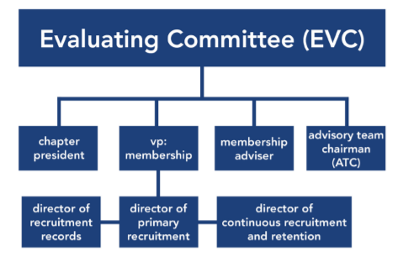
Evaluating Committee (EVC)
What does EVC do?
Plans and executes all recruitment preparation workshops
Plans and executes all things related to recruitment including recruitment rounds, Sponsor Forms, Membership Selection Criteria, etc.

Slide 11
Advisory Team
The advisory team is made up of local alumnae who volunteer their time and service to support a collegiate chapter
Each advisory team has an advisory team chairman (ATC) that oversees the other advisers, serves on multiple boards, if needed, and is the main point of contact for the chapter and the chapter’s regional team.
Take a look now in Anchorbase to see what other women support your chapter.

Slide 12
Advisory Team
Use this slide to write out the names and contact information for your chapter advisers.

Slide 13
House Corporation Board
Who is on House Corporation Board from the collegiate chapter?
ATC, chapter president, vp: finance and director of house management.
What does House Corporation do?
House Corp. “rents” the property to the chapter in a landlord-tenant relationship. A lease agreement is signed annually between House Corp. and the chapter.
Take a look in Anchorbase to see who the alumnae are that serve on your House Corp.

Slide 14
House Corporation Board
Use this slide to write out the names and contact information for your house corporation board members.

Slide 15
Delta Gamma Structure
FRATERNITY COUNCIL
There are seven women on Delta Gamma’s Council. They oversee all the Fraternity-wide initiatives and big picture of Delta Gamma to help our Fraternity to continue to move forward.
Fraternity President, Treasurer, Council Trustee: Collegians, Council Trustee: Alumnae, Council Trustee: Fraternity Programming, Council Trustee: Membership and Council Trustee: Communications.

Slide 16
Delta Gamma Structure
FRATERNITY DIRECTORS
Under Council are our Fraternity Directors. These Directors are considered subject matter experts in their respective areas.

Slide 17
Delta Gamma Structure
REGIONAL TEAMS
Regional Teams are made up of:
Regional Director (RD)
Regional Collegiate Specialist (RCS)/ Council Appointed Coordinator (CAC)/ New Chapter Coordinator (NCC)
Regional Finance Specialist (RFS)/ New Chapter Finance Coordinator (NCFC)
Regional Collegiate Recruitment Specialist (RCRS)/ Collegiate Recruitment Consultant (CRC)/ New Chapter Recruitment Coordinator (NCRC)
Regional Housing Specialist (RHS)
Regional Foundation Coordinator (RFNC)
Regional Alumnae Specialists (RAS)
Panhellenic Support Specialist (PSS)

Slide 18
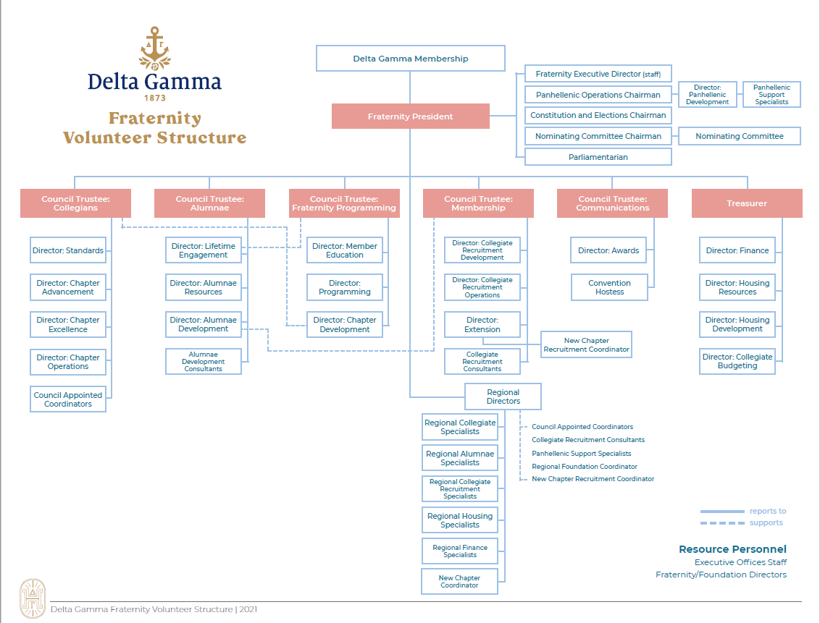

Slide 19
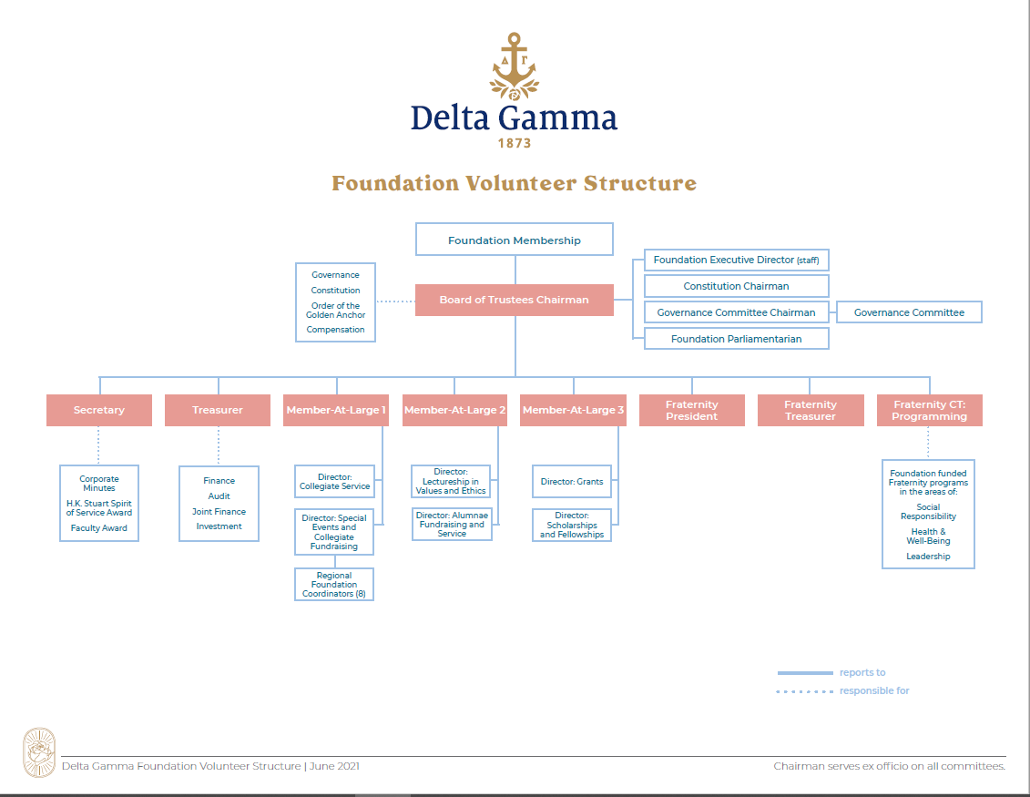

Slide 20
Test Your Knowledge
If you would like to add an event to your calendar’s already approved calendar, what regional team member would you need to contact?
  Your advisory team chairman (ATC)
What officer and directors make up the member education team?
  vp: member education, director of scholarship, director of rituals, director of new members and director of pursuits.
If vp: finance has questions about removing women from GreekBill, what regional team volunteer would she reach out to?
  Regional Finance Specialist (RFS)/ New Chapter Finance Coordinator (NCFC)
If you are having trouble attending events because of personal reasons, what board within your chapter should you go speak with?
  Honor Board
Who oversees all of our chapter’s local advisors?
  Advisory Team Chairman (ATC)

Slide 21
Test Your Knowledge
What Regional Team member approves all of your fundraising event plans?
  Regional Foundation Coordinator
During the BLSR process, which officer is in charge of facilitating the changes? Which officer is responsible for actually updating the document?
  Chapter president and vp: communications
If JCMT wants to make changes to our attendance section of the BLSRs, who should we reach out to for their guidance and approval?
  Regional Collegiate Specialist/Council Appointed Coordinator/New Chapter Coordinator
During recruitment there is a question about voting procedure, who should EVC consult?
  Their membership adviser or their Regional Collegiate Recruitment Specialist/Collegiate Recruitment Coordinator/New Chapter Recruitment Coordinator
Delta Gamma Fraternity structure has five levels. What are they?
  Council, Fraternity Directors, Regional Team, local advisory team and collegiate chapters. EO staff supports all of these levels.

