Slide 1

Additional Evaluations

Slide 2
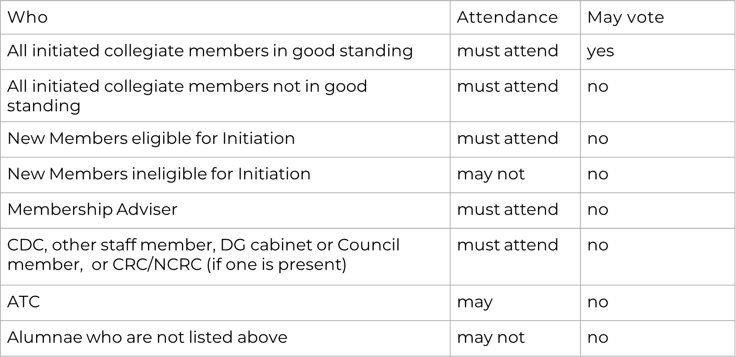
Notes:
New members who are eligible for Initiation will be permitted to participate in Membership Selection, but they may not vote. Eligibility for Initiation means that the vote to initiate has been taken after all other requirements have been met, the Initiation fee has been paid, and the Authorization
for Initiation from Executive Offices has been given. Other new members may not attend during discussion or voting.

Slide 3
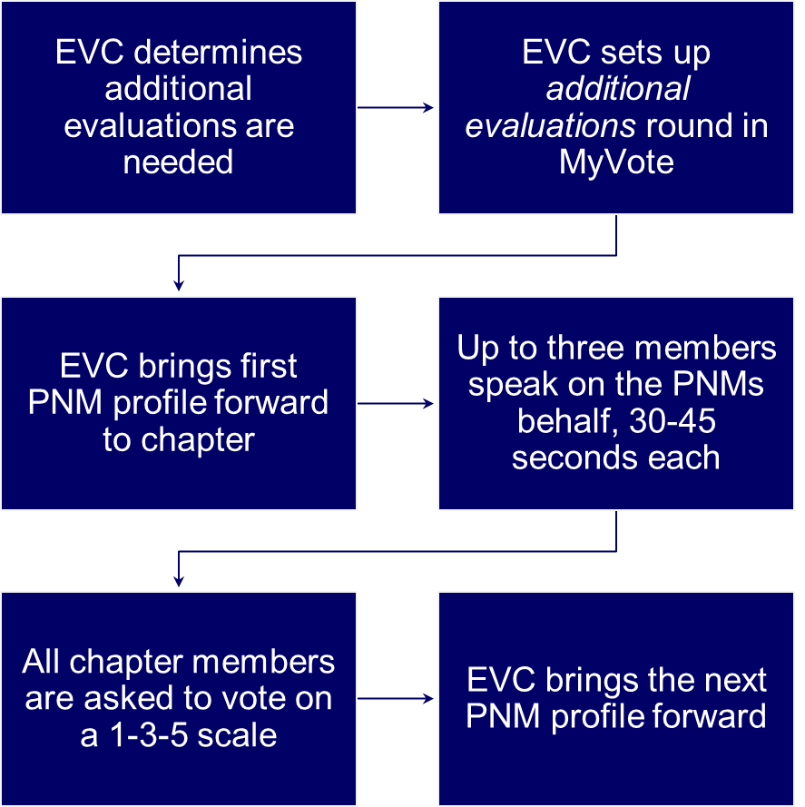
ADDITIONAL EVALUATIONS PROCESS

Slide 4
Step 1: EVC Determines Additional Evaluations Are Needed
Some suggestions of when to use Additional Evaluations
PNMs with 0 votes
PNMs who came late or missed party
PNMs with similar names
PNMs with mixed or drastically different scores
PNMs with similar scores that fall within the flex cutoffs
Tip: Mark these PNMS throughout the day so you are ready to discuss them as soon as the events end for the day.
Notes:
Next, we want to consider where the PNM scores fall with respect to the chapter’s carry figures, which we will dive into more detail on the next slide. Timing wise, though, what if the last party ended say 8 pm and Panhellenic doesn’t think they will have carry figures to you for 3 more hours. As long as you don’t have a drastic format change or change in number of chapters recruiting on campus from prior year, you can get a general idea from what carry figures the chapter had last year and start with those as a guide. You should have received that data as part of your transition, and you can discuss them with your RCRS/CRC/NCRC prior to recruitment.
# of PNMs to discuss: we don’t have a # to recommend. If the votes are clear and they feel confident in what they have, they don’t have discuss anyone. It will vary from ch to ch. Your rcrs/ncrc/crc is happy to work with you on an individual basis.
If EVC does not need Additional Evaluations for any additional votes
Let’s look at some examples on the next slide.

Slide 5
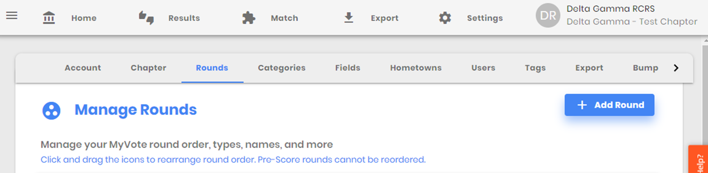
Step 2: EVC Sets Up Additional Evaluations Round In MYVOTE
Go to Settings>Rounds>Add Round

Slide 6
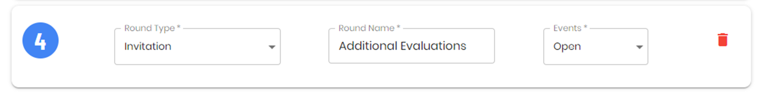
Step 2: EVC Sets Up Additional Evaluations Round In MYVOTE
Set the Round Type to “Invitation” and rename the Round Name “Additional Evaluations.” Keep the Events set to open.
Note: If you are a Campus Director chapter, you must have the Invitation round listed AFTER your preference round. You can still vote on this round before preference, but this ensures Campus Director does not sync to this round.

Slide 7
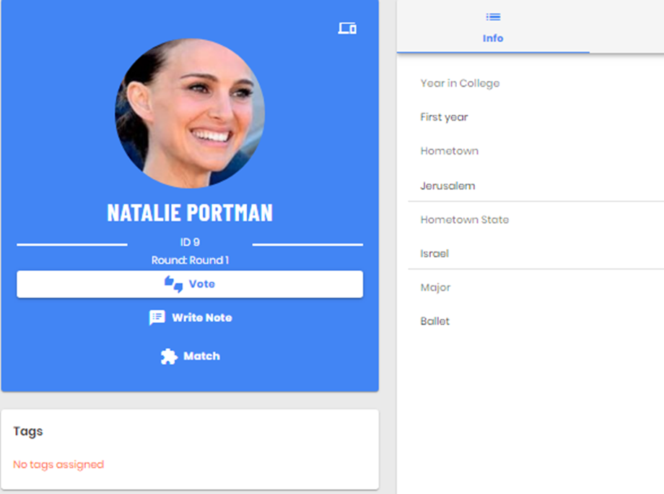

Step 3: EVC Brings First PNM Profile Forward To Chapter
What’s On the Card
Other PNM profile information could be displayed here such as activities and interests.
Remember: hide confidential information like GPA
Order: director of recruitment records can configure order the info is displayed (refer to arrow)
NOTE: Be sure you log in to a Voting Member account, so you don’t share your screen for members to view GPA, votes, and other sensitive information.
Notes:
When your rounds are set up, you’ll be able to kick off doing additional evals with the chapter.
On the PNM profile card, the director: rr can set it up to show activities, interests, major, etc. and change the order in which this information is showed.
When doing additional evaluations, you’ll want to have a second profile with normal voting member access so the chapter cannot see PNM sensitive information (GPA, votes, etc.).

Slide 8
Step 4: Up to Three Members Speak On the PNM’s Behalf – Who Should Speak
Who can speak?
Anyone who has spoken to the PNM or a member who has previously known the PNM prior to recruitment.
This is an opportunity for someone who knew her before but has not had the chance to talk to her during recruitment to speak on her behalf.
Any member regardless of whether she is in good standing or not.

Slide 9
Step 4: Up to Three Members Speak On the PNM’s Behalf – What Should They Say?
What should they say?
The member should speak about her own experience with the PNM prior to or during recruitment.
Adjectives are a good place to start, but this should dive deeper.
  How do you know that she is philanthropic?
  What did she say during your conversations to let you know she is interested in leadership opportunities?
What should they NOT say?
This is not a place to discuss what someone heard about her or a friend’s cousin’s boyfriend’s interaction with the PNM. This time should focus on first-hand interactions with the PNM that speak to the values of Delta Gamma.
We also do not want to spend time talking about how “cute” or “nice” or “wonderful” the PNM is. We are so glad she is all of those things, but how do we know? Give specifics of WHY she would be an asset to the chapter.

Slide 10
Step 4: Up to Three Members Speak On the PNM’s Behalf
Additional Evaluations Sample:
“I have known this PNM since my sophomore year of high school. We were on the cheer squad together, and she was an extremely hard worker. She showed up to everything on time and was always the last one to leave. When we spoke today, she talked about wanting to find a place on campus where she can continue to be involved and contribute to something outside of herself, and that is why she came through recruitment. She said she could see herself connecting with the women in our chapter.”

Slide 11
Step 4: Up to Three Members Speak On the PNM’s Behalf
EVC’s Role in Additional Evaluation:
vp: membership asks all members who have met her or previously knew her to stand.
vp: membership asks for three or four volunteers to speak on the PNMs behalf.
As each member speaks, president monitors time for 30-45 seconds for each speaker.
Members of EVC should serve as the moderator of Additional Evaluations and should remain neutral. They should not speak positively or negatively about the PNMs.
  If discussions turn negative, inappropriate, or begin to go too long, EVC os responsible for correcting course and steering everyone back to appropriate conversations within the correct time limits.

Slide 12
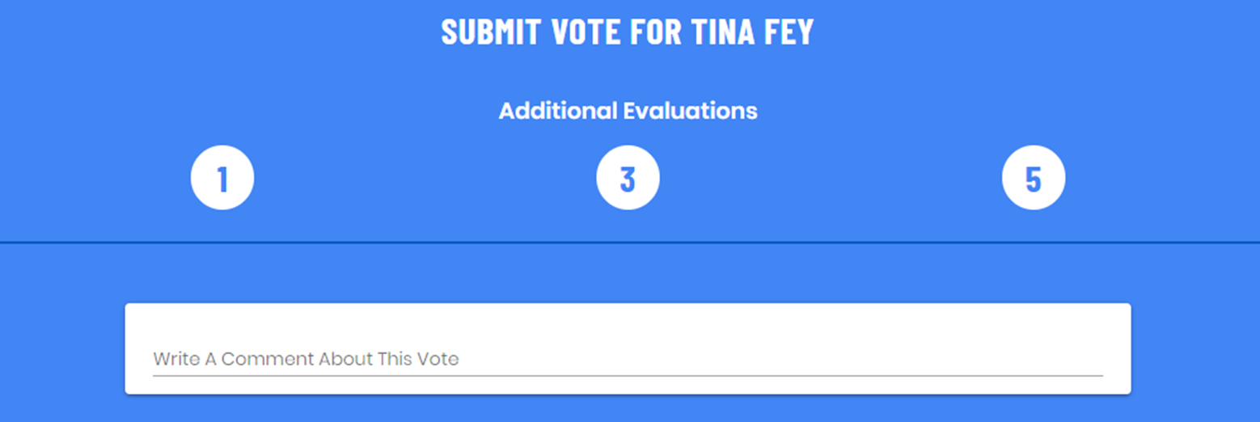
Step 4: All Chapter Members In Good Standing Vote
Notes:
A change in the process is that now during an additional evaluation, all chapter members should be voting on a PNM.
The reason for this is that previously votes were not changing during MS when only the women who previously met her voted.
Now, anyone in good standing will be voting based on what they heard from their sisters, it is important for EVC to be calling on women from different pockets of the chapter.
Vote on the quality of what they are hearing and not just who they are hearing it from.
Values of #s
1 - she should be low on our Bid list, not a good fit
3 - unsure, I am more passionate about other PNMs
5 - I want her to be a DG

Slide 13
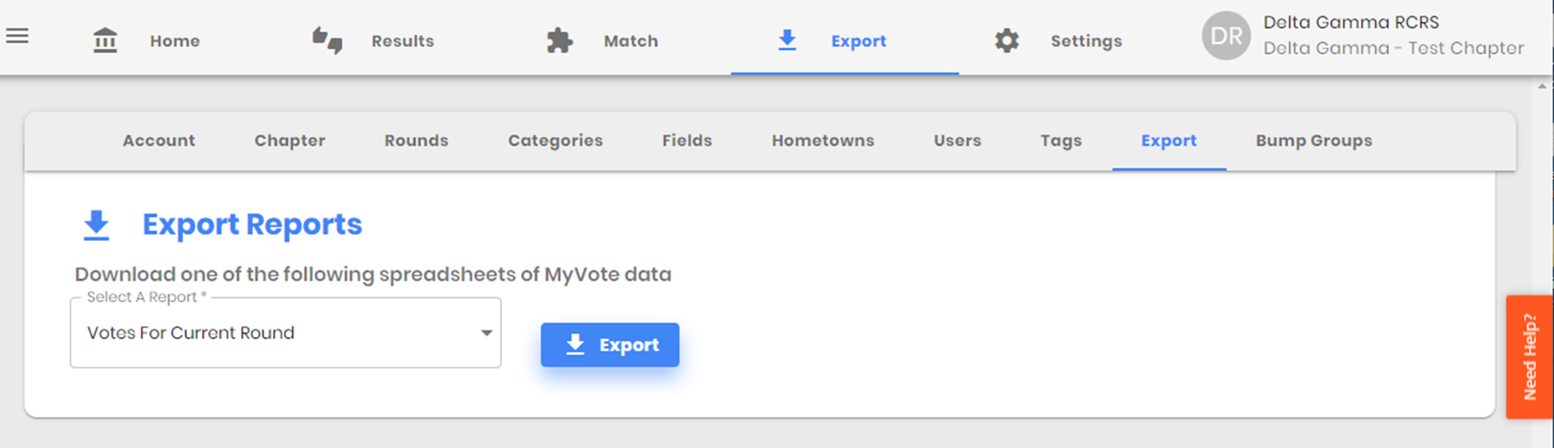
Step 6: Evaluating The Results
You can pull the data from Additional Evaluations by clicking Export>Select A Report>Votes For Current Round>Export
Notes:
Additional Evaluations does not change or influence your overall score. You’ll notice that on your results page, Additional Evaluations won’t change any of the order those PNMs.

Slide 14
What Now?
Depending on how you used Additional Evaluations (PNMs with 0 votes, PNMs with same votes in between the invite line, etc.), you can use your Export list “Votes For Current Round” to discuss with EVC how you want to reorder the PNMs in your Results page.
For example, if you voted and discussed 10 PNMs during Additional Evaluations who all had the same/similar scores, but the invite line was drawn through them, you can look at the 10 PNMs on your Export list and view how the PNMs are now ordered after Additional Evaluations.
Then, you can go back to your Results page and move the 10 PNMs to reflect the new order based off votes and discussion during Additional Evaluations.

