Slide 1


Foundation Education for Recruitment
Let’s Talk Philanthropy!

Slide 2
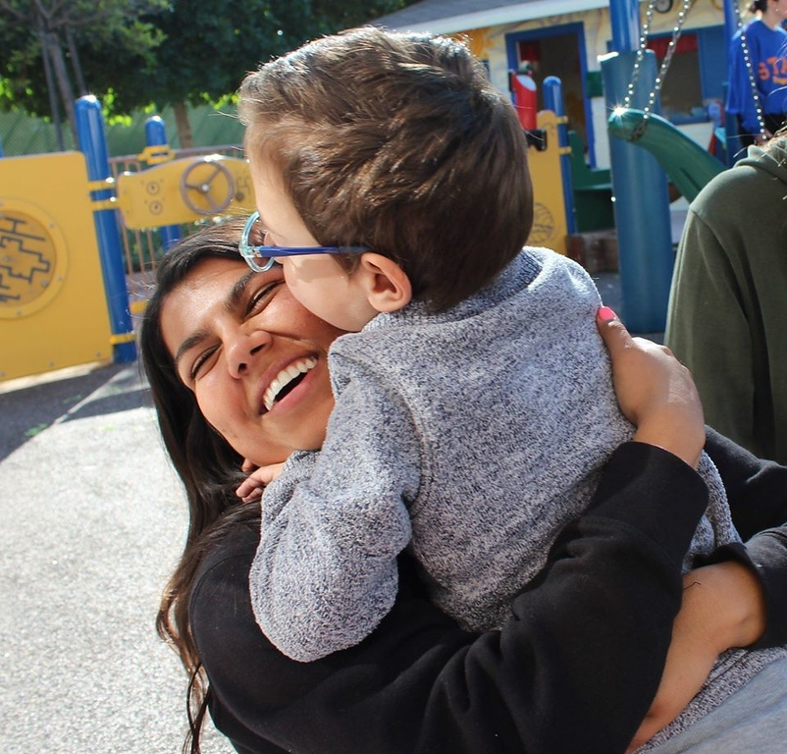

Let’s talk philanthropy…
And why we do good for Delta Gamma’s Service for Sight!
In this workshop, we will:
Discover the Delta Gamma Foundation’s role in facilitating philanthropy
Explore and tell the story of Delta Gamma’s philanthropy
Consider how to talk about how your chapter lives out our do good motto through service and fundraising
Blind Children’s Center, LA
Notes:
For the best experience, view this presentation as a slide show. Go to the “Slide Show” tab in the menu at top, then select “From Beginning”

Slide 3
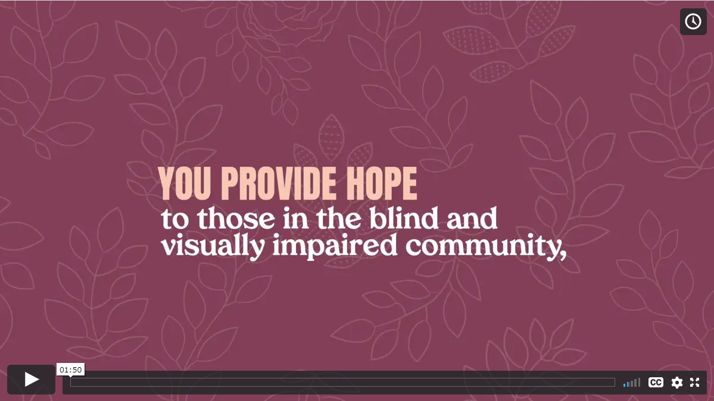
Watch this video to learn more about the Foundation and our philanthropy Service for Sight!
Click on the graphic above to play the video.
Notes:
https://vimeo.com/442084784/10b2e9f871

Slide 4
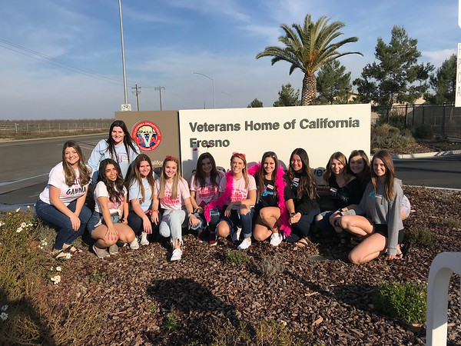
How can you describe the Foundation’s impact in 30 seconds or less?
Work together with a partner to create a pitch about the Delta Gamma Foundation.
How does philanthropy relate to our do good motto?
How does our chapter/Fraternity encourage philanthropy?
How are you personally committed to Service for Sight?
Gamma Lambda-Cal State, Fresno
Notes:
https://vimeo.com/442084784/10b2e9f871
After pairs have had a few moments to work together to create their pitch, return the group to a whole and have a few people share their pitch. Maybe prepare your own pitch ahead of t

Slide 5

Do you know the history
of Service for Sight?
Quiz time!
When did Delta Gamma adopt an official philanthropy, now known as Service for Sight?
1951
1936
1995

Slide 6
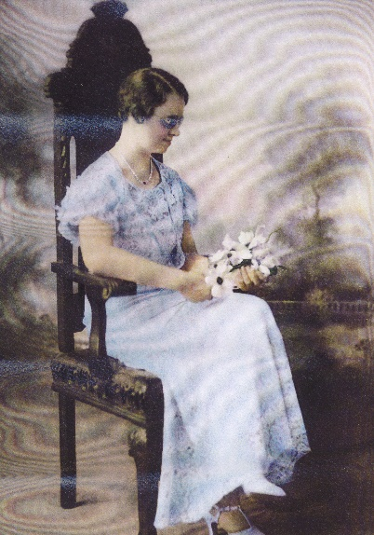
The correct answer is…
B. 1936!
In 1936, Ruth Billow, Eta-Akron asked the Delta Gamma Convention body to adopt “aiding the blind” as Delta Gamma’s official philanthropy and to fund a talking book for the visually impaired. The philanthropy name was changed to "Sight Conservation & Aiding the Blind" in 1942, and in 1995, it became "Service for Sight." Ruth Billow herself was blind and knew first-hand the needs of those in the blind and visually impaired community, particularly children. Since its founding in 1951, the Delta Gamma Foundation has fostered relationships with hundreds of organizations that provide access and advocacy for those in the blind and visually impaired community.
Ruth Billow, Eta-Akron

Slide 7
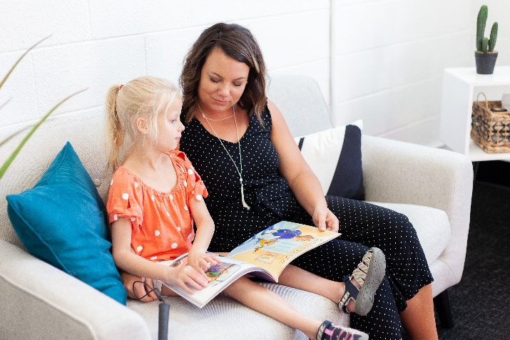
In what ways does Delta Gamma support Service for Sight?
Take a few moments to reflect upon two or three ways that the Foundation supports Service for Sight.
Delta Gamma Schools for Children with Visual Impairments
Service for Sight grants
Do Good: Service for Sight Hours
Fundraising
Addy and her mom reading a book in braille together at the American Printing House for the Blind.

Slide 8
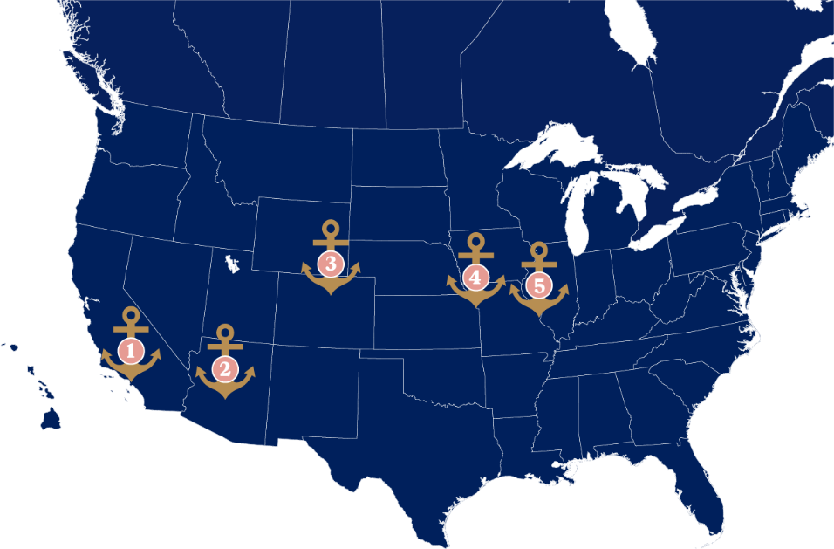
DG Schools for Children with Visual Impairments
Did you know that Delta Gammas founded 5 schools across the U.S. for children with visual impairments?
Click on each school’s name to learn more.
Blind Children's Center, Los Angeles
Foundation for Blind Children, Phoenix
Anchor Center for Blind Children, Denver
Children's Center for the Visually Impaired, Kansas City
Delta Gamma Center for Children with Visual Impairments, St. Louis

Slide 9
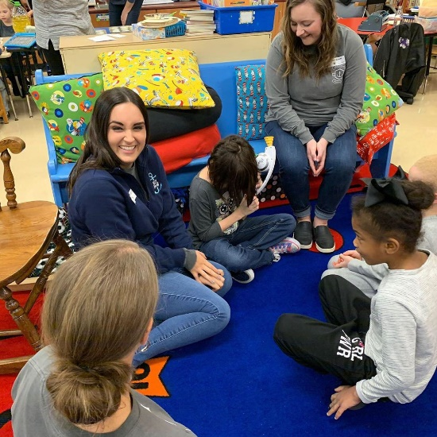
Telling your chapter’s do good story…
Take a few moments to think about the following question and jot down some answers:
What have you experienced in your chapter that you could share to tell your do good story with potential new members?
Executive Offices staff volunteering at Ohio State School for the Blind

Slide 10
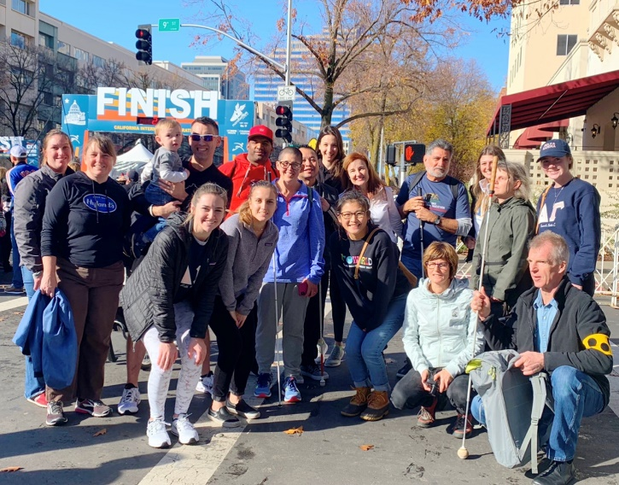
What have you experienced in SFS?
Let’s think about how we share our chapter’s commitment to philanthropy.
What are your favorite service and fundraising activities you’ve done individually or with our chapter?
Why is this work important and why are you interested in working with this organization?
Sacramento, CA area members volunteering at the California International Marathon
Notes:
Facilitator notes: Discuss with the whole chapter what their favorite service/fundraising activities have been.
Talk about who Service for Sight supports, and the why behind it.

Slide 11
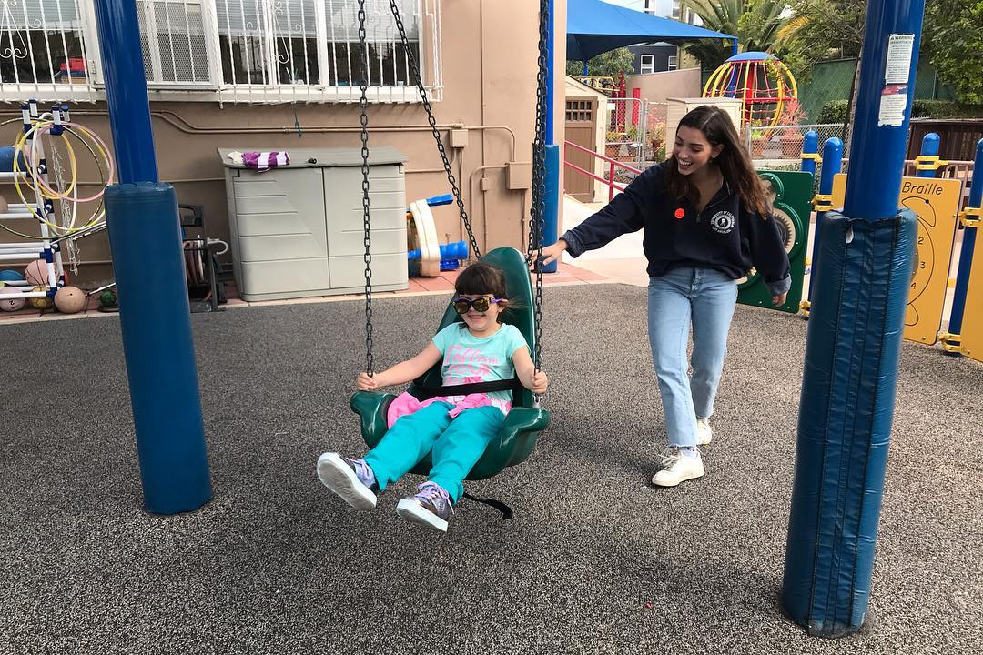
Those are great ways to share the DG philanthropy story…
We can also talk about our Delta Gamma Schools for Children with Visual Impairments during recruitment.
Our Delta Gamma schools are one way that we live out our do good motto and show our commitment to Service for Sight. These schools serve thousands of children and families each year and help children who are blind get all the opportunities and access as their peers who are sighted. The Delta Gamma Foundation is proud to support these schools, and we can support them with our chapter fundraising.
Blind Children’s Center, LA

Slide 12
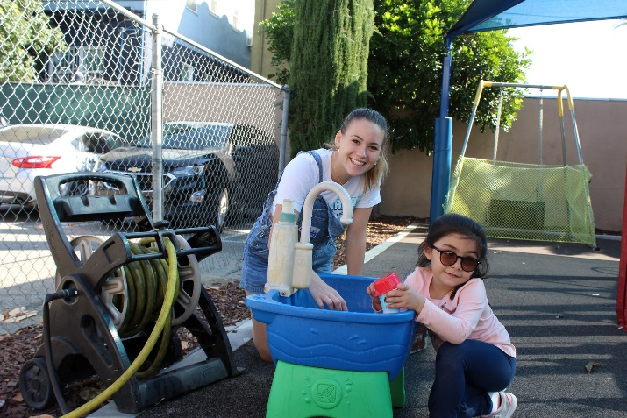
Doing good matters — here are some of the people who benefit from our commitment to philanthropy…
Hope Children.
Blind Children’s Center, LA

Slide 13
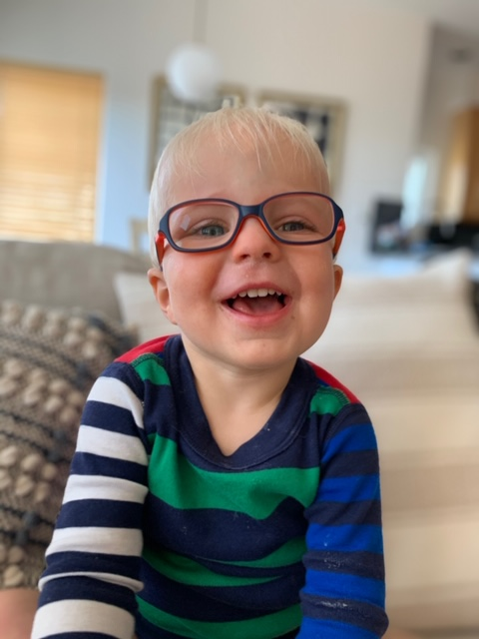
Meet Campbell
A student at the Anchor Center for Blind Children in Denver.
At just 2 and ½ years old, Campbell is fearless and willing to try just about anything, despite vision loss from ocular albinism and nystagmus (pronounced nuh·stag·muhs). When Campbell’s parents received his diagnosis when he was just four months old, they felt such natural emotions: helpless, devastated, angry and shocked. His parent’s worried he wouldn’t be able to do the things other kids could do and would struggle with everything, but Campbell continues to prove his parents wrong and doesn’t let his vision loss stand in his way. His teacher and parents give him tools to become independent and self-sufficient in so many ways. And his joy and love for life is an inspiration to those around him.
Campbell

Slide 14
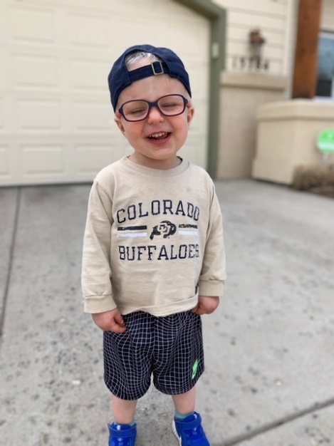
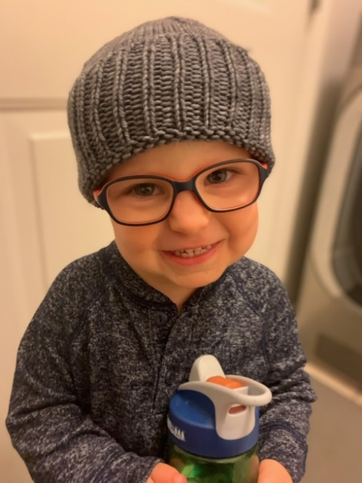
Facts about Campbell
favorite animal: his pet dog Breckenridge
favorite food: oranges and broccoli
favorite activity: singing and dancing
hero: his daddy

Slide 15
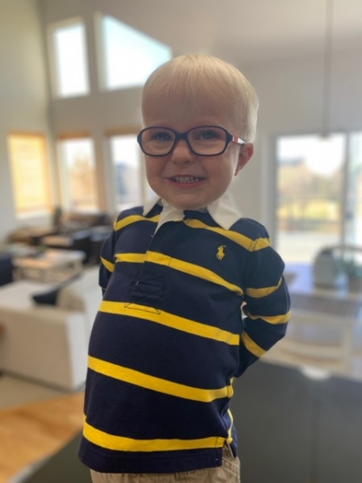
Campbell’s mom says…
When Campbell’s mom was referred to the Center, she learned that the Center was co-founded by the Delta Gamma alumnae chapter of Denver. She was surprised, because she is a DG herself, Gamma Tau-TCU.
Because of the connection to Delta Gamma, I immediately felt connected to Anchor Center and knew we’d be cared for. Right from the start, every teacher, administrator, therapist, volunteer, etc. that we met at Anchor Center was kind, loving, encouraging, empathetic and supportive. We also felt like we gained a TON of perspective while Campbell was a student there. Anchor Center supports and serves children with SUCH a wide variety of visual impairments, and we were overcome with a feeling of peace with the diagnosis our son was given. He was going to be FINE. Better than fine, even. Delta Gamma had a positive impact on my life, and now the Anchor Center has had a tremendous impact on my family. I couldn’t be more grateful!
Campbell

Slide 16
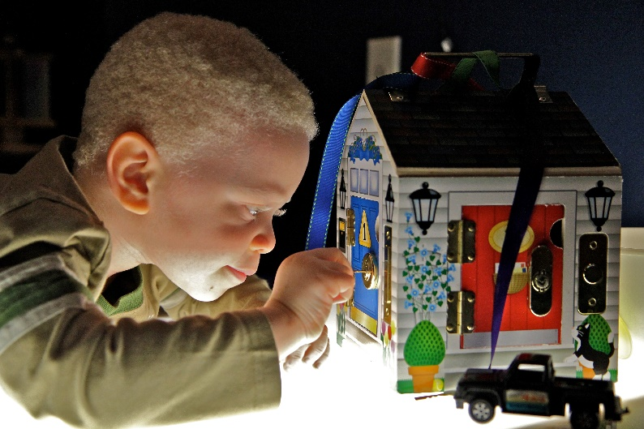
Meet Matthew
A student at the Anchor Center for Blind Children in Denver.
This 4-year-old doesn’t let oculo-cutaneous albinism slow him down! Since starting at the Center, Matthew’s mom says that he has been able to improve his social skills, manage his temper, improve his ability to communicate and advocate for himself, and show his creativity. He has developed his language and math skills and has developed an eagerness for learning. The family has been connected to the Anchor Center since 2012 when Matthew’s brother attended with the same condition. For Matthew’s family, the Anchor Center is vital to improving their children’s development and self-confidence.
Matthew

Slide 17
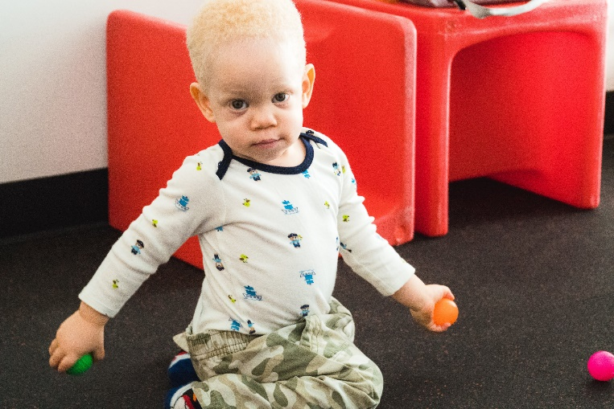
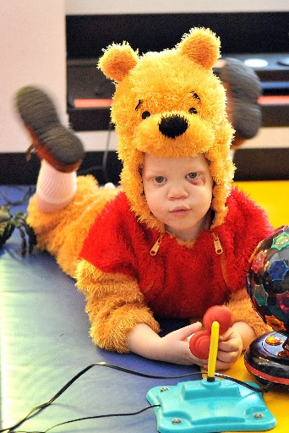
Facts about Matthew
Favorite toy: cars
Favorite food: pizza
Favorite book: Bear and his Cub
hero: his mommy

Slide 18
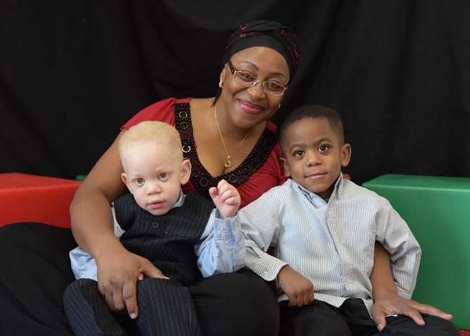
Matthew’s mom says…
We have greatly been blessed by their love, attention and compassionate care. Through the infant and toddler programs, the preschool and the parent’s pull-out, we have learned a lot about our children’s condition and how to deal with it; many of our worries have been relieved. Through the past 8 years, Anchor Center has been part of our family’s routine and because of the strong connection with the teachers, the therapists and administrative staff, we feel like we are part of Anchor Center family.
Matthew with mom and brother

Slide 19
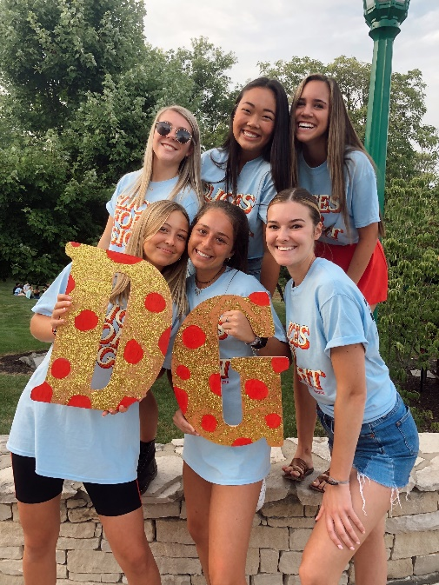
Our chapter story…
What are some new and creative ways that we can share our chapter’s philanthropy story during recruitment, particularly our relationship with (local Service for Sight organization or Hope Child)? Brainstorm some ideas and share with your sisters.
Theta-Indiana
Notes:
If your chapter has a strong service and fundraising relationship with a local Service for Sight organization(s), please think about that relationship when answering the question below. If you prefer, you can also talk about Hope Children and the DG Schools for Children with Visual Impairments.

Slide 20
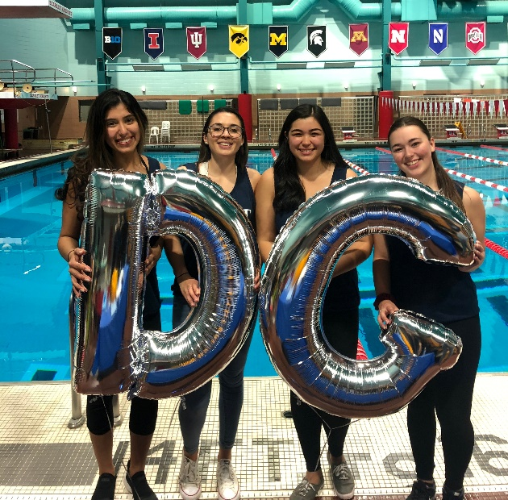
Great ideas!
Here are some others you might be able to include during recruitment:
*Stories, pictures, and quotes from a client of the organization you support
*Invite clients of the organization you support to make short videos about their experience
*Make stickers/buttons with pictures of Hope Children or guide dogs (if you’ve worked with guide dog organizations) that can be worn during recruitment
* Print posters/pictures or share online activities of the organization(s) you support
* Print posters and pictures or share online Delta Gamma schools and Hope Children
* Create audio messages to share with Hope Children at DG schools
Any other ideas that will inspire potential new members!
(asterisk indicates virtual possibilities)
Epsilon Psi-Rutgers

Slide 21
Delta Gamma Foundation Areas of Support
Individual Member Support
Endowments and annual gifts allow the Foundation to award merit-based scholarships and graduate fellowships to members, as well as provide financial assistance through Sisters Helping Sisters: Need- Based Scholarships and to members in financial need through Crisis Grants.
Sisters Helping Sisters: Need-Based Scholarships Delta Gamma need-based scholarships are for collegiate members who have proven financial need.
Merit-Based Scholarships
Merit-based scholarships are awarded on a competitive basis to qualified, initiated members pursuing undergraduate degrees.
Graduate Fellowships
Graduate fellowships are awarded on a competitive basis to qualified, initiated members pursing graduate/professional degrees.
Crisis Grants
Crisis Grants help Delta Gamma members who find themselves in an extreme financial need created by job loss, health crisis, natural disaster or other unexpected circumstances.
Training & Programming
Gifts to Training and Programming provide opportunities for collegians and alumnae to develop their leadership, mentoring and professional skills. These programs also provide assistance and resources as members tackle tough realities of life, like the effects of alcohol use, sexual violence prevention and survivor support, and attention to mental health in a Culture of Care
Social Responsibility
Alcohol Skills Training Program (ASTP)
Diversity, Equity and Inclusion
GreekLifeEDU
Human Dignity
Mock Trial
Sexual Assault Prevention/Survivor Support
Health and Well-Being
Behind Happy Faces
Bronze, Pink and You
Mental Health Initiatives
Leadership
Collegiate Development Consultants
Lewis Institute
Lectureships in Values and Ethics (at pre-established campuses)*
Service for Sight
Our philanthropy, Service for Sight, supports the five Delta Gamma Schools for Children with Visual Impairments as well as other North American organizations that promote sight preservation and conservation. Service for Sight has been at the heart of the Delta Gamma mission since 1936 when a member who was blind, Ruth Billow, Eta-Akron, petitioned to adopt it as our official philanthropy.
Grants
Donors can give to grants in general, or designate specifically to veterans
Schools
Blind Children’s Center, Los Angeles
Foundation for Blind Children, Phoenix
Anchor Center for Blind Children, Denver
Children’s Center for the Visually Impaired, Kansas City
Delta Gamma Center for Children with Visual Impairments, St. Louis
Hope Child
Service
Do Good Hours
Hope Serving

Slide 22
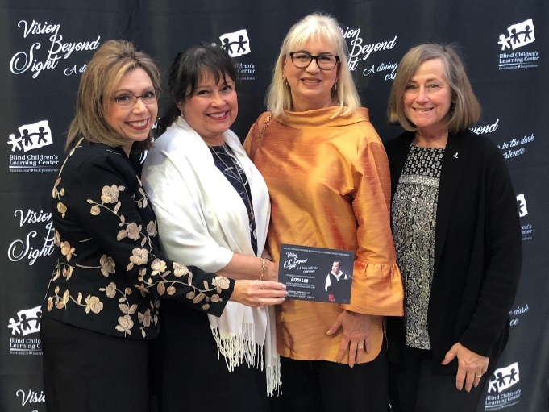
Philanthropy is
at the heart of
Delta Gamma…
and our motto to do good.
The Foundation helps members be their authentic selves, grow and develop, and do good.
Newport South Coast alumnae chapter Foundation fundraiser

Slide 23
Thank you for participating today!
We hope you have had a chance to reflect on your own do good story, to think about ways that we can share that story with others, and learn more about how the Foundation supports us as members.
After this workshop, you should be able to describe, in two minutes or less, what Service for Sight is, why you are committed to it, and what the role of philanthropy is in DG for doing good for others and for members.

